Slide 1
Mental Health in Washington Schools
Joe Hofman and Autymn Wilde

Slide 2
Student Update: Joe
Placed 3rd at State for diving
Presented at the Governor's mansion
MLK Assembly and Culture Night
Committed to dive at one of my dream schools - Georgetown University

Slide 3
Student Update: Autymn
Spoke to the Chase Youth Commission
Nominated for a Chase Youth Award
Asked to run for ASB Office
Variety Show - Lungs are good!

Slide 4
Why focus on Mental Health?

Slide 5
Why Focus on Mental Health?
Mental health education is just as important, if not more important, as the other required academic requirements students are expected to meet.
Not enough resources for students and districts to access
Students are expected to meet the highest requirements than ever before.
We have heard enough about the mental health problem in past presentations, now it is time to take action.

Slide 6
Relevance
Mental health affects school attendance, school performance, and student well-being.
It affects how a student lives their life.

Slide 7
Mental Health Supports in Washington
Mental Health requirements are outlined in the Washington State Health Education K-12 Learning Standards. Most notably, students should be able learn about:
Self-Esteem
Body Image and Eating Disorders
Stress Management
Expressing Emotions
Harassment, Intimidation, and Bullying
Emotional, Mental, and Behavioral Health

Slide 8
Mental Health Supports in WA Cont.
Within these standards, students should:
Identify school and community resources that can help a person with emotional and mental and behavioral health concerns.
Describe laws related to minors accessing mental health care.
Compare and contrast emotional and mental and behavioral illness, mental well-being, and concurrent disorders.
Explain how to help someone who is thinking about attempting suicide.

Slide 9
Problem: There is a mental health emergency among students in Washington State and there is not enough support to remedy the problems.

Slide 10
Student Well-Being

Slide 11
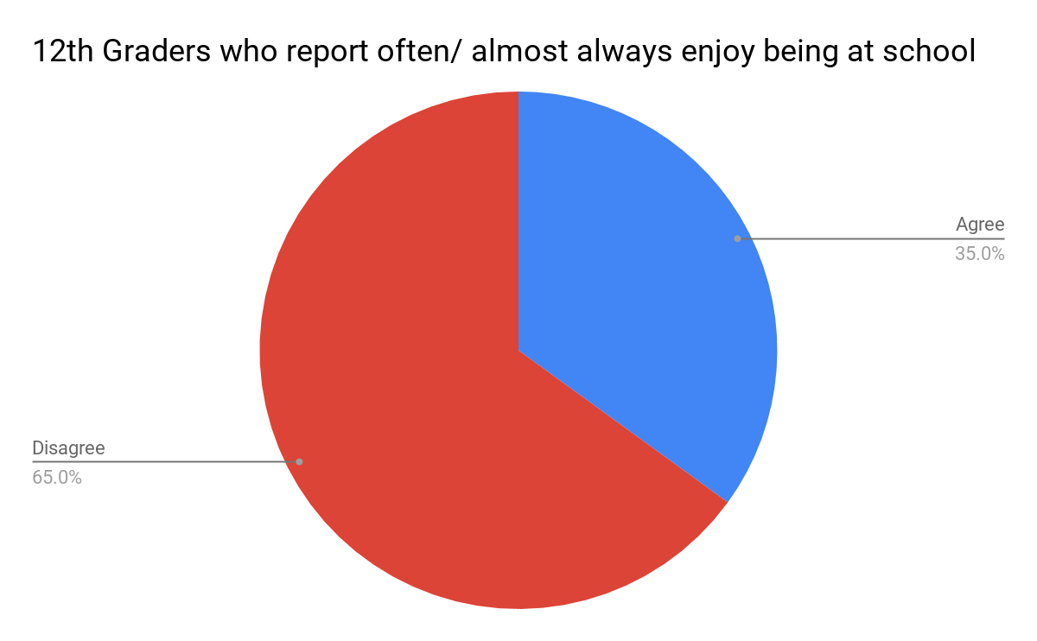
How do our students feel about being at school?
Notes:
Data from Healthy Youth Survey 2017

Slide 12
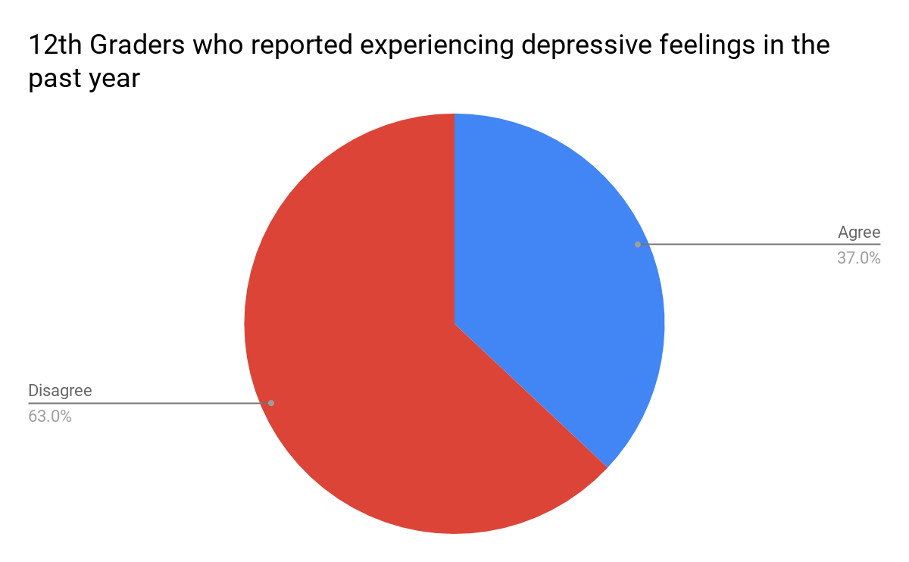
How many of our students experience depressive feelings?

Slide 13
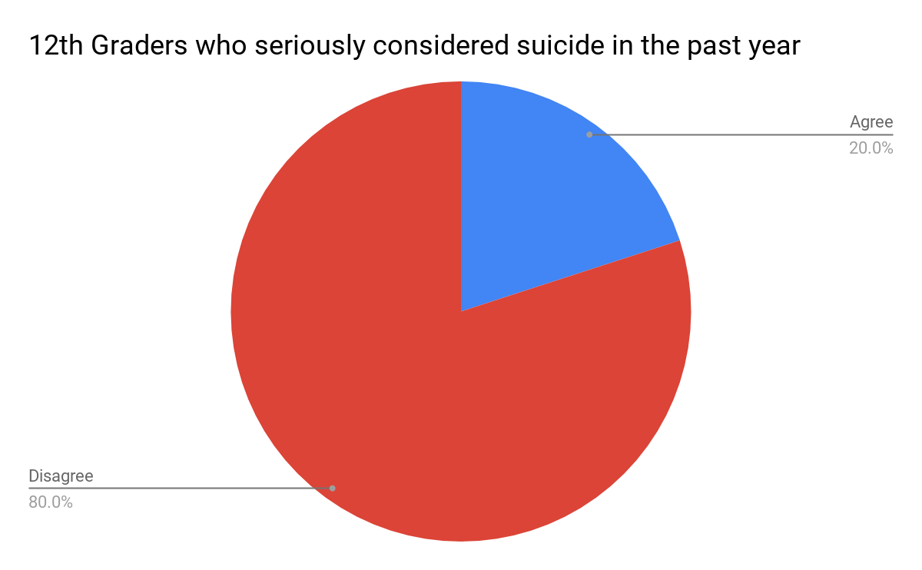
How many of our students consider suicide?

Slide 14
School attendance

Slide 15
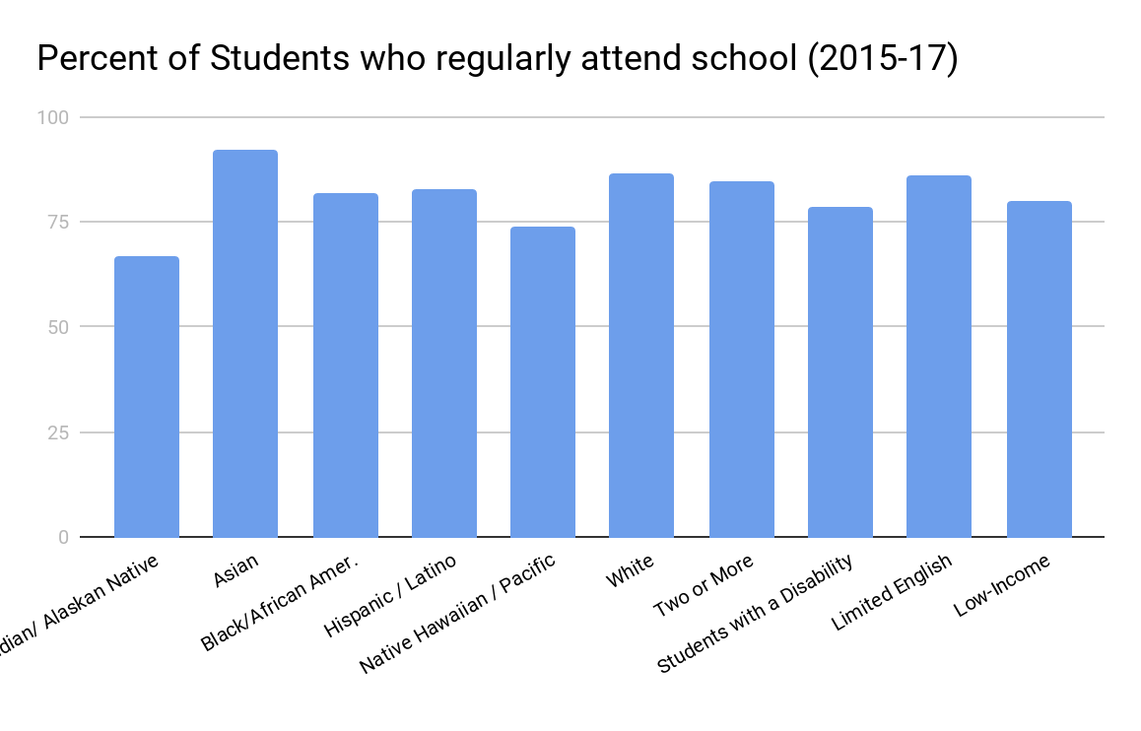
Percent of Students who Regularly attend School (2015-17)
Notes:
Source: WaSIF
Notice that the four lowest attending student groups are also the some of the most disenfranchised.

Slide 16
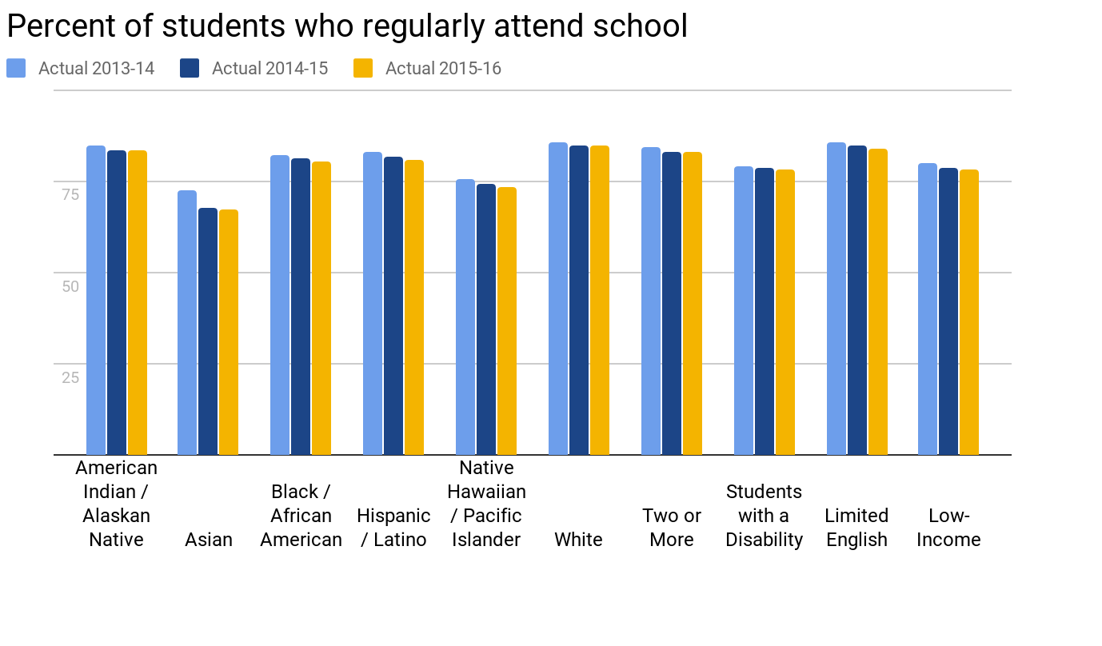
Percent of Students who Regularly Attend School
Notes:
In every student group, the percent of attendance decreased
*Have to figure out problems with the legend*

Slide 17
Counselor Relationships
Access to resources is scarce for students in Washington
Students need access to trained professionals
Students in rural districts are more at risk

Slide 18
The ratio between students and certified counselors is 402.8 students per certified counselor
Notes:
Even if a student is in an environment where they have access to mental health resources, the resources are often not being used or are not effective.

Slide 19
Our schools are contributing to this problem.
Notes:
As we continue to raise the standards, we don’t increase our supports for our students to meet them.

Slide 20
What are Districts doing?
Healthy Youth Survey
Panorama Survey - used by Seattle public Schools
Many districts have defined their own mental health initiatives, but there is no defined way to go about this.
Notes:
Here, share personal experiences relating to what our schools do for mental health.

Slide 21
What is being proposed?
In the Governor’s 2019-21 Budget Proposal, he supports:
$7.5 million for a regional support structure for districts to offer a coordinated approach to prevention, early identification and intervention for student behavioral health and safety needs.
$155 million for districts in which more than half of students are eligible for free and reduced price meals to increase staffing levels — as called for under Initiative 1351 — for nurses, social workers, psychologists and guidance counselors in elementary and middle schools.

Slide 22
This is an EQUITY issue that needs to be solved. It is time to think outside the box and utilize our resources.

Slide 23
Our Goals
Provide stakeholders and districts with many options to implement a mental health movement/campaign in their environments.
Make mental health education resources more prevalent.
Challenge the Board to make it a “Board Mission” not just a student presentation.

Slide 24
What are we going to do?
Resolution
Waiver
Student activism

Slide 25
Resolution Highlights

Slide 26
Public Resource List
“THEREFORE, BE IT RESOLVED that the State Board of Education will work alongside the Association of Washington Student Leaders to establish and publicize a list of references, ideas, guidelines, and rules that schools can access when creating their Mental Health Campaigns.”
It is vital that there is a diverse amount of solutions to combat this vast problem.
Accessible by all schools creates a commonality support system.
Rules creates a foundational piece in all campaigns.

Slide 27
District Flexibility
“THEREFORE, BE IT RESOLVED that the State Board of Education will ensure the awareness of school districts’ flexibility in scheduling mental health assemblies and other activities to implement health learning standards.”
Less backlash from administrators if approved by the state.
Allow for the needed time to create an impact, especially in larger schools.

Slide 28
Updated Curriculum
“THEREFORE, BE IT RESOLVED that the student members of the State Board of Education will examine the need for revisions to mental health learning standards and propose new curriculum standards that better inform and fit the mental health needs of students today.”
The learning standards were revised in 2016.
Greatly misunderstood and undiscussed by youth today.
No permanent change unless we start educating our students on their own well being.

Slide 29
District Training
THEREFORE, BE IT RESOLVED that the State Board of Education encourages districts to develop a staff training seminar to highlight the mental health and support needs of students.
Nurses, teachers, and administrators face the task of supporting student well being on a daily basis.
Nurses, teachers, and administrators are unprepared and under trained to support the well being of students on a daily basis.

Slide 30
Mental Health Professionals
“THEREFORE, BE IT FURTHER RESOLVED that the State Board of Education will actively advocate for funding Mental Health Professionals with the goal of having at least one Mental Health Professional accessible to every student and or school.”
Resolution is a step in the right direction, and we must hold ourselves to continuingly moving forward.
Any solution will come with a price tag, but one student life is priceless in comparison.
Vital support for student mental health campaigns and school community.
Permanent solution of preventing student suicide and treating mental health issues.

Slide 31
Spreading Awareness
“THEREFORE, BE IT FINALLY RESOLVED that the State Board of Education will actively promote awareness of this resolution to partner organizations to further mental health supports for students and staff in the K-12 education system.”
News will only spread if the majority of board members actively support.
Phenomenal impact if other organizations assist in spreading awareness.
Districts will be greater influenced by personal and public outreach and awareness.

Slide 32
THANK YOU

