Slide 1
School Recognition – Phase II
Washington State Board of Education
September 12, 2019

Slide 2
Phase I Metrics

Slide 3
Statutory Direction: 28A.657.110
(3) The state board of education, in cooperation with the office of the superintendent of public instruction, shall annually recognize schools for exemplary performance as measured on the Washington achievement index. The state board of education shall have ongoing collaboration with the educational opportunity gap oversight and accountability committee regarding the measures used to measure the closing of the achievement gaps and the recognition provided to the school districts for closing the achievement gaps.

Slide 4
Rationale for Redesigning the School Recognition System Spring 2017 Washington Achievement Awards
Approximately one-third of the school awards went to a handful of districts, which were mostly low poverty.
One-third of awarded schools (93 of 281 schools) were from five school districts in the central Puget Sound area.
The 93 schools from the five school districts had an average FRL rate of 11.8%.
The rationale to redesign the system was driven in part by the changes brought about by the shift to the Every Student Succeeds Act (ESSA) accountability system and by the desire of the organizations to make the school recognition system more equitable.

Slide 5
Phase I Combined Quantitative Model Schools Can Demonstrate Being Exemplary in Many Ways

Slide 6
Phase I Combined Quantitative Model

Slide 7
Phase I School Recognition - Closing Gaps Route Schools Identified for Support Closed Gaps for Certain Student Groups

Slide 8
Phase I School Recognition - Growth Route Schools Demonstrating the Greatest Growth on the most Reportable Measures

Slide 9
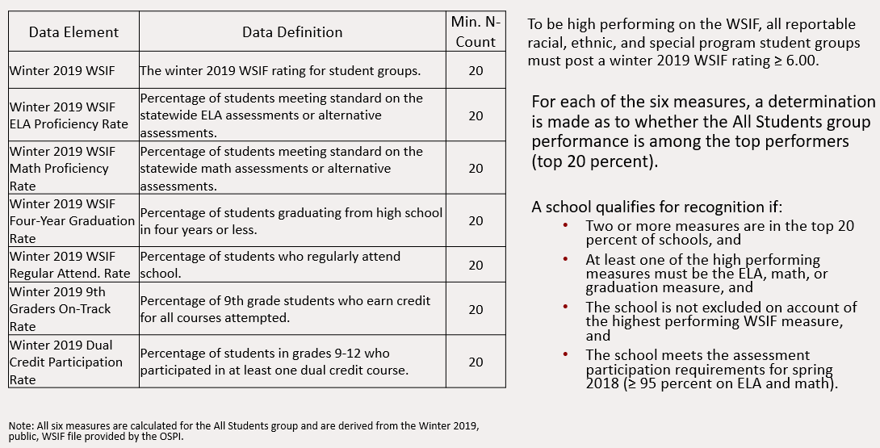
Phase I School Recognition - Achievement Route Schools Demonstrating the Highest Performance on Multiple Measures

Slide 10
Phase I Results

Slide 11
216 Schools Earned Recognition
 | Closing Gaps | Closing Gaps and Growth | Growth | Growth and Achievement | Achievement | Total
Tier 3: Comprehensive | 24 | 1 | 4 |  |  | 28
Tier 2: Targeted 3+ Groups or Low EL Progress | 13 |  | 2 |  |  | 15
Tier 1: Targeted 1-2 Groups | 71 | 7 | 3 |  |  | 74
Foundational |  |  | 30 | 1 | 68 | 99
Total | 99 | 8 | 39 | 1 | 68 | 216

Slide 12
Recognition – Achievement Route
We see evidence of performance differences based on school level. The meaningfulness of school recognition may be enhanced if Phase II were to be revised in a manner to consider school level as a distinguishing factor. In other words, compare a high school’s performance to other high schools, an elementary school’s performance to other elementary schools, and so on.
 | ELA Prof. | Math Prof. | 4-Year Grad. | Reg. Attend. | 9th Grade On Track | Dual Credit Part. | Total
Elementary Schools | 40 | 42 |  | 38 |  |  | 42
Middle Schools | 5 | 5 |  | 4 |  |  | 5
Combined Schools | 2 | 2 |  | 1 |  |  | 2
High Schools | 11 | 1 | 9 |  | 5 | 4 | 11
Combined High Schools | 4 | 2 | 7 | 5 | 8 | 1 | 9
Total | 62 | 52 | 16 | 48 | 13 | 5 | 69

Slide 13
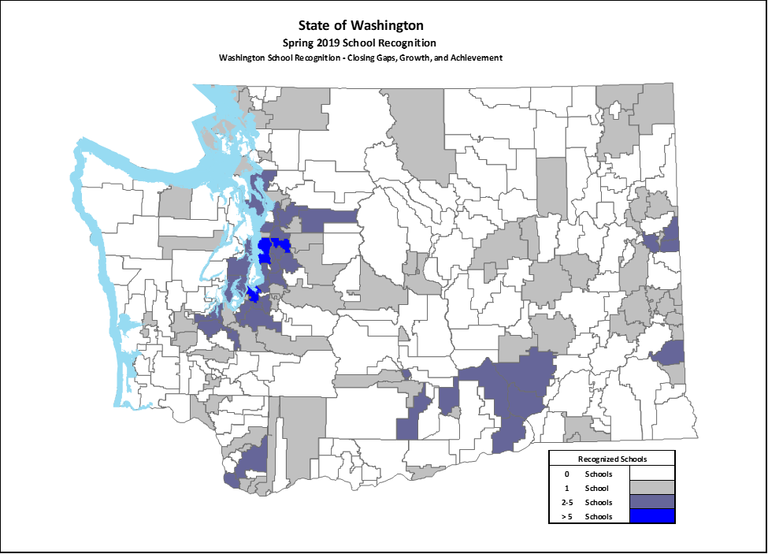
Spring 2019 Recognized Schools
216 schools were recognized
Average FRL rate is 40.1 percent, just a little lower than the state average of 46.0 percent.
Approximately 54 percent of the recognized schools (117/216) were identified for Tier 1-3 supports in the winter 2018 WSIF.
The demography of the recognized schools is similar in many respects to the demography of schools not identified.

Slide 14
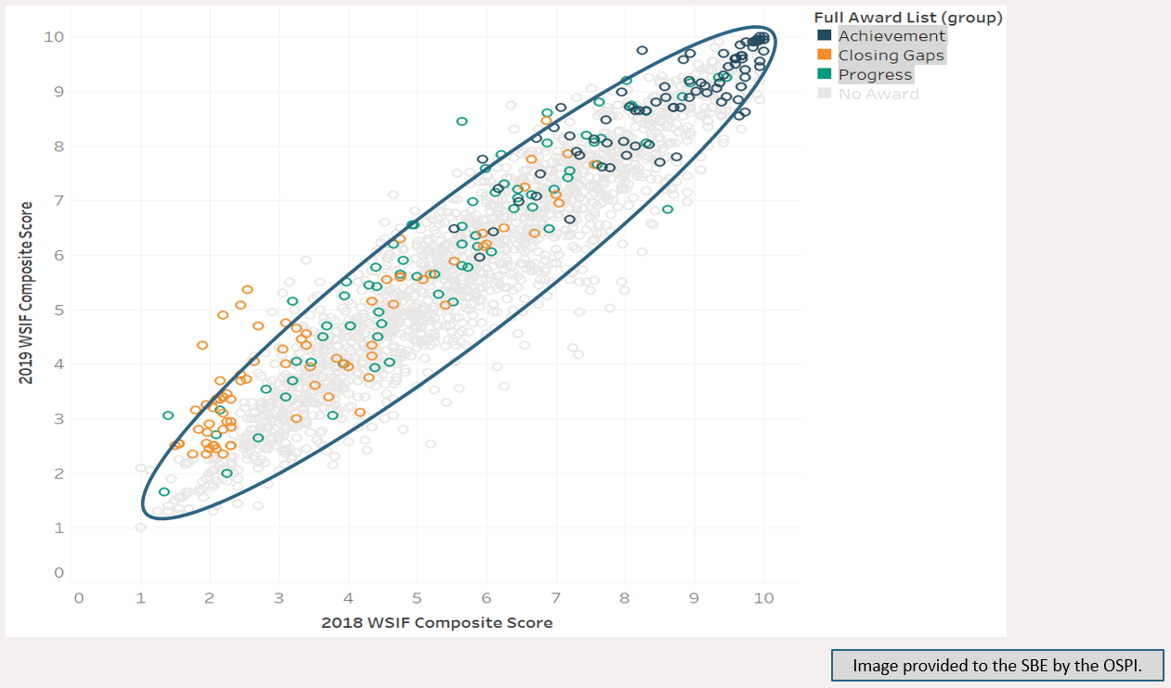
Recognized Schools – Performance Along a Continuum

Slide 15
Disproportionately Low Rate of Recognition? High Schools
 | Recognized Schools when the ESSA Participation Requirement is Applied | Identified Schools when the ESSA Participation Requirement is Not Applied | All Schools - Percentage by School Level in Washington
Elementary Schools | 137 (63.4%) | 139 (58.9%) | 53.1 %
Middle Schools | 34 (15.7%) | 34 (14.4%) | 18.1 %
Combined Schools | 6 (2.8%) | 6 (2.5%) | 4.0 %
High Schools | 22 (10.2%) | 33 (14.0%) | 17.3 %
Combined High Schools | 17 (7.9%) | 24 (10.2%) | 7.5 %
Total | 216 | 236 | 1960*
Had the ESSA participation requirement not been in place, 57 high schools (24.2 percent of the total) would have been recognized, which is reflective of the statewide totals.
*Note: the total of 1960 schools represents those schools with a winter 209 WSIF rating. Approximately 500 additional schools without a WSIF rating are not included here.

Slide 16
Recognition - Achievement Route
 | Average Number of Reportable Groups in the Winter 2019 WSIF | Average Number of Reportable Groups for Schools through the Achievement Route
Elementary Schools | 5.9 | 5.1
Middle Schools | 7.1 | 4.6
Combined Schools | 4.5 | 2.0
High Schools | 5.0 | 2.6
Combined High Schools | 2.4 | 2.2
Total | 5.6 | 4.2
It is evident that elementary and middle schools meet the Phase I recognition requirements for the Achievement route even when larger numbers of reportable student groups are present, while high schools and combined with more reportable groups (typically larger schools) are less likely to meet the recognition requirements.

Slide 17
Phase II Considerations and Discussion

Slide 18
Questions to Consider
Are we measuring the “right” things in the “right” manner?
Does the methodology adequately assess the performance of student groups as well as the All Students group?
Would the framework benefit from better differentiation of schools by school enrollment, school level, school location, and or school type?
Would the framework be improved through better recognition of school differences by race, ethnicity, income, or other student characteristics?

Slide 19
SBE-EOGOAC-OSPI Joint Workgroup Meeting (July 30) Information on Additional Metrics
The workgroup discussed the suitability of other metrics in the school recognition system
School climate and student engagement data
School discipline data
Equitable student access to educators
The workgroup discussed the possible manners in which to include other metrics in the school recognition system
Qualitative vs. quantitative data elements
Use as an excluder or a measure of high performance or closing gaps

Slide 20
Should the Recognition System Differentiate Performance Thresholds by School Level, Type, or other School Characteristics?
Phase I explored various manners in which to differentiate schools
School level
Elementary (K-5), middle (6-8), combined (K-8), HS (9-12), and combined HS (K-12)
Five school types
School location
Regional by ESD, setting (urban, suburban, rural, etc.)
Four school types
School enrollment (# of assessment records)
small < 70, medium 70-334, and large >335
Combinations of the discriminators
School level by setting
Five by four matrix yielding 20 distinct school types (e.g. rural high schools)
The decision was made to not differentiate schools in Phase I and to reconsider the issue more closely in Phase II after considering feedback from districts, schools, and other stakeholders.

Slide 21
Phase I Recognized Schools by ESD
The Phase I methodology identified schools across the state at a rate that approximated the distribution of all schools across the state.
For example, approximately seven percent of the recognized schools were in the ESD 105 region, and approximately eight percent of all schools in the state are in the ESD 105 region.
 | ESD 101 Spokane | ESD 105 Yakima | ESD 112 Vancouver | ESD 113 Tumwater | ESD 114 Bremerton | ESD 121 Renton | ESD 123 Pasco | ESD 171 Wenatchee | ESD 189 Anacortes
Number of Schools Recognized | 32 | 15 | 15 | 15 | 4 | 86 | 14 | 5 | 32
Percent of Recognized Schools by ESD | 14.8 | 6.9 | 6.9 | 6.9 | 1.9 | 39.8 | 6.5 | 2.3 | 14.8
Percent of Total Schools by ESD | 11.2 | 5.5 | 8.4 | 7.7 | 4.6 | 31.1 | 5.8 | 5.4 | 14.2
The percentages of recognized schools for all ESDs appeared reasonable, so school discrimination by region was not deemed necessary.

Slide 22
Phase I Recognized Schools by School Size
The Phase I methodology identified schools from very small to large.
For example, approximately 19 percent of the recognized schools were categorized as large, and approximately 23 percent of all schools in the state are categorized as large.
School Size* | Recognized | Not Recognized | Washington Total
Small School (< 75 records) | 41 (19%) | 504 (25%) | 545 (24%)
Medium School (75 to 334 records) | 133 (62%) | 1048 (52%) | 1181 (52%)
Large School (≥ 335 records) | 42 (19%) | 488 (24%) | 530 (23%)
The percentages of recognized schools by school size approximated the state distribution, so school differentiation by school size was not deemed necessary.
*Note: the school size uses the number of ELA assessment records from 2018 as a proxy measure for the 2018 school enrollment.

Slide 23
Should the School Recognition System Expand the Explicit Consideration of Race, Income, or Special Populations when Evaluating Growth?
The Closing Gaps route explicitly requires at least one student group corresponding to the support tier identification to demonstrate substantial improvement.
Identify student groups (based on race/ethnicity) at a school that met the group’s ESSA annual step increases in ELA, math, graduation rate.
Identify student groups (based on FRL, EL, and SWD status) at a school that met the group’s ESSA annual step increases in ELA, math, graduation rate.
An expansion such as this would have the expected results of:
Explicitly connecting school recognition to the ESSA plan and improvement goals specified in RCW 28A.305.130 (4)(a).
Providing information to other schools or districts that could be applied locally to bolster the outcomes of similar students. (e.g. the XXX student group at this school improved greatly, what did this school do to get the results and how can I apply these practices to my school to achieve similar results for my XXX students?)

Slide 24
Phase I Combined Quantitative Model Schools Can Demonstrate Being Exemplary in Several Ways

Slide 25
Example: Suggested Phase II Combined Quantitative Model Schools Can Demonstrate Being Exemplary in More Ways

Slide 26
Student Groups Making Annual Step Increases Toward Meeting Long-Term Goals

Slide 27
Phase II General Work Plan and Timeline
September | October | November | December | January | Feb | March | March - April
SBE meeting and discussion | Joint EOGOAC, SBE, OSPI meeting | SBE meeting and discussion | Joint EOGOAC, SBE, OSPI meeting | SBE meeting |  | SBE Task | SBE Task
EOGOAC meeting |  | EOGOAC meeting |  | EOGOAC meeting
Review work plan and discuss metrics | Review current and additional metrics & get LEA feedback |  | Agree on final Phase II methodology | Final approval of Phase II metrics and methodology |  | Identify and notify schools after WSIF public release | Recognition event(s)

Slide 28
Contact Information
Website: www.SBE.wa.gov
Facebook: www.facebook.com/washingtonSBE
Twitter: @wa_SBE
Email: sbe@k12.wa.us
Phone: 360-725-6025
Web updates: bit.ly/SBEupdates

