Slide 1
SBE Achievement & Accountability Workgroup Dual Credit Options in WA
June 20, 2014

Slide 2
RCW 28A.600.280 Dual credit programs — Annual report
Findings -- Intent -- 2009 c 450: "(1) The legislature finds that the economy of the state of Washington requires a well-prepared workforce. To meet the need, more Washington students need to be prepared for postsecondary education and training. Further, the personal enrichment and success of Washington citizens increasingly relies on their ability to use the state's postsecondary education and training system. To accomplish those ends, the legislature desires to increase the number of students who begin earning college credits while still in high school. (2) The legislature further finds that dual credit programs introduce students to college-level work, provide a jump start on getting a college degree, and, perhaps most importantly, show students that they can succeed in college. Dual credit programs also provide another avenue of student financial aid, since many programs are offered for little or no cost to students. (3) The legislature also finds that students must be provided a choice when selecting a dual credit program that is right for them. Options should be available for the student who wants to learn on a college campus and the student who wants to stay at the high school and take college-level courses. Options must also be available for the hands-on learner who seeks to complete an apprenticeship program. (4) The legislature intends to blur the line between high school and college by articulating a vision to dramatically increase participation in dual credit programs. It is for this reason that the legislature should call on all education stakeholders to come together to coordinate resources, track outcomes, and improve program availability. (5) The legislature further intends to provide high schools, colleges, and universities with a set of tools for growing and coordinating dual credit programs. Institutions should be given some flexibility in determining the best methods to secure long-term, ample financial support for these programs, while students should be given some help in offsetting instructional costs." [2009 c 450 § 1.]

Slide 3
Dual Credit Program Benefits
Provide a head start on postsecondary education and training
Save state taxpayers and the families of students millions of dollars of postsecondary education costs
$42.2 million - Taxpayers
$45 – Families
SBCTC estimates for Running Start
Notes:
With 12,717 FTES enrollments in 2011-12, Running Start resulted in a savings of about $45.0 million for parents and students and about $42.2 million for taxpayers. The savings represent the tuition and state support costs of 12,717 FTES students attending a higher education institution for one year.

Slide 4
Dual Credit Opportunities in Washington
Advanced Placement | International Baccalaureate
Cambridge International | Running Start
College in the High School | Tech Prep
Gateway to College

Slide 5
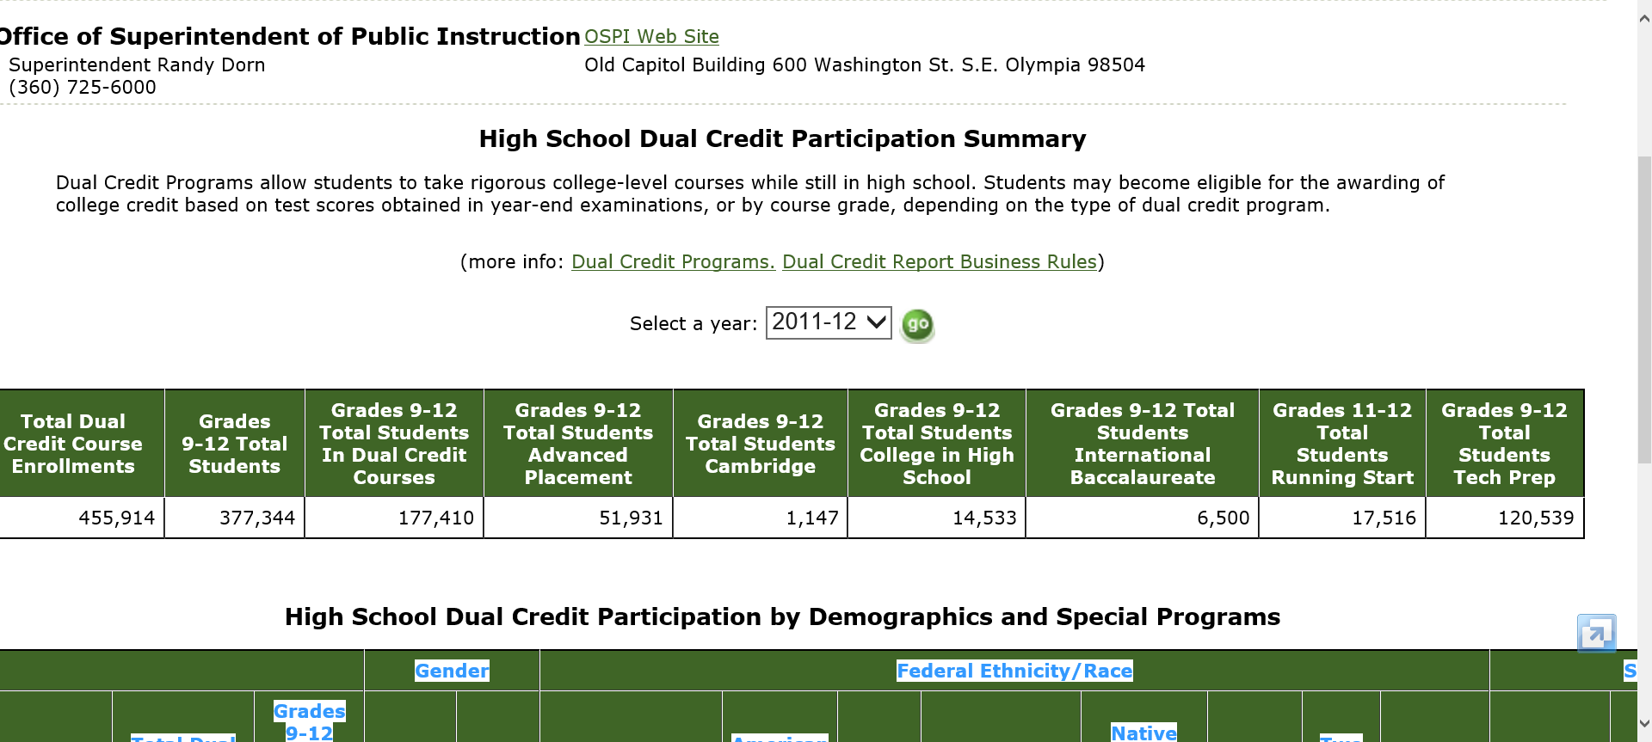
Washington State School Report Cards

Slide 6
Dual Credit Participation Student Demographics
Student enrollment | 2011 | 2013 | % change
11th & 12th grade enrollments | 194,243 | 191,728 | -1.3
9th through 12th grade enrollments | 329,771 | 373,960 | +13.4
Average # of dual credit courses per year | 2.57 | 2.75 | +7

Slide 7
Dual Credit Participation Student Demographics (con’t.)
Student enrollment by ethnicity | 2011 | 2013 | % change
American Indian/Alaska Native | 2078 | 2065 | -.6
Asian | 13,502 | 15,115 | +11.9
Black / African American | 7424 | 8358 | +12.6
Hispanic / Latino | 25,335 | 26,392 | +4.2
White | 108,487 | 111,155 | +2.5
Native Hawaiian/Pacific Islander | 1343 | 1481 | +10.3
Two or more races | 7791 | 9615 | +23.4
Ethnicity not Provided | 11 | 2 | -81.8

Slide 8
Dual Credit Participation Student Demographics (con’t.)
Student enrollment | 2011 | 2013 | % change
Female | 82,389 | 86,804 | +5.4
Male | 83,582 | 87,379 | +4.5
Special Education | 12,355 | 12,039 | -2.6
Bilingual programs | 5379 | 4625 | -14
Gifted programs | 6198 | 14,819 | +139.1
Free/Reduced Lunch Eligible | 60,152 | 66,462 | +10.5

Slide 9
RCW 28A.320.195 & 196 (2SHB 1642) High School Academic Acceleration / Dual Credit Programs
(2) However, the legislature further finds that more can be done to promote academic acceleration for all students and eliminate barriers, real or perceived, that may prevent students from enrolling in rigorous advanced courses, including dual credit courses

Slide 10
2SHB 1642 Components #1: Academic Acceleration School Board policy adoption encouraged
Automatic enrollment in next most rigorous level of advance courses offered
Subject matter of the advanced courses depends on statewide assessment results
District must notify students/parents of the policy and advanced courses available
Opt out provisions for parent

Slide 11
2SHB 1642 Components #2: Competitive Grants
Purpose: To support teacher training, curriculum, technology, examination fees, and other costs associated with offering dual credit courses to high school students.
iGrants Package 661 Dual Credit Capacity Expansion Competitive Grants

Slide 12
Competitive Grant Requirements
Must have an Academic Acceleration board policy that address the 4 elements
Automatic enrollment in next most rigorous level of advance courses offered,
Subject matter of the advanced courses depends on statewide assessment results
District must notify students/parents of the policy and advanced courses available
Opt out provisions for parent

Slide 13
2SHB 1642 Components #3: Incentive awards for earned dual credit
School districts to receive an incentive award for each student (unduplicated) who earned dual high school and college credit for courses offered by the district's high schools during the previous school year.
The funds are to go back to the high schools that generated them
FRL students count for 125% of base award

Slide 14
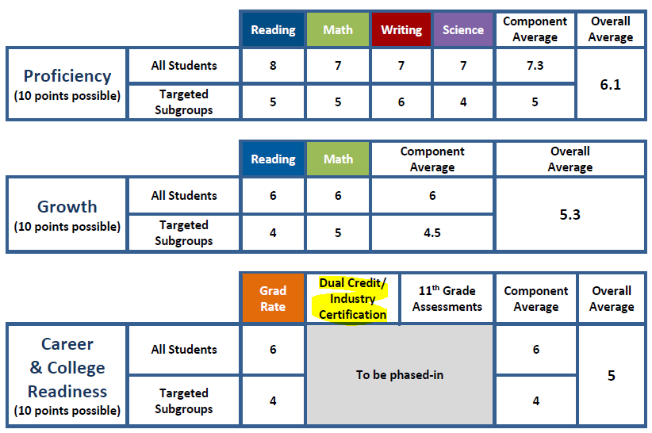
Career and College Readiness
✓

Slide 15
College and Career Readiness in the Achievement Index
Dual Credit … How to measure it?
Percent of students enrolled in D/C
Percent of students earning credit in D/C course
Number of students reaching a threshold (e.g., score a 3 on an AP exam)
Should individual student count more than once?
Denominator: all students in the school or students in 11th and 12th grades?

Slide 16
Dual Credit Data by Area
 | Grades 9-12 Total Students Advanced Placement | Grades 9-12 Total Students Cambridge | Grades 9-12 Total Students College in High School | Grades 9-12 Total Students International Baccalaureate | Grades 11-12 Total Students Running Start | Grades 9-12 Total Students Tech Prep
Students Enrolled in D/C (Report Card) | 52,217 | 1,318 | 18,118 | 7,696 | 17,704 | 119,930
Percent of 9-12 Graders Enrolled | 13.2% | 0.3% | 4.6% | 1.9% | 4.5% | 30.3%
Students “Earning” Credit (incentive award definitions) | 23,675 | 181 | 1,378 | 1,914 | x | 21,053
Percent of 9-12 Graders “Earning” | 6.0% | 0.0% | 0.3% | 0.5% | x | 5.3%

Slide 17
Dual Credit Reporting
 | OSPI Report Card (participation) | Academic Acceleration incentive award | RW28A.300.560 Posting to OSPI Report Card
Advanced Placement | ✓ | Score 3+ on AP exam | Score 3+ on AP exam
International Baccalaureate | ✓ | Score 4+ on IB exam | Score 4+ on IB exam
Cambridge | ✓ | Pass Cambridge exam | Pass Cambridge exam
College in the HS | ✓ | Complete CIHS course AND awarded credit by partner institution | Complete CIHS course AND awarded credit by partner institution
Tech Prep | ✓ | Earn college credit through TP course | Earn college credit through TP course
Running Start | ✓ | x | Awarded credit from post-secondary institution

Slide 18
Industry Certification in CEDARS
H21: Did student receive a state or nationally recognized industry certification?
Indicates whether, as a result of taking the CTE course identified in Element H17, Classification of Instruction Program (CIP) Code Number, the student received a state or nationally recognized industry certification or successfully passed a certification exam as part of a state or nationally recognized industry certification program during the reporting period. Industry certification is based on the student’s ability to demonstrate skills and knowledge to industry standards. Some industry certifications may be earned in fewer than 360 hours of instruction. Therefore, the student may not be a "CTE program completer" at the time the industry certification is earned. For a list of approved state and nationally recognized industry certifications, please contact OSPI’s CTE office or visit: http://www.k12.wa.us/careerTechEd/courseapproval.aspx.
H24: Did student take or pass a state or nationally recognized assessment of technical skills and knowledge?
Indicates whether the student has taken and/or passed a state or nationally recognized assessment in the approved CTE course identified in Element H17, Classification of Instruction Program (CIP) Code Number. An assessment based on the necessary training to prove knowledge and demonstrate skill level to obtain employment and/or recognition in an industry; a tool that demonstrates skill level and knowledge. Not limited to practicum.

Slide 19
More Information
Mike Hubert, Director
Guidance & Counseling / Secondary Education
mike.hubert@k12.wa.us
360 725-0415
Deb Came, Director
Student Information
Deb.Came@K12.wa.us
360 725-6356

