Slide 1
Your Washington State
Board of Education
WSSDA Regional Meetings
Fall 2014

Slide 2
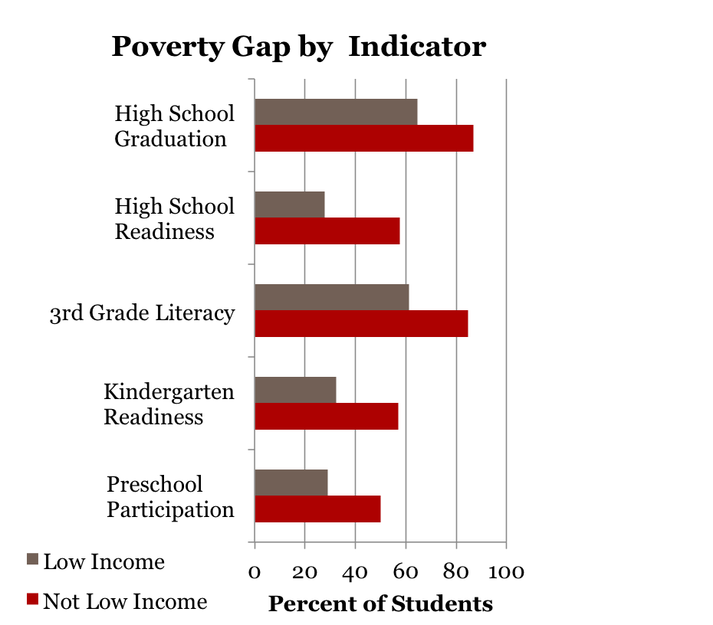
Putting our shared educational challenges in perspective
Overall WA Performance
Not meeting gap reduction targets; 34th percentile nationally and not comparable
to Peer States
Not meeting gap reduction targets
Not meeting gap reduction targets
4th Grade NAEP Reading - Not in top 10% nationally; not comparable to Peer States
WaKIDS not meeting gap reduction targets
Participation in Early Childhood Ed. is
not comparable to Peer States

Slide 3
Our Common Goals
Ensuring the quality of our children’s education
Ensuring readiness for college, career, and life
Providing time and resource for professional development
Having a coherent and balanced assessment program
Having sufficient funds to provide a quality education
Closing the achievement and the opportunity gaps
Enhancing collaboration among all stakeholders (parents, teachers, administrators, legislature, government agencies)

Slide 4
The SBE’s Core Role in this Effort
Provide advocacy and oversight of public education
Implement a standards-based accountability framework that contributes to improved academic performance
Provide leadership in a system that personalizes education
Promote achievement of the goals of basic education (RCW 28A.150.210)

Slide 5
SBE’s Focus Over Past Two Years
Career and college-ready diploma
Statewide CTE course equivalency models
Statewide Accountability System
Ample school funding
Statewide Indicators of Educational System Health
Revised Achievement Index to include student growth
Implementing the charter school law

Slide 6
Our Near-Term Legislative Priorities
Ample Provision: Meet the state’s constitutional obligation to make ample provision for basic education.
High School & Beyond Plan: Strengthen the High School and Beyond Plan (HSBP) for Washington’s students.
ESEA Flexibility Waiver: Encourage the needed action to restore Washington’s ESEA Flexibility Waiver and return control of federal funds to local districts.
Professional Learning for Educators: Incorporate a robust program of educator professional learning into the state’s program of basic education.
Modify Career & College Ready Exam Requirements: Streamline alternative assessments available for graduation.

Slide 7
Our Continued Focus for the Coming Years
Supporting ample school funding
Strengthening career and college planning and guidance for students
Investing in strategies that close achievement and opportunity gaps
Streamlining the Achievement Index, increasing its usability
Developing and implementing oversight expectations for high-quality charter authorizers
Working with agencies and organizations (e.g., WSSDA) to create solid paths to achieve our common goals

Slide 8
We also aim to expand communication / coordination and cooperation
Attendance at Local School Board and WSSDA meetings
Community Forums
  Informal meetings before or after SBoE board meetings
  Invite superintendents, school board members and legislators to learn what topics are most pressing in your district
  Seven held so far: Yakima, Vancouver, Tumwater, Renton, Kennewick, Spokane, and Wenatchee
  Next community forum is November 12 in Vancouver

Slide 9
Working Together
We look forward to regular opportunities to talk / listen / and work collaboratively toward delivering the vision we all share:
“All students graduate
prepared for
career, college, and life”

Slide 10
Resources
Website: www.SBE.wa.gov
Blog: washingtonSBE.wordpress.com
Facebook: www.facebook.com/washingtonSBE
Twitter: www.twitter.com/wa_SBE
Email: sbe@sbe.wa.gov
Phone: 360-725-6025

Slide 11
Let’s Talk

