Slide 1
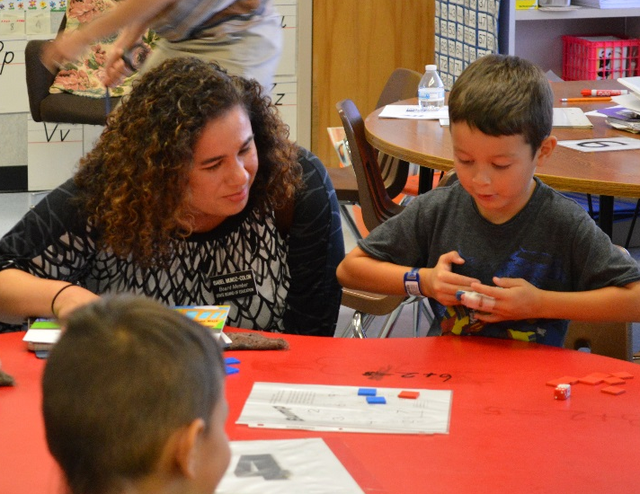
Washington State PTA
Legislative Assembly
Isabel Muñoz-Colón,
Chair
Ben Rarick,
Executive Director
October 25, 2014

Slide 2
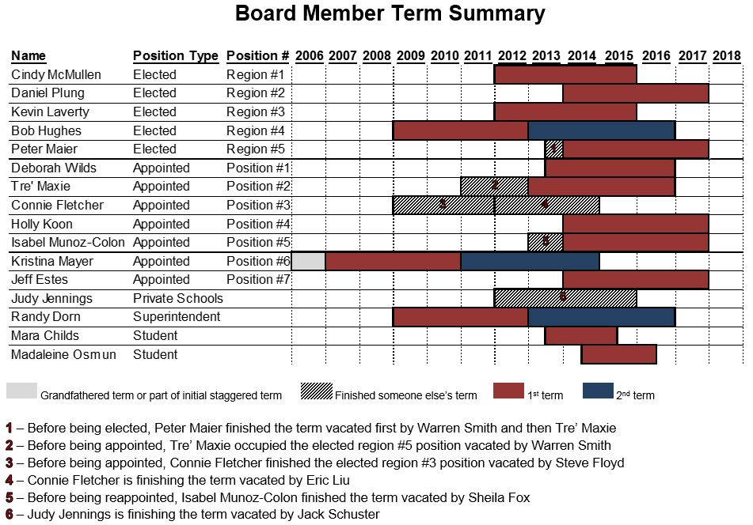
Board Member Terms
Executive Committee Member
Chair

Slide 3
The SBE’s Core Role
Provide advocacy and oversight of public education
Implement a standards-based accountability framework that contributes to improved academic performance
Support the continued development of a system that allows for personalized student pathways
Promote achievement of the goals of basic education (RCW 28A.150.210)

Slide 4
Emerging Issues
Career and College Readiness
School Accountability and Supports
Legislative Priorities
Opportunities to Work with the Board

Slide 5
SBE Near-Term Legislative Priorities
Ample Provision: Fully fund McCleary, without hurting early and higher Ed. or social services that help our families. SBE recognizes this necessarily must include additional revenue.
ESEA Flexibility Waiver: Encourage needed action to restore Washington’s ESEA Flexibility Waiver and return control of federal funds to local districts.
Professional Learning for Educators: Incorporate a robust program of educator professional learning into the state’s program of basic education. Seek funding 10 days PD.
Modify Career & College Ready Exam Requirements: Streamline alternative assessments available for graduation.
High School & Beyond Plan: Strengthen the High School and Beyond Plan (HSBP) for Washington’s students.

Slide 6

Graduation Requirements
Establish high school graduation requirements and equivalencies
Grant extension for districts to implement 24 credits for one or two years
2019 Graduation Requirements: http://sbe.wa.gov/GradRequirements/ClassOf2019.php

Slide 7
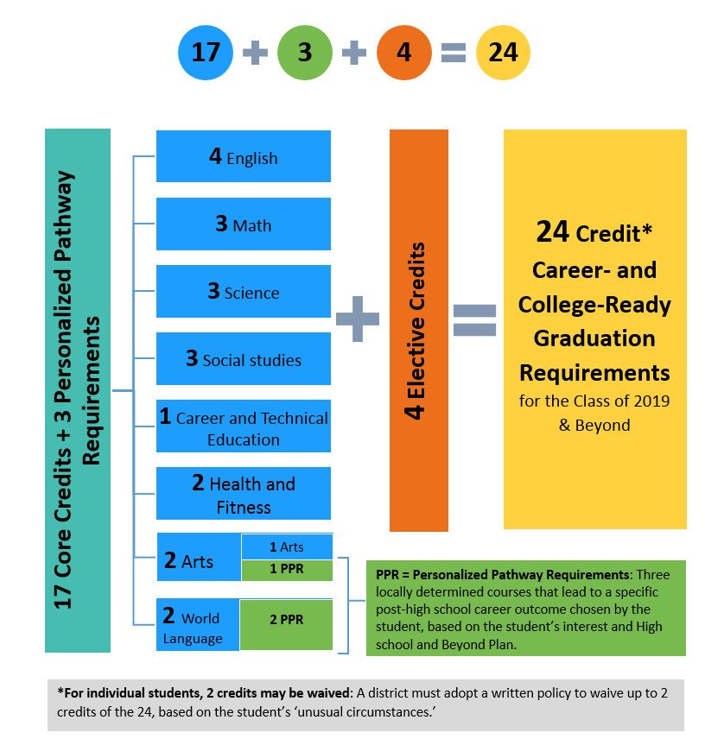
A Personalized Pathway Approach to the 24-Credit High School Diploma

Slide 8
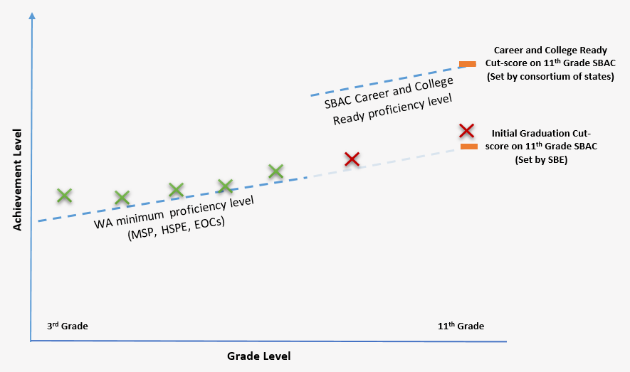
Graduation Cut-score on the 11th Grade SBAC

Slide 9
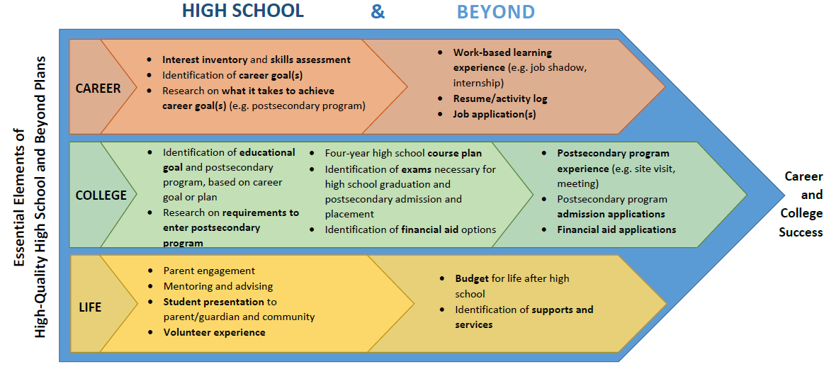
Essential Elements of high-quality
High School and Beyond Plans

Slide 10
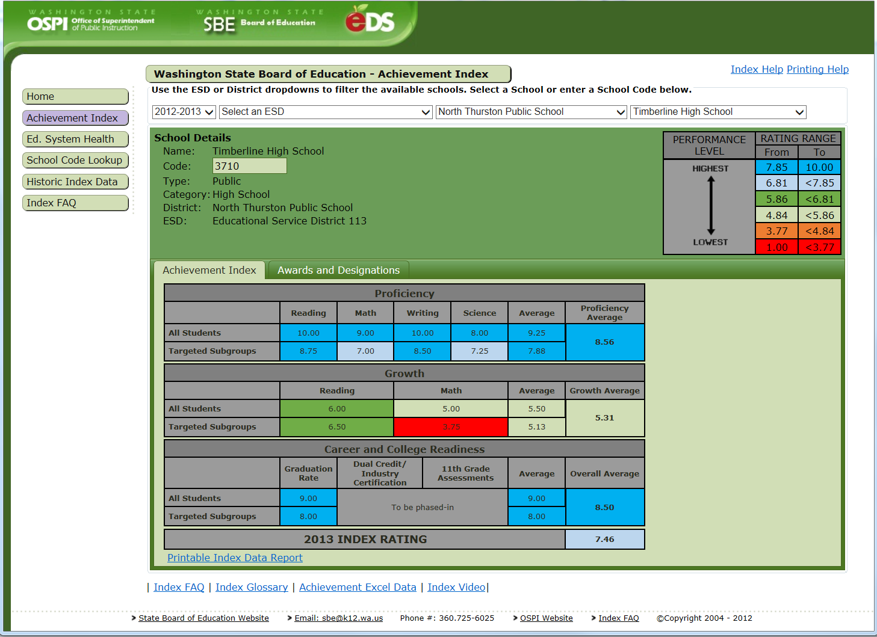
Index Website
https://eds.ospi.k12.wa.us/WAI
Notes:
Index web-tool readily identifies low performing Targeted Subgroup.

Slide 11
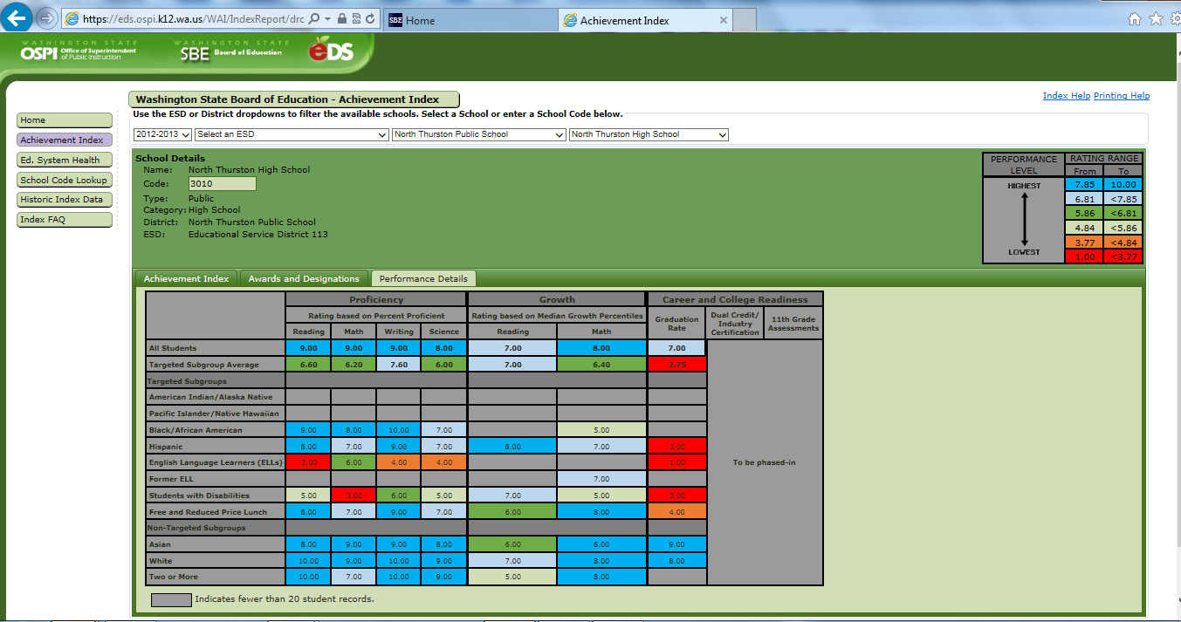
Disaggregated Subgroup Performance
Notes:
TAKEAWAY – drill down allows you to identify the low performing subgroups.
In this example we can see that all of the Targeted Subgroups had low index ratings for graduation. In fact, the posted 5-Year graduation rates for all of these subgroups were below 70 percent. A graduation rating of 3 means that the 5-year graduation rate was between 60 and 65 percent.

Slide 12
Common Vision
“All students graduate
prepared for
career, college, and life”

Slide 13
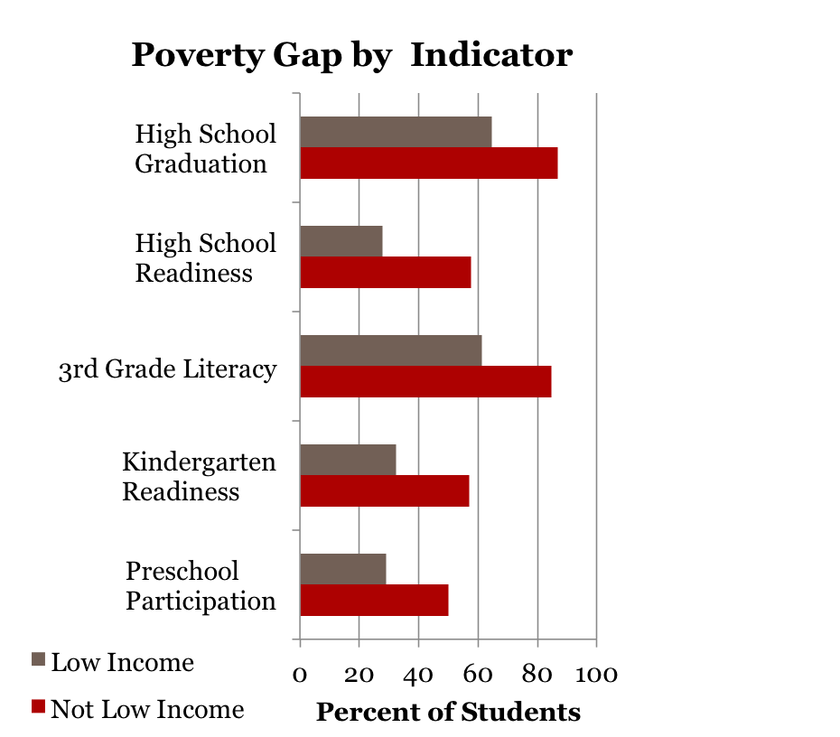
Putting our shared educational challenges in perspective
Overall WA Performance
Not meeting gap reduction targets; 34th percentile nationally and not comparable
to Peer States
Not meeting gap reduction targets
Not meeting gap reduction targets
4th Grade NAEP Reading - Not in top 10% nationally; not comparable to Peer States
WaKIDS not meeting gap reduction targets
Participation in Early Childhood Ed. is
not comparable to Peer States

Slide 14
Community Forums
Informal meetings before or after SBE board meetings
Invite superintendents, school board members, legislators, advocates to learn what topics are most pressing in your district
Eight held so far: Yakima, Vancouver, Tumwater, Renton, Kennewick, Spokane (2), and Wenatchee
Next community forum is November 12 in Vancouver

Slide 15

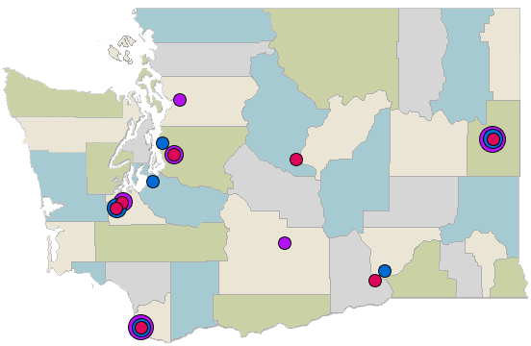
Board Meetings
Everett
Seattle
Spokane
Renton
Wenatchee
Tacoma
Olympia
Tumwater
Yakima
Pasco
Next Meeting
Nov 13-14
Kennewick
Vancouver

Slide 16

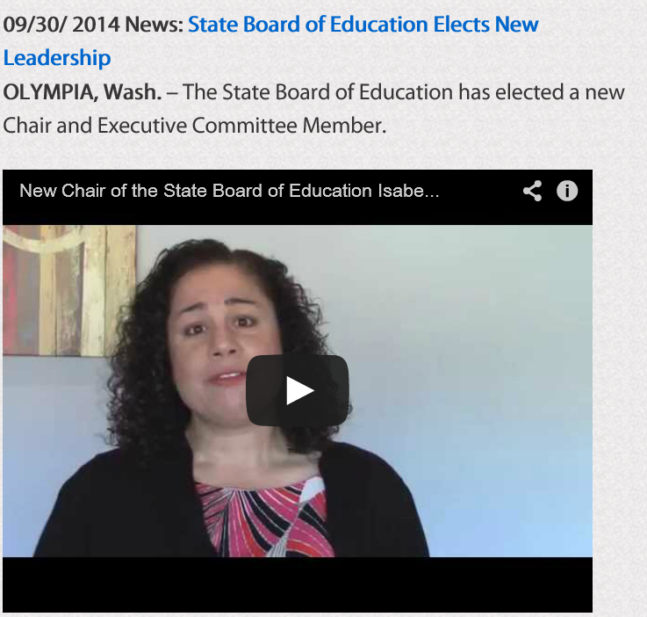
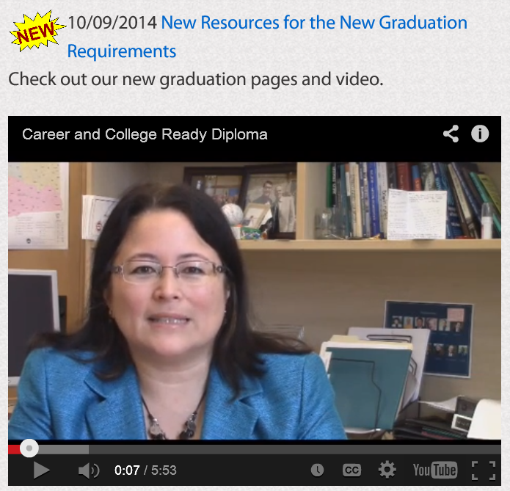
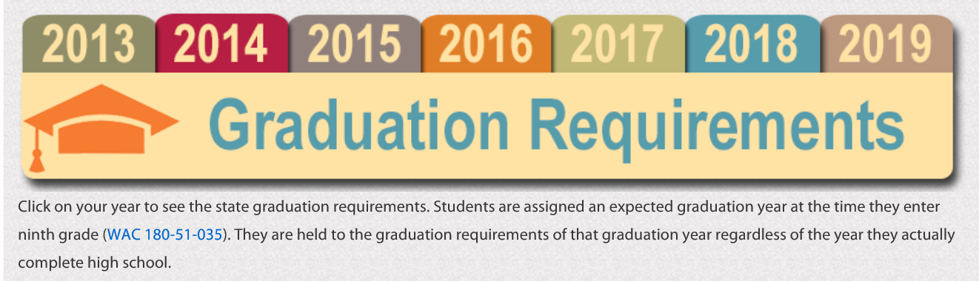
Web Site Resources Available to You

Slide 17


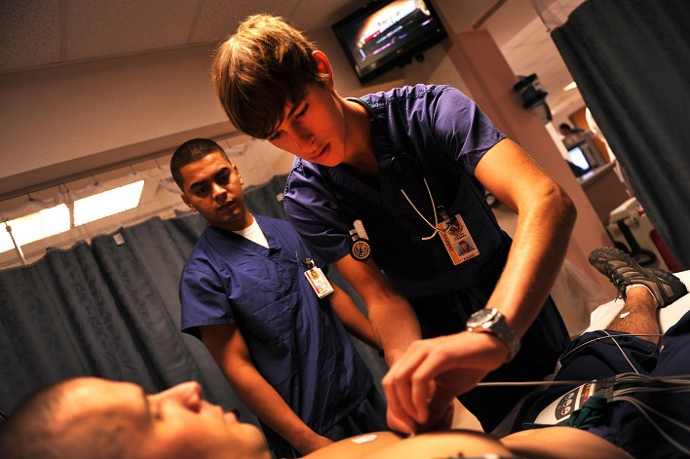
Resources
Website: www.SBE.wa.gov
Blog: washingtonSBE.wordpress.com
Facebook: www.facebook.com/washingtonSBE
Twitter: www.twitter.com/wa_SBE
Email: sbe@sbe.wa.gov
Phone: 360-725-6025

Slide 18
Transition to a Career- and College-Ready
Assessment System
Up through the Class of 2014
Transition Classes of 2015 to 2018
Additional Options for Math and English Language Arts
Transition of 2019 and Beyond
Reading HSPE and Writing HSPE
Math End of Course
Biology End of Course
Biology End of Course
3 Assessments:
3 Assessments:
Math and English Language Arts SBAC
http://www.k12.wa.us/assessment/StateTesting/default.aspx

Slide 19
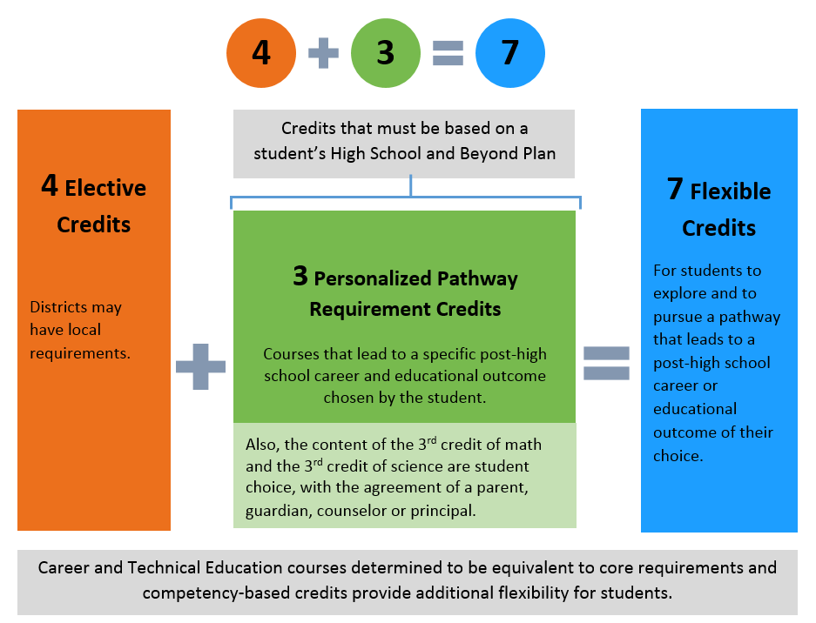
How Much Student Choice?
Highlights:
2 for 1 crediting
Competency-based crediting
CTE course equivalencies
Algebra II no longer default 3rd credit of math

Slide 20
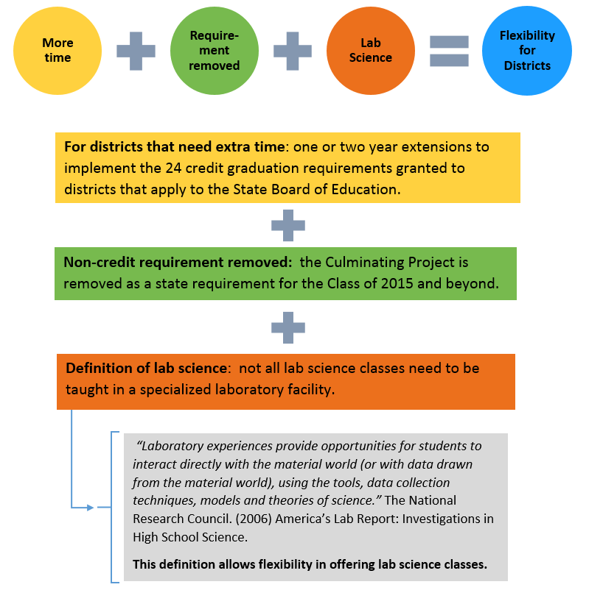
What Flexibility is There for Districts?

