Slide 1

Making the Transition:
ESSA Implementation, Year 1
Washington State Board of Education
Kristen Amundson, NASBE Executive Director
September 14, 2016

Slide 2
Key Themes
The current state of play
  Regulatory environment
  What is left to states
II. Key decision points
III. Examples of state leadership

Slide 3
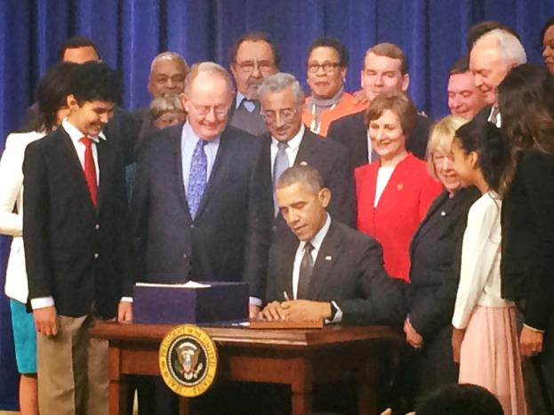
Opportunities & Requirements
Notes:
Remember that this was a bipartisan bill – with all that entails

Slide 4
Every Student Succeeds Act
Wall Street Journal: “Biggest devolution of federal power in a quarter century.”

Slide 5

  ESSA
“With great power comes great responsibility.”
Notes:
In key instances, the Secretary’s authority (particularly w/r to accountability) is constrained

Slide 6
Regulatory Environment
USED has published proposed ESSA regulations:
  Accountability, reporting, state plans – filed 8/1/16
  Assessments – filed 9/16
  Innovative Assessments Pilot
  Supplement, not Supplant – due 11/9
    Fiscal rule, new interpretation would require state and local funding parity between Title I and non-Title I schools

Slide 7
What’s Left to States - Assessment
States May:
Give a single summative test or break up the assessment into smaller components given throughout the year.
Exempt 8th graders from middle grades math assessments under certain conditions
Use adaptive assessments with conditions
Include portfolios or performance tasks as part of the overall assessment
Notes:
S

Slide 8
ESSA Requirements – Accountability
States Must
Develop accountability systems that
  Align with state academic standards
  Focus on student academic achievement and school success
Include performance goals for each subgroup,
  Annually measure student performance based on state assessments
  For high schools: annually measure graduation rates (4 year adjusted cohort rate)
Notes:
S

Slide 9
ESSA Requirements – Accountability
States Must
Include indicators focused on
  Academic achievement – proficiency on annual assessments
  Student growth measures or another reliable and valid statewide indicator for elementary schools and non-high-school secondary schools
  The 4-year adjusted cohort grad rate (plus extended, at state’s discretion)
  Progress in English language proficiency
Notes:
S

Slide 10
What’s Left to States – Accountability
The fifth indicator
  Not less than 1 additional indicator of school quality or student success
    School climate and safety (how to measure)
    Educator engagement (again, how to measure)
    Attendance (average daily? Chronic absenteeism?)
      6.5 million students—13 percent of all students—missed 15 days or more of school in 2013-14.
    Access to (or completion of) advanced coursework
    Social and Emotional Learning
Notes:
Hawaii includes voter registration as one of its accountability metrics.
Oklahoma and Alaska report on student volunteer hours.

Slide 11
ESSA Opportunities - Accountability
Course | Schools with high enrollment of black & Latino students | Schools with low enrollment of black & Latino students
Calculus | 33% | 56%
Physics | 48% | 67%
Chemistry | 65% | 78%
Algebra II | 71% | 84%
Notes:
S

Slide 12
What’s Left to States –
Teacher Evaluation
States may continue to use their existing teacher evaluation system.
But they are under no obligation to do so
“Highly qualified teacher” requirement is eliminated.
Notes:
S

Slide 13
Teacher Evaluation
Teacher equity even more important under ESSA – states can use Title II formula funds for this purpose
Student test scores not required to be part of teacher evaluation – but many states will stay the course
Notes:
S

Slide 14
What’s Left to States?
School Improvement
States must annually identify schools for “Targeted Support and Improvement”:
  All schools with consistently underperforming subgroups
Notes:
S

Slide 15
What’s Left to States?
School Improvement
  Every 3 years, identify schools for “Comprehensive Support and Improvement”
    The lowest performing 5 percent of Title I schools
    All high schools with graduation rates at or below 67 percent
    Schools with very low-performing subgroups that are not improving
Notes:
S

Slide 16
What’s Left to States?
School Improvement
States approve and monitor LEA plans for Comprehensive Support & Improvement
LEA plans must:
  Be informed by all accountability indicators
  Include evidence-based interventions
  Be based on a school-level needs assessment
  Identify resource inequities and
  Be approved by the school and LEA
Notes:
S

Slide 17
Decision Point: Accountability
What is your theory of action?
“Accountability systems need to be designed according to a well-articulated theory of action that clearly lays out the intended goals and outcomes as well as proximal and intermediate indicators and the mechanisms and processes necessary to realize these goals.”
- Scott Marion
National Center for the Improvement of Educational Assessment

Slide 18
Decision Point: Accountability
What is your theory of action?
Goals for Washington graduates
All students should be prepared for
Postsecondary education
Gainful employment
Citizenship

Slide 19
Decision Point: Accountability
What is your theory of action?
Create a modern definition of career readiness
Take action on existing accountability policies (Achievement Index and Indicators of Educational System Health)
Move towards broader system alignment (competency-based learning)

Slide 20
Decision Point:
Accountability System
What is the goal? 100% proficiency ?
  Does a 100% goal lead to the “Lake Woebegon Effect?” (all the children are above average)?
  If 100% is not the goal, which kids get left out?
Is the goal closing gaps?
  What is the state role in setting meaningful goals?
  How do those goals get translated into improvement targets for districts?
  How does all this affect district ratings?

Slide 21
Decision Point: Fifth Indicator
What will you measure?
School climate and safety (how to measure)
Educator engagement (again, how to measure)
Attendance (average daily? Chronic absenteeism?)
6.5 million students—13 percent of all students—missed 15 days or more of school in 2013-14.
Access to (or completion of) advanced coursework
Social and Emotional Learning

Slide 22
Decision Point:
Stakeholder Engagement
“There is a big difference between engaging people and having a meeting.”
    From CCSSO’s Stakeholder Engagement Guide
Notes:
S

Slide 23
Stakeholder Engagement:
Kansas
Goal – to graduate KS students who are college and career ready
“The voice of parents, business, and local stakeholders wasn’t part of the process.” – Board Chair Jim McNiece
Focus groups, one-on-one conversations with more than 2,000 Kansans in more than 20 communities – added more business leaders, who were undersampled at first
Notes:
S

Slide 24
Stakeholder Engagement:
Kansas
Board and Commissioner have now announced an initiative called “Kansas Can”
Not a ‘one and done’ approach
Stakeholder engagement will continue
Notes:
S

Slide 25
Accountability System:
Kentucky
Goal is to graduate students who are college and career ready.
Kentucky’s College- and Career-Readiness Accountability Measures
College Ready 1 point A student must meet benchmarks on 1 of the following | Career Ready 1 point A student must meet benchmarks on one from each of the following columns: |  | College and Career Ready 1.5 points
 | Career Ready Academic | Career Ready Technical | College Ready Academic | College Ready Technical
ACT or COMPASS or KYOTE | ASVAB or Work Keys | KOSSA or Industry Certificate | ACT or COMPASS or KYOTE | KOSSA or Industry Certificate
Notes:
S

Slide 26
Discussion
What are the key decision points for the Washington SBE to focus on?
What parts of your current system do you want to maintain?
How should your accountability system change?
How will stakeholders be involved after the plan is filed?

Slide 27
Further Questions?
Kris Amundson
kristen.amundson@nasbe.org
703-740-4821
Notes:
S

