Slide 1
Student Transitions
By Baxter Hershman and Lindsey Salinas
State Board of Education
09 March 2017

Slide 2
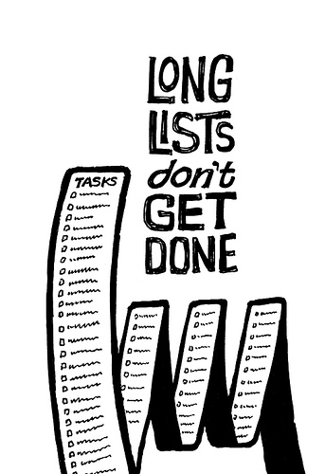

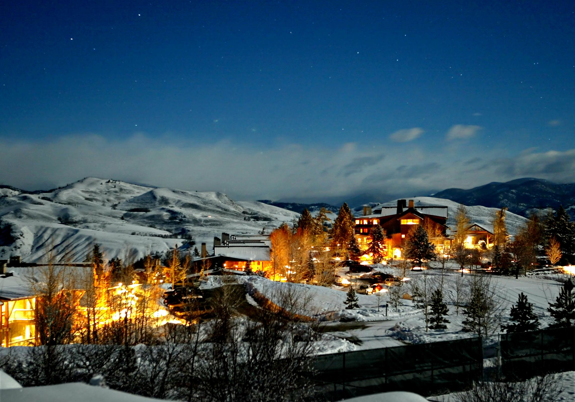
Student Update: Lindsey
Struggles
High workload
Mentoring future ASB President
Rushing to get out
On track to graduate
SAT
Northwest Indian Youth Conference

Slide 3



Student Update: Baxter
College apps are finished
Second semester of senior year
Senioritis
Recent workshop on civility
First Job
Graduation in sight
Local Student Board Member
What college will I be attending?
Notes:
I applied to eleven schools
Scholarships have replaced them
Strange
Received a 4.0 last semester
Hasn’t hit me yet
I keep waiting for it but it never comes
My friends are definitely experiencing it
Probably because I have not received my acceptance letters
I got a job at Cheney Stadium as a part of the fun squad
Describe it
It is fast approaching
Finally!
I have worked on it since my first meeting

Slide 4
To Be Determined

Slide 5
Overview
Normative Transitions
Non-normative Transitions
Personal Experience with Transitions
Student Suggestions

Slide 6
Normative vs. Non-Normative
Notes:
Let’s differentiate between the two here
Normative
Transitions that all students experience
Non-normative
Not every student experiences them but a large population does
Results in significant hardship for those that experience it

Slide 7
Normative Transitions

Slide 8
High School to Postsecondary
College
Career
Life

Slide 9
College
Freshman Myth
  Overly optimistic and confident in their ability to manage the challenges they will encounter at college
  Students create expectations of college that are not met
Academic expectations
  It is not the same as high school
Social Challenges
  Brand new environment with new rules and new people
Notes:
Freshman Myth
overly optimistic and confident in their ability to manage the challenges they will encounter at college
Can disenfranchise incoming college students
34% of freshman college students drop out due to overconfidence
It needs to be addressed early
Over-romanticism
Students think it will be a fun trip away from parents
It is a harsh reality
Lots of work and hard living
Academic Expectations
New college students have this feeling that someone will hold their hand
It is on them
Teaching styles can differ from teacher to teacher
A’’s are not a given in college
High school can be a little bit of an A factory while college is far and few between
Lack of connection with teachers is different
Social challenges
Seniors spend 12 years in a system that generally has a similar situation
Many are not prepared for the shock of this type of adjustment

Slide 10
Career
Competition
  Be prepared to get rejected
  Increasing difficulty due to higher qualifications
“Lock-In” Myth
  Once you have chosen a field, you are stuck in it
Notes:
Competition
It takes multiple times of applying to get it
Keep trying
There is a lot of competition out there
Often is due to lack of experience or credentials
You will get a job eventually
Job availability
Overflow of

Slide 11
Life
Notes:
You gain personal freedom
People do not judge you as hard as you think they do
People form impressions of you based on many events while you create ideas that one ruins you
You are able to find who you are
Life goes from being structured to what you structure it to be
You can orient your life how you want
In any aspect
You choose where you go
You are the driver of your own bus

Slide 12
Non-Normative Transitions

Slide 13
Homeless Students and Transience
The McKinney-Vento Homeless Assistance Act
  Students that lack a regular, fixed night time residence
Enrollment and Transportation
  Immunization records
  Proof of residence
School District Responsibilities
  Track their homeless students and report back to OSPI

Slide 14
Military Students
Slow transfer of records
  Documents can take weeks to travel from one school to the other
Differences between curricula
  Students often have to relearn
Constant change
  Families prepare for another move at the beginning of another

Slide 15
Re-Entrance from Exclusionary Discipline
Reduce Discipline
  Punishment
  Time
Student Re-Engagement
  Behavioral
  Communication
  Other Resources

Slide 16
Student Suggestions

Slide 17
Student Suggestions: Baxter
Standardized testing can provide a streamlined system but can take away from quality of education
Student leaders can help to make up the difference

Slide 18
Emotional vs. Educational
Notes:
Let’s differentiate between the two here
Bring up examples of students not doing well because of the students that were there
It is important for the new student to have a community of friends to fall back on
Helps students buy in

Slide 19
Student Suggestions: Lindsey
Having outside support systems
  Community
  Family
  Tribal Organizations

Slide 20
Final Thought

Slide 21
Thank You
Questions?

