Slide 1
School Recognition 2018-19
April 2020

Slide 2
What will the webinar cover?
Welcome from the SBE
Background on the school recognition system
How schools are identified for recognition
Where to find more information
Navigating the data files

Slide 3
The spring 2020 school recognition public release marks the culmination of the School Recognition Workgroup’s Phase 2 work.
Phase 1
Phase 1
Spring 2019: recognized 216 schools, via three routes, relying primarily on the All Students group
Phase 2
Phase 2
Spring 2020: recognizes 391 schools, via three routes, with Growth by student groups added to the methodology.
Phase 3
Phase 3
Spring 2021: expected to explore the inclusion of qualitative, locally derived data and will be complicated by the cancellation of the spring 2020 statewide assessment administration.

Slide 4
Communications
April 21: Embargoed press release and communications tools sent to ESD Communications Directors, Washington School Public Relations Association listserv, live on sbe.wa.gov/recognition
April 22: Press Release - “State Celebrates Schools During School Recognition Week”
April 27 – May 1: Washington School Recognition Week (Legislatively recognized)
Share your congratulations with recognized schools safely on Twitter! Use the hashtag #WASchoolsWeek and SBE will engage!
School Name

Slide 5
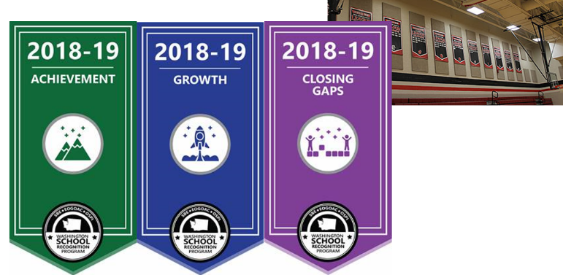
Banners & Certificates
School Name

Slide 6
2018-19 School Recognition Model Schools Can Demonstrate Being Exemplary in Many Ways

Slide 7
High Performing - Closing Gaps -
 | General Criteria Defining a High Performing School for Closing Gaps*
Comprehensive Support Schools | The increase on the WSIF from winter 2019 to winter 2020 for the All Students group is in the top 20 percent of schools and the school WSIF score is higher than the 2.30 identification cutoff.
Targeted Support Schools | At least one student group with a WSIF rating ≤ 2.30 in winter 2018 showed an increase on the WSIF from winter 2019 to winter 2020 that is in the top 20 percent of schools and the group WSIF is higher than the 2.30 identification cutoff.
Low EL Progress Schools | The 2019 annual EL Progress measure is above the 48.9 percent identification threshold.
Low Grad Rate Schools | The 2019 annual WSIF four-year graduation rate is above the 66.7 percent identification threshold.
*Note: other qualifying criteria for all schools include meeting participation requirements on statewide assessments, and for Comprehensive and Targeted Support schools, no targeted groups may show a WSIF decline and no new groups may fall below the 2.30 identification threshold.

Slide 8
High Performing - Growth -
 | General Criteria Defining a High Performing School for Growth*
All Students Group | At least 60 percent of the reportable measures for the All Students group are in the top 10 percent of schools.
Disaggregated Student Groups | At least 60 percent of the reportable measures for a student group in the top 10 percent performance for that student group.
*Note: other qualifying criteria for all schools via any of the routes include meeting participation requirements on statewide assessments. For the All Student recognition, the school must be reducing the WSIF gap between the highest and lowest performing groups and both the highest and lowest performing groups must be improving on the WSIF.

Slide 9
High Performing - Achievement -
 | General Criteria Defining a High Performing School for Achievement*
All Students Group | The 3-year rollup performance of the All Students group for at least two measures are in the top 20 percent of schools.
*Note: other qualifying criteria for all schools include meeting participation requirements on statewide assessments, and all reportable student groups must post a winter 2020 WSIF score of at least 6.00.

Slide 10
Recognition Route by School Level
 | CLOSING GAPS | CLOSING GAPS AND GROWTH | GROWTH | GROWTH AND ACHIEV. | ACHIEV. | TOTAL
Elementary Schools | 42 | 22 | 139 | 6 | 21 | 230
Middle Schools | 27 | 6 | 26 | 0 | 5 | 64
High Schools | 8 | 2 | 30 | 2 | 13 | 55
Combined Schools | 1 | 1 | 4 | 1 | 3 | 10
Combined High Schools | 4 | 1 | 14 | 0 | 13 | 32
All Schools | 82 | 32 | 213 | 9 | 55 | 391

Slide 11
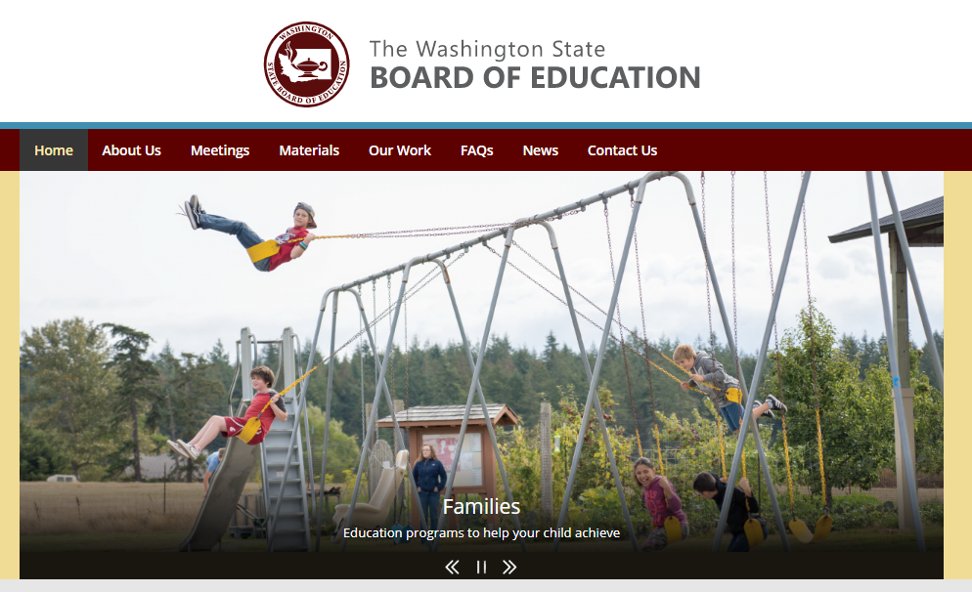
Where to find information on the 2018-19 Recognized Schools
Sbe.wa.gov homepage

Slide 12
Where to find information on the 2018-19 Recognized Schools, continued
Generalized description of the 2018-19 school recognition methodology

Slide 13
Detailed information on the 2018-19 recognized schools
Generalized description of the 2018-19 school recognition methodology
Sortable list of the 2018-19 recognized schools.
Detailed description of the 2018-19 school recognition methodology

Slide 14
Other information available upon the public release.
At the time of the public release, links will be provided for two data files:
Simplified data for the 389 recognized schools
Detailed file for all public schools containing the data elements required to understand why a school or was not identified for recognition.

Slide 15
Questions?

Slide 16
Contact Information
Randy Spaulding, Executive Director
Randy.Spaulding@k12.wa.us
Andrew Parr, Research Director
Andrew.Parr@k12.wa.us
Stephanie Davidsmeyer, Communications Manager
Stephanie.Davidsmeyer@k12.wa.us

