Slide 1
SBE Executive Committee Retreat
June 10th
PSESD

Slide 2
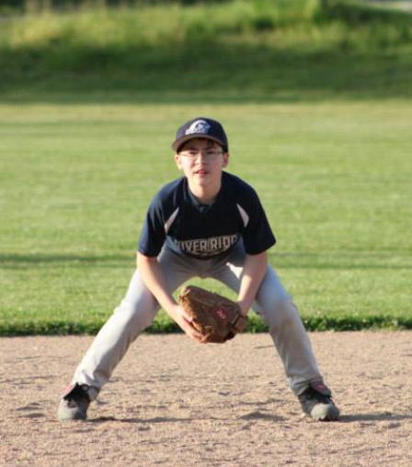
River Ridge Scorpions Win!

Slide 4
Logistics/Updates
Budget
Running at about 92%
Governor to ask for 15% cut drills in 2015-17 due to McCleary structural deficits
NASBE membership?
Personnel update
Consultant
Reviews
Communications audit from CFM

Slide 5
Hopes/Fears
Hopes:
Crisp discussion. Leave with sense of accomplishment and a clear narrative for the discussion in July.
Insights that lead to outside-the-box new policy directions. What are we truly capable of?
Fears:
Conversation sprawls due to a desire to cover every little thing.
We lose track of our goals because the conversation gets sidetracked.
Leave exhausted, and more uncertain than before.
Rehash old conversations without any new insights.

Slide 6
Calendar of Key Decisions
My recommendation:
Leadership: nominations in July, election at Retreat
Legislative priorities: discussion in July, adoption at Retreat
Strategic Plan: discussion in July, adoption of framework at Retreat (mission/vision, high-level goals). Final adoption tentative for November.

Slide 7
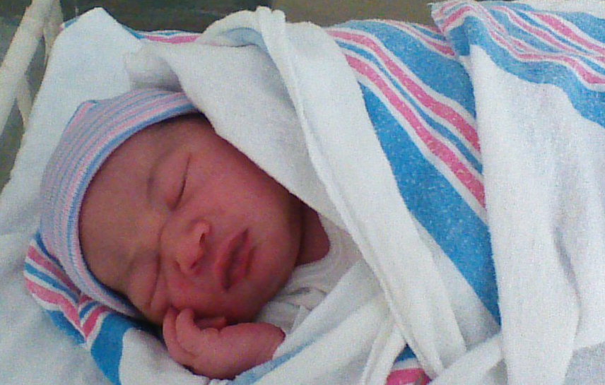
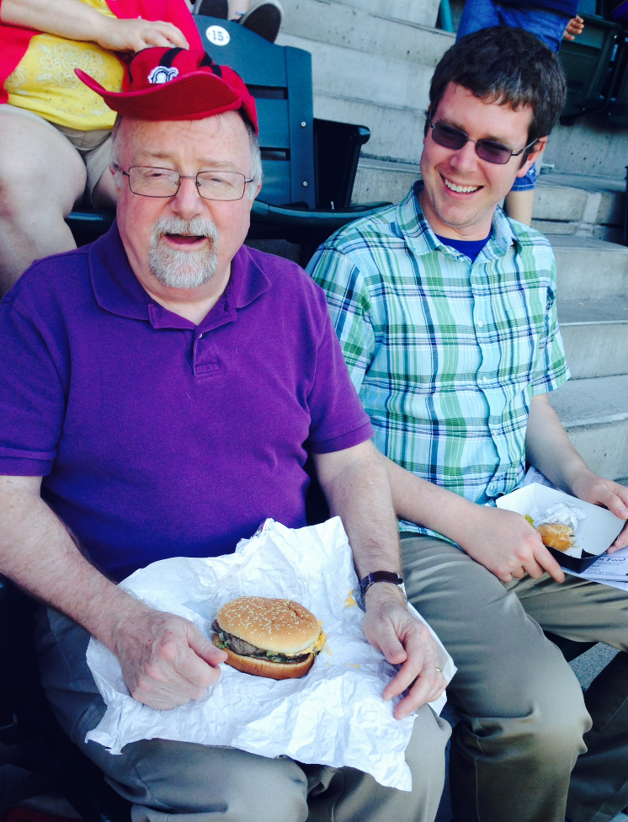
SBE Staff Send Their Regards!

Slide 8
Legislative Agenda - Options
McCleary response – ample provision but not at the expense of important social services.
Professional development funding framework
Commensurate limits on waiver days for the purpose of PD.
ESEA Waiver fix – take another run at this?
Testing requirements for the high school diploma (science end-of-course, etc).

Slide 9
SBE Strategic Plan
Current strategic plan dashboard:
http://www.sbe.wa.gov/documents/BoardMeetings/2014/May/01StrategicPlan.pdf
See key questions posed in advance memo.
We don’t need to wordsmith the mission and vision statement today, but what thoughts and considerations do you have as you think about the current mission/vision?

Slide 10
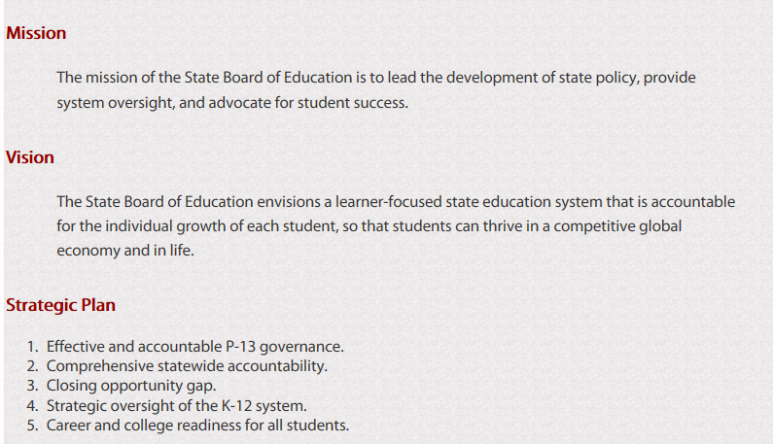

Slide 11
Dear Members of the State Board of Education:
We, the executive committee, had a retreat. We did some planning so we could effectively guide the entire Board through a process of change. Our deliberations led us to the following recommendations:
We would propose the following calendar.
We would propose the following statements about the evolution of SBE’s mission, vision, and goals.
We would propose considering the following items for our 2015 Legislative Priorities.
Here is the broad outline of the planning process we propose for the Fall, including opportunities for public comment in Plan development.
Signed,
Executive Committee Members

