Slide 1
Vision for Career and College-Readiness for All Students Opportunities for SBE and SBCTC Collaboration
Ben Rarick,
Executive Director
March 27, 2014

Slide 2
Topics for Today
Bridging the Gap between High School and College
How to Leverage the 11th grade Common Core (SBAC) assessment results towards improved course-taking in high school and less remediation in college.
The potential for pre-remedial college transition courses in our high schools.
What role can the high school and beyond planning process play?
What would it take to cut remediation rates in half by 2020?

Slide 3
Strengthening High School Graduation Requirements
“Core 24” was not well received – SBE spent the last year building more flexibility into the framework.
Restore Electives
Strengthen Math & Science CTE Course Equivalencies so that CTE is embedded, rather than separate.
Build around the concept of Personalized Pathway Requirements (PPR)
Focus more on the outcomes (Career-and-College Readiness), and less on inputs (1080 hours).
In the 21st century, all students need Science, Technology, Engineering and Math (STEM) skills; 3 credits of math and 3 credits of science are foundational course credits that keep our students competitive.
Every student should have a High School and Beyond Plan by 9th grade or earlier, upon which all course-taking decisions will be based.
All students should be preparing for their life after high school; each student’s High School and Beyond Plan should identify a postsecondary pathway.
“College” is more than just a 4-yr degree! Community colleges, trades, industry certification, etc. – many individualized pathways for students of all interests and abilities.

Slide 4
HIGHLIGHTS ENGROSSED SECOND SUBSTITUTE SENATE BILL 6552 (as passed Legislature – pending Governor’s signature)
More Flexible Instructional Hour Requirements & Funding
1000 hours in grades 1-8 & 1080 hours in grades 9-12, “all of which may be calculated… using a district-wide annual average… over grades one through twelve.” (read: average of 1027 hours)
$97 million provided for instructional hours increase last year is “redirected” to guidance counselors, supplies, class size.
$34 million for lower class size for high school lab science classes.
$16 million for guidance counselors
$45 million for high school materials and supplies (“MSOC”)
NOTE: $58 million in MSOC added to the budget beyond existing money that was “redirected”
SBE to implement 24 career and college-ready framework for the Class of 2019.
Individual school districts shall receive 1 or 2-year implementation extensions by filing with the state board of education.
The culminating project is eliminated as a high school graduation requirement.
*This is an initial interpretation. Rules will ultimately implement these provisions and districts should not use this presentation in place of rule language.

Slide 5
SB 6552 HIGHLIGHTS (continued)
The third credit of math and science are student choice, based on HSBP, with the approval of a counselor, principal, parent, or guardian.
SBE must allow districts to waive 2 credits for a student, on a case-by-case basis, based on “unusual circumstances.”
Districts must adopt local policies to administer this waiver, and WSSDA is to develop a model policy and make available for districts.
Districts must offer at least one CTE math and at least one CTE science equivalency course. Districts with fewer than 2000 kids can seek a waiver. OSPI, w/ SBE, to develop more standardized approach to CTE equivalency in math & science.
A new task force is created on success of students with special needs. Headed up by Office of Education Ombuds. SBE is a member of this task force.

Slide 6
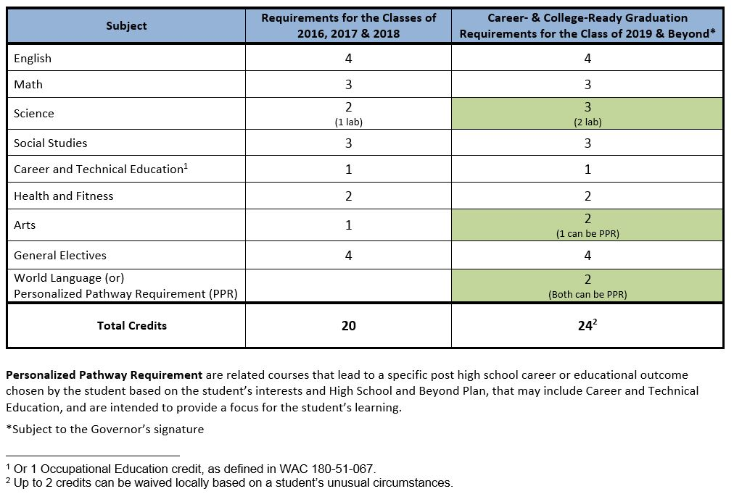
Graduation Requirements 24 credit framework

Slide 7
Personalized Pathway Requirements
“Personalized Pathway Requirements” are locally determined, but should reflect coursework important to pursuing a variety of post-secondary pathways, including:
Attend a skills center or pursue a Career and Technical Education program of study.
Pursue a certificate or degree in a professional/technical program.
Pursue a 2 or 4-year degree via a college, university, or college transfer program.

Slide 8
Potential Next Steps
SBE rule-making
Instructional hours requirement
24 credit framework
CTE waiver process (potentially)
Work on development of math & science CTE course equivalencies that deliver needed rigor.
Collaborate on use of 11th grade SBAC test results for course placement purposes (see feedback letter).
Collaborate on High School and Beyond Plan.

Slide 9
Remediation
What would it take to cut remediation rates in half by 2020?
Strengthened course-taking in senior year (particularly math)
Strengthened High School and Beyond Plan
Linking the third credit of math to the content of credit-bearing coursework at community college level.
Ever improving awareness/planning between the two systems.

Slide 10
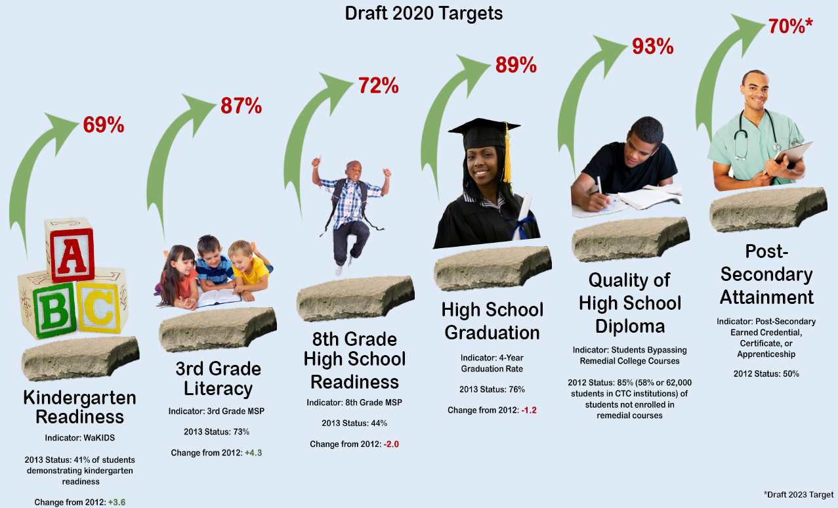
Stepping Stones to Career and College Readiness for ALL Students

Slide 11
Questions?

Slide 12
Resources
Website: www.SBE.wa.gov
Blog: washingtonSBE.wordpress.com
Facebook: www.facebook.com/washingtonSBE
Twitter: www.twitter.com/wa_SBE
Email: sbe@sbe.wa.gov
Phone: 360-725-6025

