Slide 1
MBL Work Group Summer Retreat July 15-16, 2020

Slide 2
Retreat Agenda
Wednesday, July 15
9:00-9:15 Welcome and Updates
9:15-10:15 Culturally Responsive MBL practices in the classroom
10:15-11:15 Diploma framework discussion part I
11:15-11:30 Break
11:30-12:15 Supports for educators to deliver MBL: Example model from Washington State LASER
12:15-12:30 Setting the Stage for Day 2 and Debrief
12:30 p.m. Adjourn
Thursday, July 16
9:00-10:00 HSBP: Perspectives from Two Schools
10:00-11:30 Diploma framework discussion part II
11:30-1:00 p.m. Lunch Break
1:00-2:30 p.m. Report Recommendations
2:30-2:55 Discussion: Debrief the Day
2:55-3:00 Next Steps
3:00 Adjourn

Slide 3
Culturally Responsive MBL practices in the classroom Aira Jackson, ELA Director, OSPI Ellen Ebert, Science Director, OSPI; Mechelle LaLanne and Pranjali Upadhyay

Slide 4
Diploma Framework Discussion: Part I

Slide 5
Discussion Questions from Prework Presentations
Can current policy, programs, and practices enhance, help build, or be incorporated in the diploma framework?
Do any of the current policies, programs, and practices need to change to better support a MBL diploma framework?
Are there characteristics you want to incorporate into Washington’s framework from other state’s diploma frameworks? (e.g. regional support structure, statewide competencies, pilot approach, etc.)

Slide 6
Supports for educators to deliver MBL: Example model from Washington State LASER
Notes:
I am going to provide an overview about how Washington State LASER program operated both initially and today. Then, we are lucky to have Dennis Schatz, Retiring President, National Science Teaching Association Board of Directors who is listening in and ready to answer your questions about the model and how it might be applicable to a support structure for educators you could recommend for MBL.
Dennis helped to create and lead the LASER program here in Washington.

Slide 7
LASER Background & Context
In 1999:
A few districts were initiating science education reform.
Science was being phased into the state’s school improvement strategy.
A diverse, but collaborative, science education community existed within the state.
There was no statewide plan to provide the tools and technical assistance needed to help school districts “systemically” initiate, implement and sustain science education reform.
Notes:
Twenty years ago, although the science community in the state had pockets of collaboration, there was no statewide plan to ensure districts and educators had the tools they needed to provide high-quality science education to all of their students. Thus, the Washington State Leadership and Assistance for Science Education Reform (LASER) program was created in 1999, based off the national LASER model, which provides the infrastructure to build local capacity, local ownership, and sustainability of high-quality science education.

Slide 8
LASER Theory of Action
Smithsonian Science Education Center: National LASER
Notes:
The work of Washington State LASER is actualized through ten regional Alliances, geographically aligned with Washington’s ESDs. These Alliances offer leadership and technical assistance, including strategic planning support, within the five components of the LASER model developed by the Smithsonian Science Education Center: professional learning, curriculum, instructional materials support, assessment, and administrative and community support. LASER plays a key role in ensuring that state science leaders maintain a learning community and develop their skills to provide leadership and assistance in service of removing barriers and structures to improve STEM implementation at the school and district levels.
Notes:
Smithsonian Science Education Center (SSEC) was formerly known as the National Science Resources Center until 2010 when the Smithsonian took on the full operation of the SSEC.
SD Infrastructure boxes say: research-based curriculum, competent teachers, aligned assessment, materials support, school and community support

Slide 9
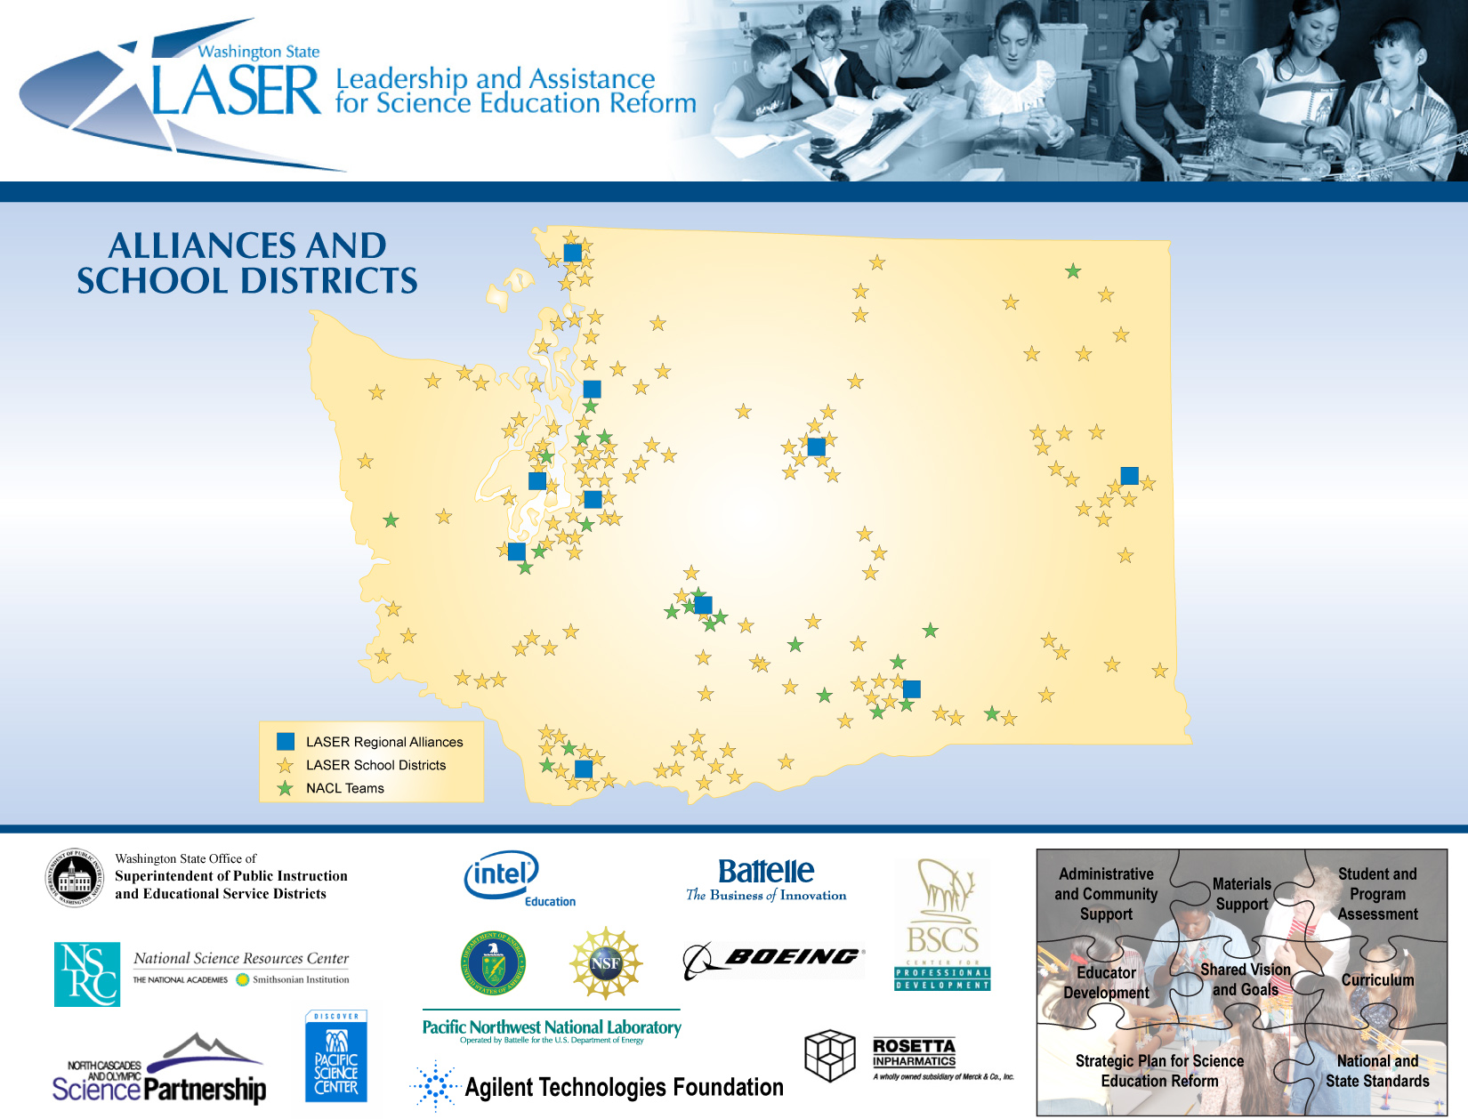
LASER Map Reflecting NACL Districts
Notes:
The LASER program began with four regional alliances, and has since grown to 10 regional alliances. This is a snapshot of the LASER network implementation in our state from around 2008-09. The blue boxes are LASER Alliances or “hubs” that support the work of LASER school districts. The gold stars are LASER school districts who primarily are focusing on the quality of K-8 science education. The green stars are “early adopter” school districts that are working to bring the kind of improvements found at the K-8 level to high school through a program called the National Academy for Curriculum Leadership.

Slide 10
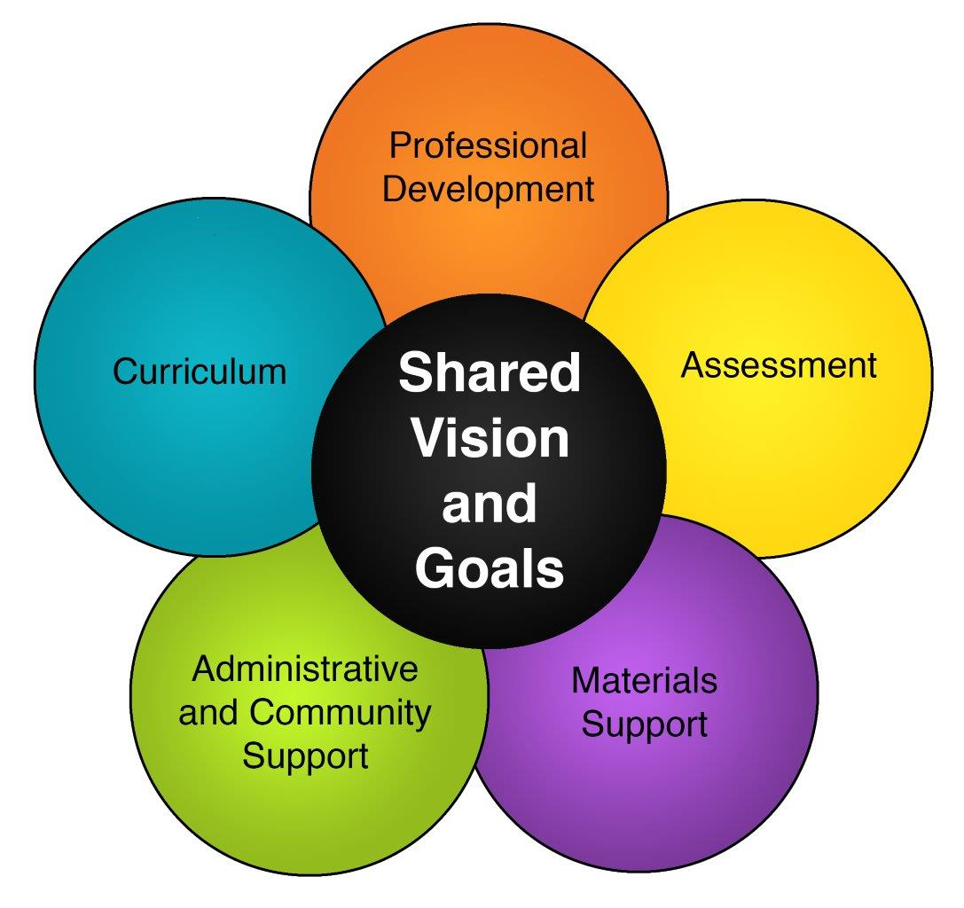
Scaling Up Strategies
Focused on a public/private partnership approach
Wore multiple hats (e.g. science education, collaboration, public affairs)
Created distributed leadership with a shared vision that included key stewards in business, community, and education
Used a regional alliance/hub approach
Provided technical assistance for school improvement efforts
Used a bottoms up strategy (grassroots to key influencers)
Worked to create clarity regarding roles and responsibilities
Notes:
The program was built on Nation Science Foundation’s implementation model, that included research and best practices on how to disseminate information and create sustainable programs.
There was a public/private partnership approach: Funding for Washington State LASER was initially provided through the Washington State Legislature, Battelle, and the Boeing Company.
LASER directors at the state and regional level had multiple responsibilities: with a primary focus on increasing implementation of high quality science education, the organizers also did a lot of networking within communities to build relationships and understanding of the program.
To facilitate ownership of the program in schools, the LASER organizers intentionally didn’t used a top down approach. Instead, the program helped school & district level people to be “in charge” of implementation and have a voice in making the work happen.

Slide 11
National LASER: Research study results
Notes:
The national LASER model has reached 47 US states and 24 nations. Washington is one of a few states to implement statewide and have an ongoing regional support structure.
A key component of the LASER program are student assessments and program evaluations aligned with cognitive research, that provide meaningful feedback about student learning. From 2010-15, a national study found that students participating in the study states of New Mexico, North Carolina, and Texas consistently out-performed their peers on performance-based assessments, indicating that they were able to apply what they learned in novel, hands-on situations. Teachers who were a part of the LASER study consistently felt more prepared to teach inquiry-based science than their peers

Slide 12
Washington State LASER: Present Day Support Structure
LASER is led by Washington STEM along with Educational Service Districts (ESDs), and the Logan Center for Education at the Institute for Systems Biology (ISB).
Washington STEM: provide capacity-building support and technical assistance to Co-Directors and Alliance Directors in service of LASER goals.
LASER Co-Directors: design, facilitate, and implement activities that lead to progress toward LASER goals.
Regional Alliance Directors: implement, share, and refine best practices and tools that contribute to LASER goals.
LASER Advisory: exists to (1) provide critical advice, and (2) support/promote LASER through their normal networks.
Notes:
Washington State LASER is primarily funded through a legislative proviso (Laws of 2020, 2ESHB 6168, Sec 520 (12)), administered and overseen by OSPI. Washington STEM serves in a coordinating and technical support role, and the LASER leaders - Co-Directors and Alliance Directors - carry out the implementation of work aligned with the LASER goals, and regional needs. Over half of the Alliance Directors are also Regional Science Coordinators at Educational Service Districts.
The purpose of the LASER Advisory is to represent a range of perspectives that challenge and support the program, especially with respect to increasing equitable access to STEM-related careers. The Advisory members promote LASER through their networks, and are a mix of state people and national folks, higher education, and business. Members include: West Valley school district, UW, Smithsonian, CWU, OSPI, SBE, WA STEM, North Central and Northeast ESDs, Seattle U, Lummi Nation, ISB.
Also coordinated through LASER and the ESD’s Regional Science Coordinators is the state’s Science Fellows. Science Fellows are teachers selected through a state application process to become teacher leaders. They attend trainings on the state’s science learning standards, and then go back and share their learning with their school and district.

Slide 13
What can we learn about possible MBL educator supports from the LASER Model?
A regional support structure with a point of contact at the state level for statewide coordination and technical support has worked well in other settings
Start small and build up, with people enthusiastic about the model
Bringing together people from all roles within the district, to create buy-in through strategic planning
Infrastructure to support those on the ground doing the work
Community involvement is critical
Funding matters (especially for initial implementation)
Notes:
If we were to use the LASER program as a model for a MBL support structure:
A state organization that could provide statewide coordination through capacity-building support and technical assistance, including through communications and advocacy around the shared goals of MBL.
Perhaps we could also use the ESDs as an already existing regional support organization. The ESDs could focus on implementing, sharing, and refining best practices for improving student learning outcomes by acting at the system and organization levels. They could provide professional development and a space to meet regularly for discuss schools’ shared learning.
Including a nonprofit as part of the support structure could be helpful, in order to receive funding from the business community (this way funding could be a mix of public and private money).
The state’s support structure for science education, through LASER and the teacher leader Science Fellows, is similar to Idaho Mastery Education Network teacher leaders example from your prework presentation. In Idaho, the school incubator teams who implemented MB education under the pilot approach then began leading the implementation of MB education in their communities, just as Washington’s Science Fellows teacher leaders do for implementation of the science learning standards in their communities.

Slide 14
Debrief

Slide 15
Retreat Day 2: July 16, 2020

Slide 16
HSBP: Perspectives from Two Schools Kory Kalahar and Aurora Flores

Slide 17
Diploma Framework Discussion: Part II

Slide 18
Lunch Break

Slide 19
Report Recommendations

Slide 20
Debrief

Slide 21
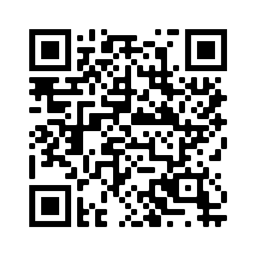
SBE Contact Information & MBL Webpage
Website: www.SBE.wa.gov
Facebook: www.facebook.com/washingtonSBE
Twitter: @wa_SBE
Email: sbe@k12.wa.us
Phone: 360-725-6025
Web updates: bit.ly/SBEupdates
More MBL work group information and resources:
https://www.sbe.wa.gov/our-work/mastery-based-learning-work-group

