Slide 1
Index Update to Learning First Alliance
Ben Rarick, Executive Director
May 21, 2014

Slide 2
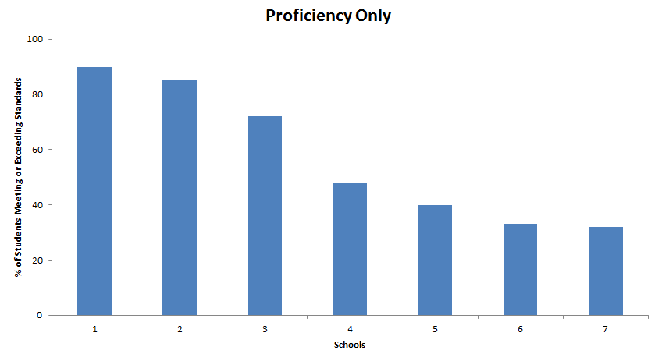
Proficiency + Growth = Better Evaluation

Slide 4
Priority School Identification
Other Low
5 schools in the bottom 5 percent in reading or math for 3 years.
Continuing Priority – 25 schools currently implementing Priority Turnaround models.
Achievement Index – 18 schools with the lowest Composite (3-Year) Index rating.
Graduation Floor – 11 schools with a 3-Year average graduation rate < 60 percent.
Proficiency Floor – 61 schools with a 3-Year average reading and math proficiency rate < 40 percent.
Cont. Priority
Index
Low Grad
Low Proficiency

Slide 5
Differentiated Supports and Recognition

Slide 6
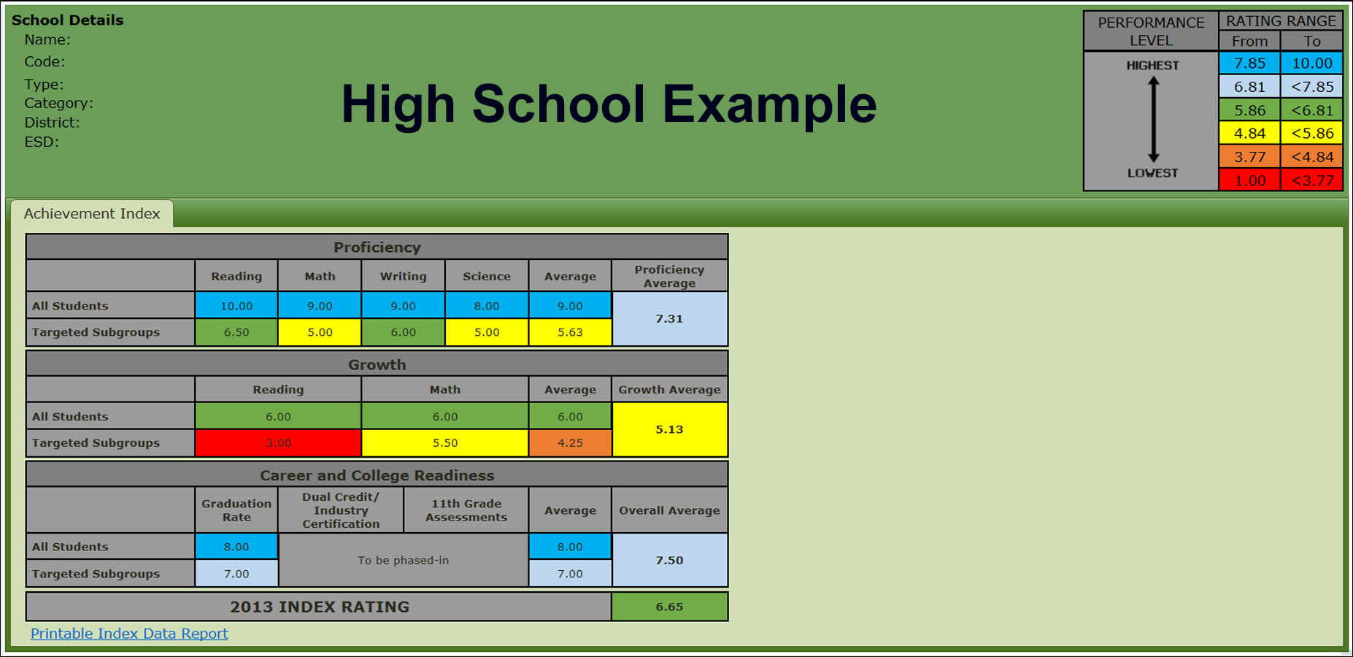
Display of Index Information

