Slide 1
Advancing Science Education through a College & Career-Ready High School Diploma Framework
WA State Leadership and Assistance for Science Education Reform Advisory Board
Ben Rarick,
Executive Director
Notes:
Thank you for service

Slide 2
Goals for Today
Provide overview of some on-going efforts by SBE to strengthen course-taking and post-secondary planning.
Discuss how science education fits into that larger agenda.
Engage in a discussion about how we can work together to advance common goals.
Notes:
Galvanize Support for System Needs.
Positive Peer Pressure.
Set a Standard That Challenges Historical “Paths of Least Resistance” for Kids.
Spur Innovation by Clarifying What's Possible.

Slide 3
Preparing for a Transition in Standards & Assessments
Transition Overview Video
Notes:
I was thinking that Linda’s video could be a great “conversation” starter for you presentation, but it could be further augmented by your request for those present to engage and enable the college and career ready policies put in place by the SBE. The LASER Advisory Committee representatives are mostly folks working at the program, practice and partnership levels. As Executive Director, SBE, what would you request they do? What feedback do you need from them that could help inform the SBE work going forward? Is there anything that you think (or wonder about) that the SBE and LASER could do together that builds on the joint strengths and capabilities they represent.

Slide 4
4 Science Policy Issues as Part of the Career and College-Readiness Agenda
Rethinking the vision for science assessment and grad req’s going forward (E.g. the future of Biology EOC)
Rethinking the role of Career/technical education in delivering math and science content to students.
Implementing the third credit of science – and the second lab requirement -- in the context of NGSS.
Professional development is essential, yet non-existent in basic education funding.
Rethinking what is science… computer science, “Big History”, Etc.
Notes:
Galvanize Support for System Needs.
Positive Peer Pressure.
Set a Standard That Challenges Historical “Paths of Least Resistance” for Kids.
Spur Innovation by Clarifying What's Possible.

Slide 5
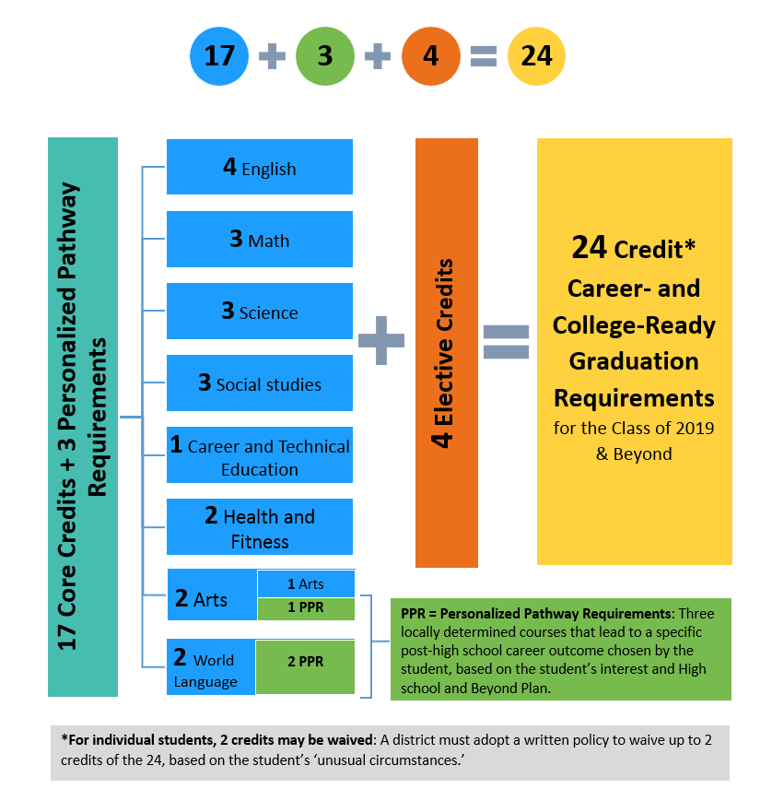
A Personalized Pathway Approach to the 24-Credit High School Diploma

Slide 6
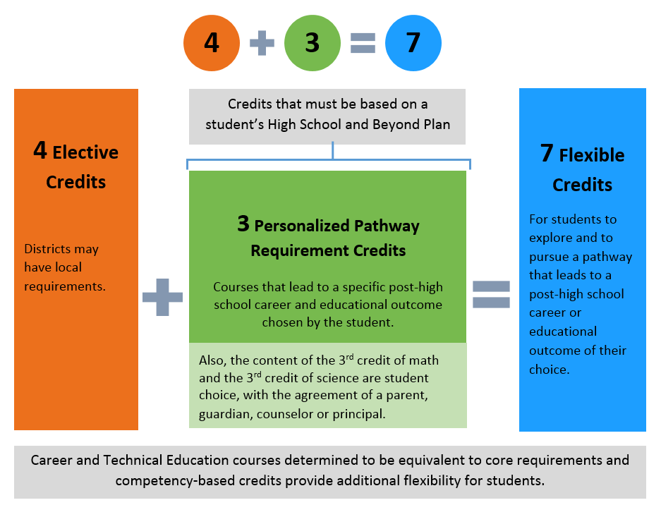
How Much Student Choice?
Highlights:
2 for 1 crediting
Competency-based crediting
CTE course equivalencies
Algebra II no longer default 3rd credit of math

Slide 7
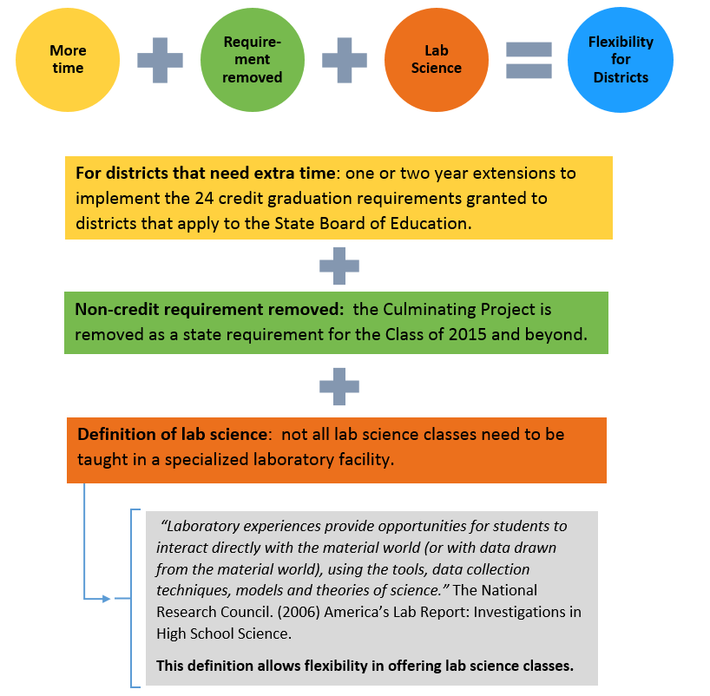
What Flexibility is There for Districts?

Slide 8
The High School and Beyond Plan
Renewed importance - will guide students’ personalized pathway and third credit of math and science choices
Wide latitude to local decisionmakers
SBE working with partners to ensure students have access to high-quality, meaningful HSBP tools.

Slide 9
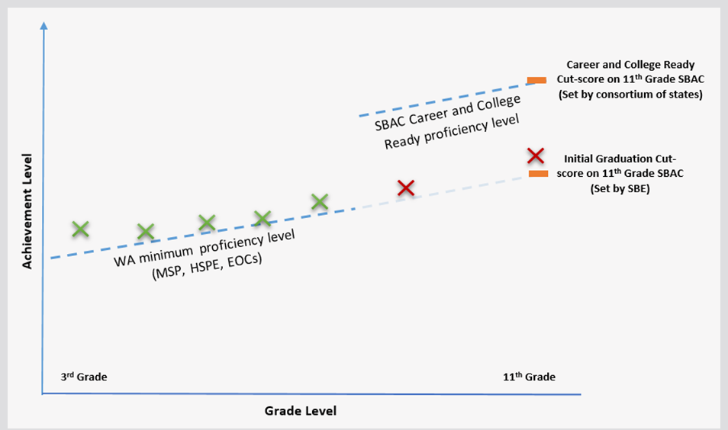
How to Responsibly Transition to Career & College-Ready Standards in a Transition?

Slide 10
How Does State Policy Leverage Local Change?

Slide 11
How Does State Policy Leverage Local Change?
The Power of Advocacy
The Power of Measurement
The Power of Expectations
The Power of “Permission”
The Power of Incentives
Notes:
Galvanize Support for System Needs.
Positive Peer Pressure.
Set a Standard That Challenges Historical “Paths of Least Resistance” for Kids.
Spur Innovation by Clarifying What's Possible.

Slide 12
Our Ask of You
Stick up for High Standards – Be a Vocal Advocate
Be Vigilante About How State Policies Are Applied Locally
Are we maintaining fidelity to the mission?
Are we exercising flexibility to help kids or accommodate adults?
Find ways to engage and galvanize parents – they are our best allies in this effort.
Be patient through the transition to career and college-ready standards; don’t let perfect be the enemy of better.
Notes:
Galvanize Support for System Needs.
Positive Peer Pressure.
Set a Standard That Challenges Historical “Paths of Least Resistance” for Kids.
Spur Innovation by Clarifying What's Possible.

Slide 13
Achievement Index Includes Science Achievement
https://eds.ospi.k12.wa.us/WAI
Notes:
Index web-tool readily identifies low performing Targeted Subgroup.

Slide 14
Disaggregated Subgroup Performance Where are our Achievement gaps in science?
Notes:
TAKEAWAY – drill down allows you to identify the low performing subgroups.
In this example we can see that all of the Targeted Subgroups had low index ratings for graduation. In fact, the posted 5-Year graduation rates for all of these subgroups were below 70 percent. A graduation rating of 3 means that the 5-year graduation rate was between 60 and 65 percent.

Slide 15
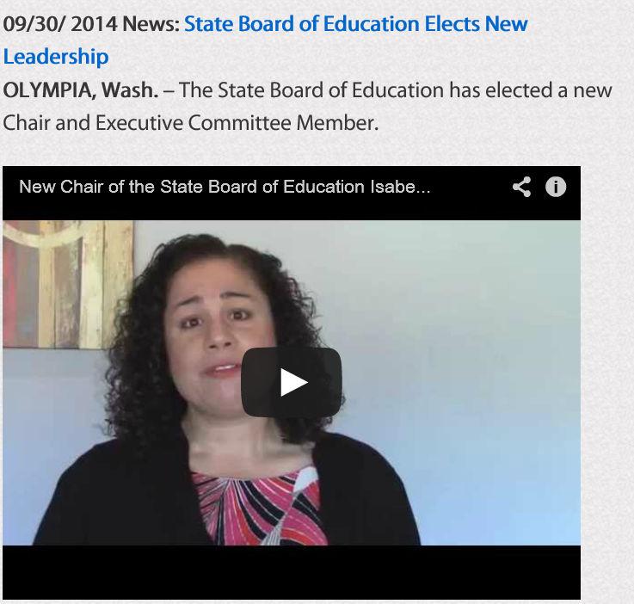
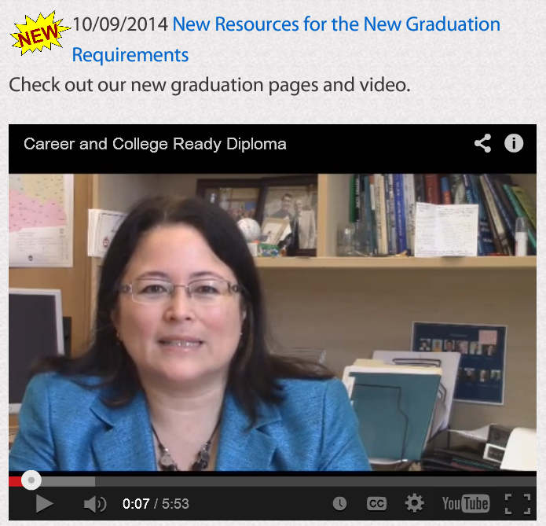
Web Site Resources Available to You

Slide 16
Resources
Website: www.SBE.wa.gov
Blog: washingtonSBE.wordpress.com
Facebook: www.facebook.com/washingtonSBE
Twitter: www.twitter.com/wa_SBE
Email: sbe@sbe.wa.gov
Phone: 360-725-6025

