Slide 1
24-Credit Graduation Requirements Pathways to Postsecondary
November 2014

Slide 2
Why Have Graduation Requirements?
Equity
Preparation
Competition
Notes:
Equity: State graduation requirements establish credit standards for all Washington students. All our students need the opportunity and the access to choose among a full range of postsecondary pathways, including career and technical certificates and degrees and four-year and post-baccalaureate degrees. Without uniform standards, some students in the state will have access and others will not. Preparation: Washington is one of the top five states in the percentage of jobs requiring a postsecondary education; if we want our students to be prepared for the jobs in our own workforce, they must be ready for postsecondary education when they exit high school. Competition: Other states and countries have more rigorous credit and course standards. Washington students will be competing for jobs in a global economy; our students should have equal opportunities as students from other states and countries.

Slide 3
Guiding Principals
Foundational course credits earned to meet intent of basic education
STEM is important in the 21st Century
Electives are important
High School and Beyond Plan as the foundation for all course taking decisions
High School and Beyond Plan should identify a postsecondary pathway
Notes:
• All students should earn certain foundational high school course credits to meet the intent of basic education.
• In the 21st century, all students need Science, Technology, Engineering, and Math (STEM) skills. Three credits of math and three credits of science are foundational course credits.
• High school electives are important, allowing choice in course-taking, and providing the opportunity to explore a range of fields of knowledge and pursue particular postsecondary pathways.
• Every student should have a High School and Beyond Plan by ninth grade or earlier, upon which all course-taking decisions will be based; the plan may evolve if the student’s interest and goals change.
• All students should be preparing for their lives after high school. Each student’s High School and Beyond Plan should identify a postsecondary pathway.

Slide 4
Postsecondary Pathways
Should include the opportunity to pursue:
Professional/technical certificate or degree
4-Year degree at college or university
Notes:
Personalized postsecondary pathways are locally determined, but should include, at least, the opportunity to:
• To pursue a professional/technical certificate or degree at a community or technical college.
• To pursue a four-year degree at a college, university, or college transfer program. Students’ high school classes should align with the Washington Student Achievement Council’s College Admission Standards.

Slide 5
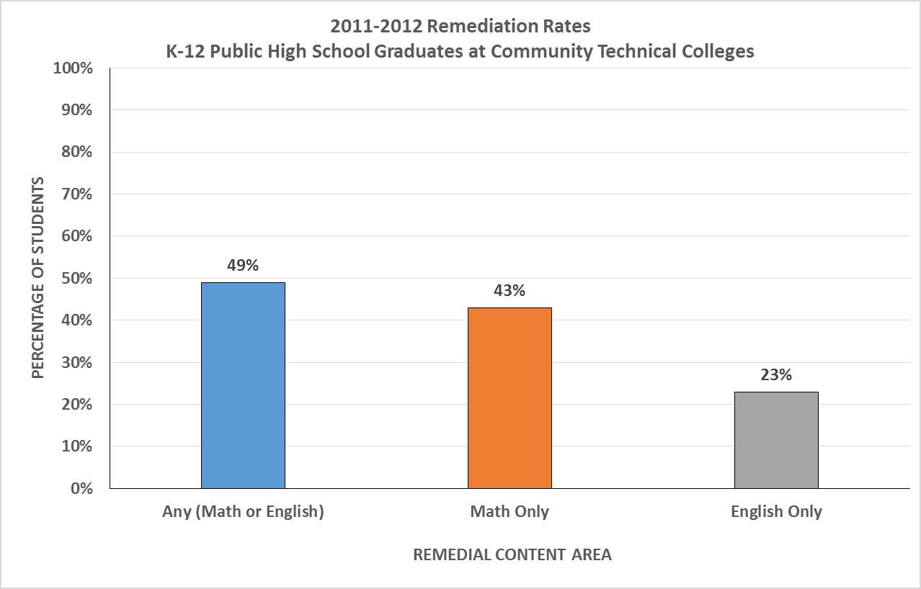

Slide 6
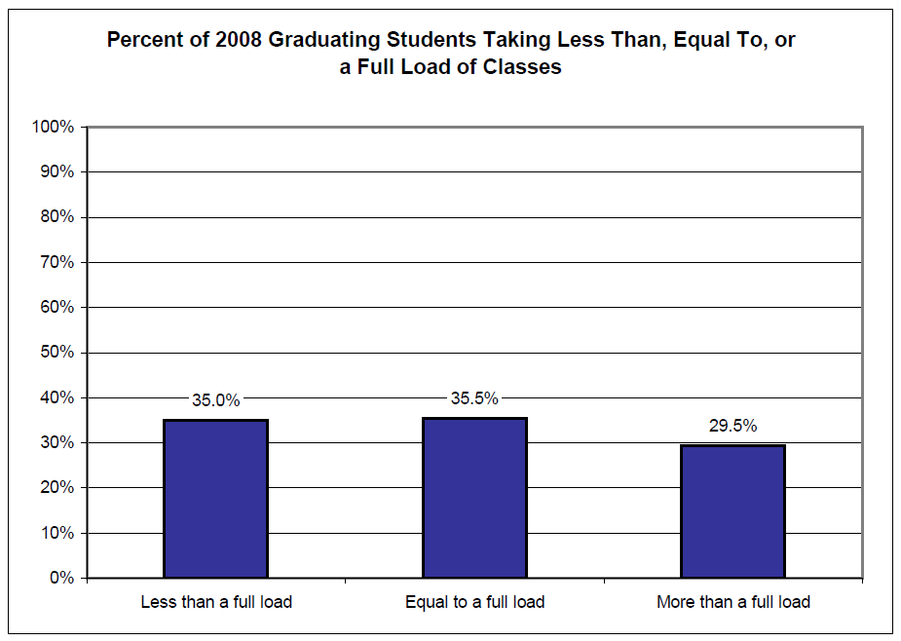
Percent of 2008 Graduating Students Taking Less Than, Equal To, or a Full Load of Classes
Washington State Board of Education Transcript Study. 2008, BERC Group.
Notes:
Why did the State Board of Education increase the number of credits to 24?
Given the high percentage of students having to take non-credit bearing classes at 2 year or 4 year colleges before they can start accumulating college credits, we had to take a hard look at how students were using this precious resource: a free public education. We found that over a third of the students were not taking full advantage of this opportunity by taking a full load.

Slide 7
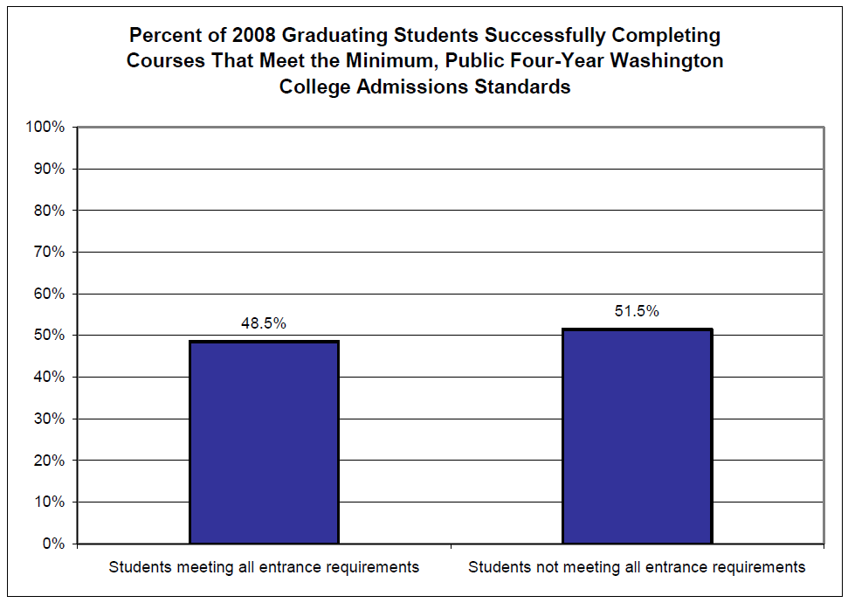
Percent Students Completing Minimum Admission Standards
Washington State Board of Education Transcript Study. 2008, BERC Group.
Notes:
Fewer than half of all students graduating had the credits they needed to be admitted to a four year college. While college is not for everyone, students often change they minds about attending college, sometimes too late to take the two credits of world language or extra credit of English or math that were required.

Slide 8
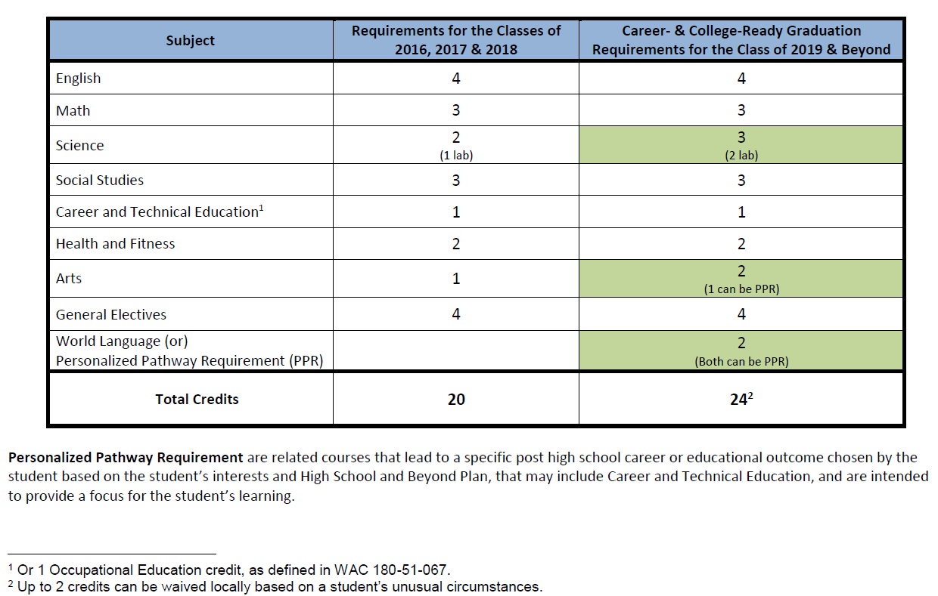
Graduation Course-Taking Requirements
Notes:
The new Career and College Ready Graduation Requirements were developed so that all graduates would have as many opportunities open to them as possible. It prepares them to be admitted to a two year or four year college, while giving them the flexibility to use their credits to pursue a career or technical credential while in high school.

Slide 9
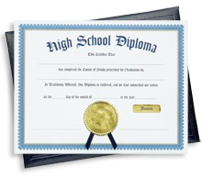
E2SSB 6552
Twenty-four credit requirements
for the Class of 2019
Extra time for districts that need it
Culminating projects eliminated as a state requirement starting with the Class of 2015
Flexible hour requirement
About $97 million redirected for:
Guidance counselors
Materials and operating costs
Reduce lab science class size
Notes:
In the 2013 legislative session, the number of hours required by districts for high school students was increased to 1080 to accommodate the 24 credits. In 6552, the legislature adopted the 24 credit requirements during the 2014 session. The full implement is timed to coincide with the full funding of basic education by the legislature, and as mandated by the Supreme Court under the McCleary decision.

Slide 10
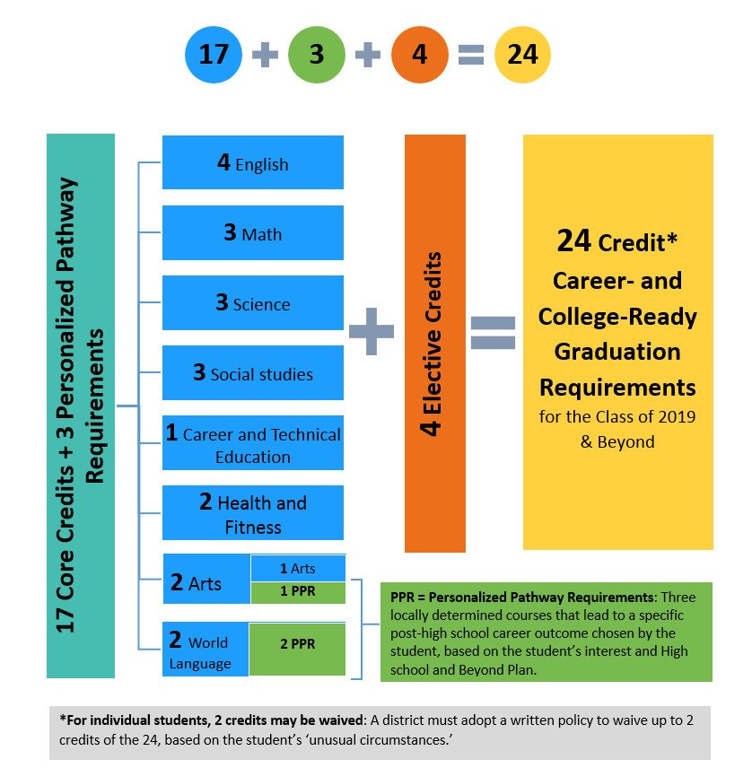

How Do the 24-Credit Graduation Requirements Add Up?
Notes:
There is a lot on this page: 17 core classes, three personal pathway requirements, which, for a 4 year college bound student would include a World Language, and four electives.
Up to two non-core credits can be waived, based on District policy, for students with unusual circumstances. I called this the Grace provision when we were developing the framework.

Slide 11
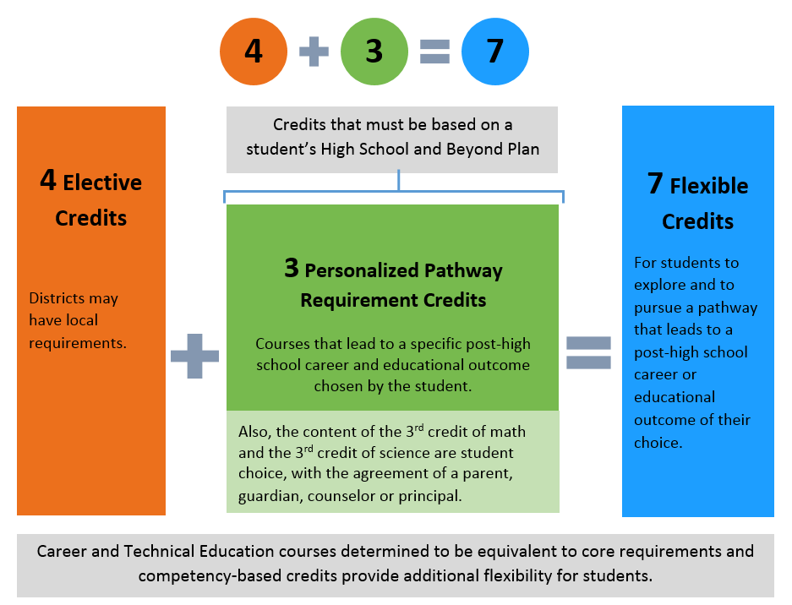
How Much Student Choice?

Slide 12
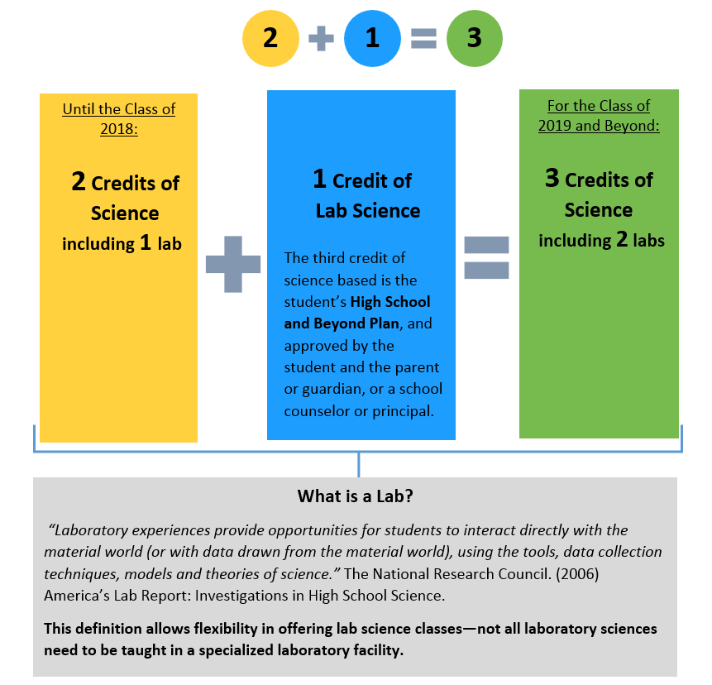
How Are Science Requirements Changing?

Slide 13
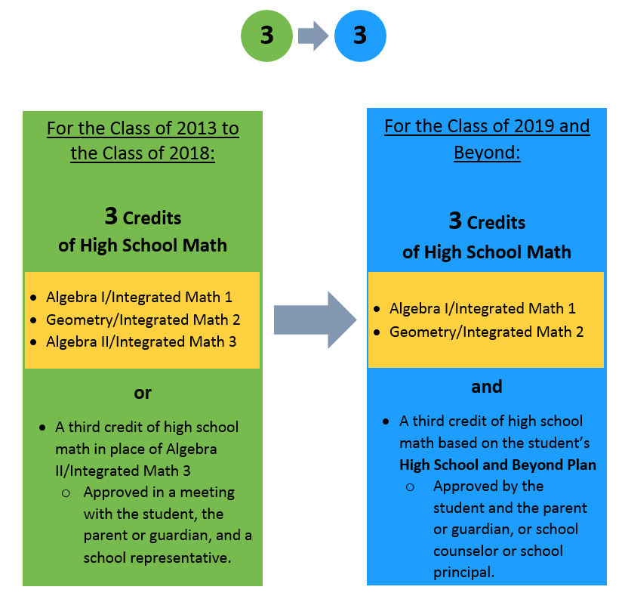

How Are Math Requirements Changing?
Notes:
There is additional flexibility built into the math requirements. When we began the development of the Career and College Ready requirements, it was believed that Algebra II was the gateway course to many professions. We now know more about actual math requirements for many professions and another may be more appropriate for a students career goals.

Slide 14
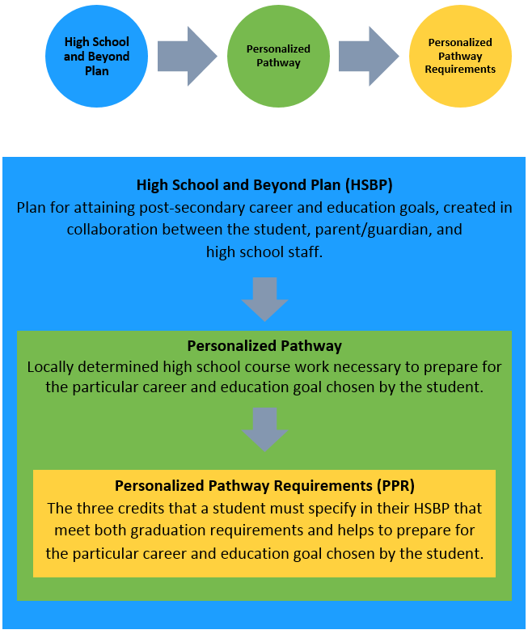
How Do Personalized Pathway Requirements Relate to the High School and Beyond Plan?
Notes:
A solid High School and Beyond Plan, preferably starting in middle school is very important. As parents you play a vital role in helping your child explore career options and choosing appropriate high school courses.

Slide 15
WAC 180-51-050 also allows for competency-based crediting
WAC 180-51-050(1)(b) Satisfactory demonstration by a student of proficiency/competency, as defined by written district policy, of the state’s essential academic learning requirements (learning standards).
Notes:
The SBE is also encouraging the competency or proficiency based crediting that will allow students who have attained mastery in a subject to get high school credit for it. For example, students raised with a primary language other than English can take a test and get world language credits, depending on their level of proficiency. This frees up time in their schedule they may need to gain mastery in English or another subject.

Slide 16
Resources
Website: www.SBE.wa.gov
Blog: washingtonSBE.wordpress.com
Facebook: www.facebook.com/washingtonSBE
Twitter: www.twitter.com/wa_SBE
Email: sbe@sbe.wa.gov
Phone: 360-725-6025
Notes:
.

Slide 17
WAC 180-51-050 allows local discretion for defining successful completion of high school credit
The term “high school credit” shall mean:
WAC 180-51-050(1)(a) Successful completion, as defined by written district policy, of courses taught to the state’s essential academic learning requirements (learning standards). If there are no state-adopted learning standards for a subject, the local governing board, or its designee, shall determine learning standards for the successful completion of that subject;

