Slide 1
State Board of Education Update
Ben Rarick,
Executive director

Slide 2
Why Revise the Achievement Index?
ESEA Waiver opens the door . . .

Slide 3
Revised Index Principles

Slide 4
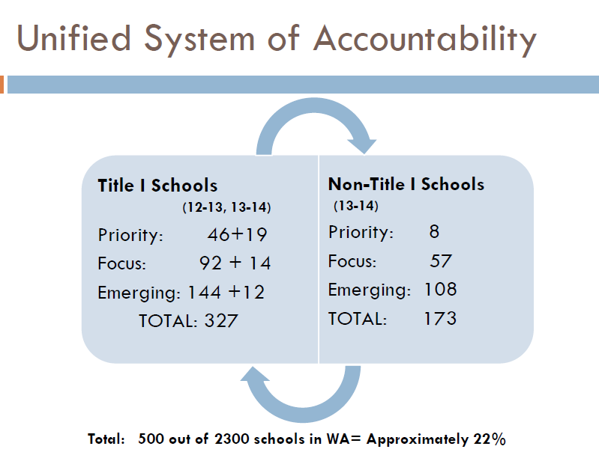

Slide 7
Revised Index Scoring
Moving from a seven-point scale to a 10-point scale
Lens on achievement gap -- moves from low-income vs. non low-income to incorporation of individual federal subgroups.
Targeted Subgroups (e.g. Opportunity Gap) – half of overall Index score, and included in every performance indicator
Typical federal accountability business rules will apply:
Non-continuously enrolled students not included in school Index rating
Multiple years of data used
Participation rates of 95%

Slide 8
What is Changing?
Revised Index:
Removes peers, improvement indicators
Adds SGP growth in reading and math for grades 4-8 and high school
Will disaggregate by every federal subgroup (includes ELL and Former-ELL)
In future years, adds dual credit/industry certification rates for high schools

Slide 9
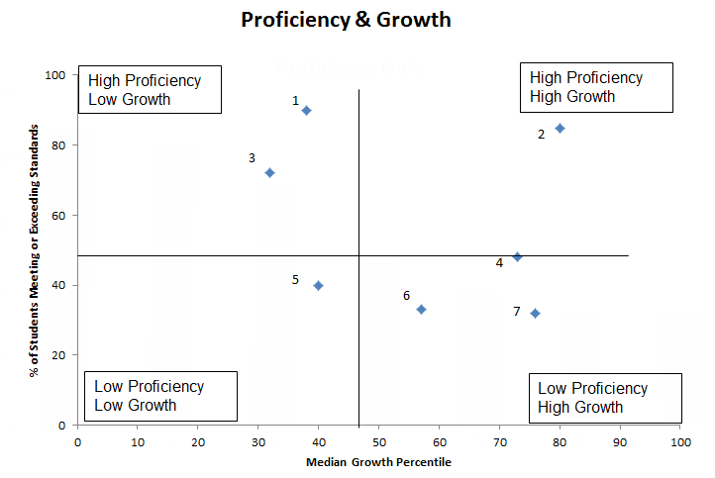
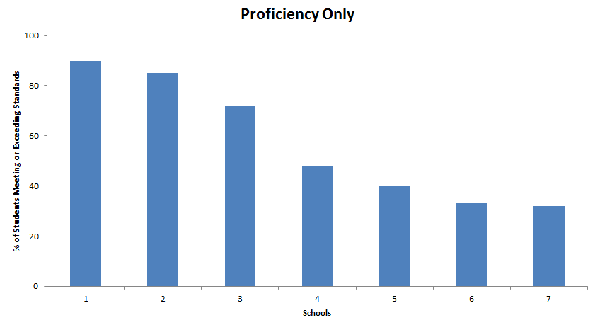
Proficiency + Growth = Better Evaluation

Slide 10
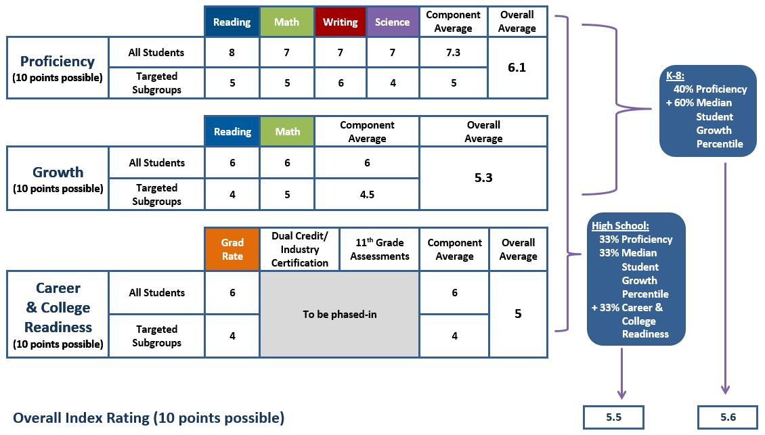
Revised Index

Slide 11
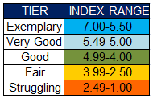
Tier Labels
Current Labels
Revised Labels
Intent is to establish initial distribution, then develop objective cut scores as we transition to Common Core. Ultimate goal: many more schools strive for and gravitate to ‘good’ ‘very good’ and ‘exemplary’ tiers.

Slide 12
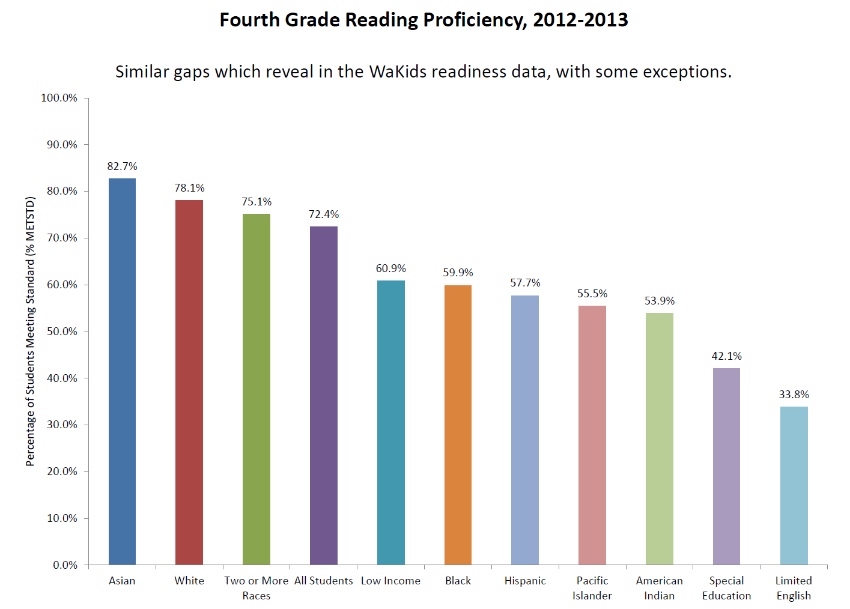
Growth vs. Proficiency Two different points of view

Slide 13
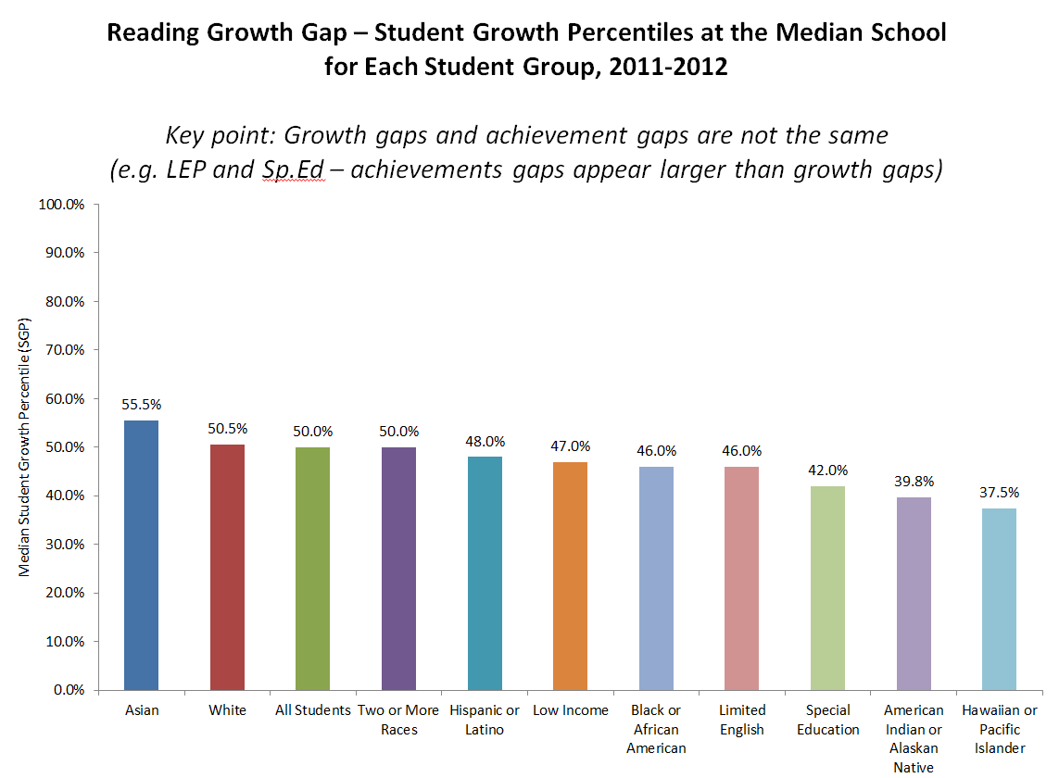
Growth vs. Proficiency Two different points of view

Slide 14
Impacts of Index Revisions
A Fairer way of evaluating what schools do.
Most schools have little control over which kids show up at their door, but they do have some control over how much academic growth those students experience once they are in school. Growth is what schools do!
The Index itself is less important than how its used -- how does it trigger resources and assistance for those schools that need it?
Senate Bill 5329 – More $ for assistance, stronger OSPI role.

Slide 15
Next steps
SBE adopts ‘accountability framework’ in rule, and works with OSPI to establish business rules on Priority, and Focus schools designations.
Negotiations with US Dept. of Education continue.
Data vetting process with districts.
Development of online tools and training opportunities.

Slide 16
Update on Grad Requirements Discussion

Slide 17
Graduation requirement guiding principles
All students should earn certain foundational high school course credits to meet the intent of Basic Education.
In the 21st century, all students need Science, Technology, Engineering and Math (STEM) skills; 3 credits of math and 3 credits of science are foundational courses credits.
High school electives are important, allowing choice in course-taking, providing the opportunity to explore a range of fields of knowledge, and allowing the opportunity to pursue certain postsecondary pathways.
Every student should have a High School and Beyond Plan by 9th grade or earlier, upon which all course-taking decisions will be based.
All students should be preparing for their life after high school; each student’s High School and Beyond Plan should identify a postsecondary pathway.

Slide 18
Postsecondary Pathways
Post-secondary pathways are locally determined, but should include, at least, the opportunity to:
Attend a skills center or pursue a Career and Technical Education program of study
Pursue a certificate or degree in a professional/technical program
Pursue a 4-year degree via a college, university, or college transfer program

Slide 19
Stakeholder Input
Stakeholder Input | Options
24-credit framework crowds out electives. | Show general electives as unchanged.
CTE pathways need to be incorporated. | Create “personalized pathway requirements.” Change “occupational education” credit to “Career and Technical Education.”
Make sure students have enough free electives to pursue courses at a skills center. | 4 electives + 3 personalized pathway requirements creates a combined 7 available credits.
Embrace a broader definition of college to include postsecondary education and training. | Use “pathways to postsecondary” as branding term for requirements.
The third credit of science and math make it harder for students to attend skills centers. | Develop state models of math and science course equivalencies. Students should get credit for the math and science they take at skills centers.

Slide 20
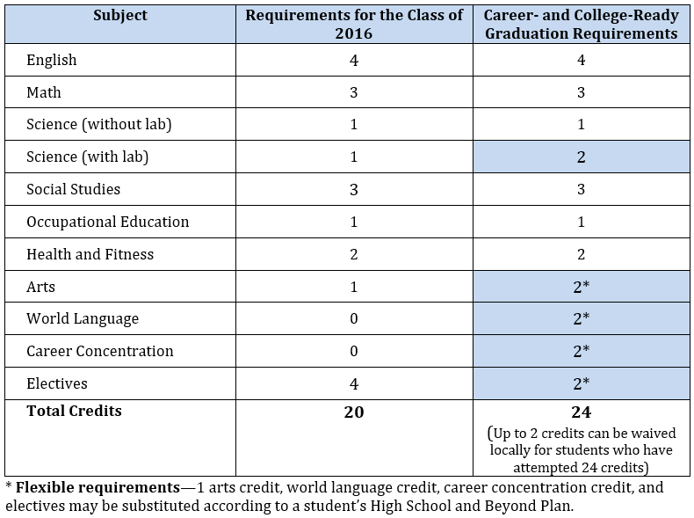
Previously Proposed Requirements

Slide 21
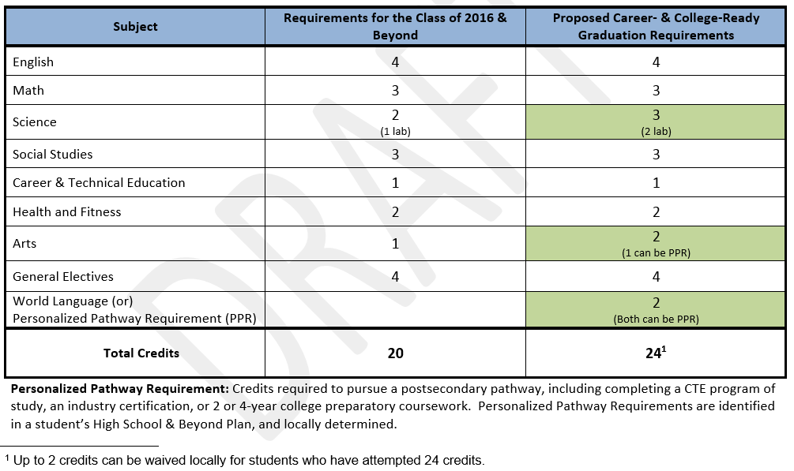
Currently Proposed Requirements

Slide 22
Changes to Basic Education the 1080 hour requirement

Slide 23
Change in instructional hour requirements for 2014-15
The basic education requirements for minimum instructional hours in grades 1-12 are revised as follows:
Through 2012-13 “BEFORE” | District-wide annual average 1,000 hours in grades 1-12
Beginning 2014-15 “AFTER” | 1,000 hours in each of grades 1-6 1,080 hours in each of grades 7-12

Slide 24
Instructional hours – what counts?
RCW 28A.150.205
“Instructional hours” means those hours students are provided the opportunity to engage in educational activity planned by and under the direction of school district staff, as directed by the administration and board of directors of the district, inclusive of intermissions for class changes, recess, and teacher/parent-guardian conferences that are planned and scheduled by the district for the purpose of discussing students' educational needs or progress, and exclusive of time actually spent for meals.
[1992 c 141 § 502.]
Shorthand interpretation: Start from when the first class begins, end when the last class is dismissed, and subtract out lunch.
Notes:
The following are questions and concerns from districts:
Can we count zero period?
Can we take short lunches?
What about before and after school programs we offer to all students – do they count?
Can we average the instructional hours within a grade across schools?
How are we going to provide professional development on Common Core? We can’t schedule PLC “late starts” or “early releases” anymore and still get to 1080 hrs.
Collective bargaining issues need to be resolved soon.
How does this effect our existing 180-day waivers?

Slide 25
What happens from here?
SBE has issued FAQ guidance on calculating hours for basic education compliance.
SBE will ask the Legislature to adopt a 24-credit graduation requirement framework for students who are seniors during the 2018-19 school year.
Restoring Learning Improvement Days (LIDs) will address some of the unintended consequences of this change on professional development in districts.

Slide 26
Timeline for charter authorizer applications WAC 180-19-030
Action | 2013 Approval Only | 2014 Approvals And Ongoing
District notice of intent to submit authorizer application. | April 1, 2013 | October 1, 2013
SBE must post authorizer application. | April 1, 2013 | October 1, 2013
Closing date to submit authorizer application to SBE. | July 1, 2013 | December 31, 2013
Closing date for SBE to approve or deny authorizer applications. | September 12, 2013 | April 1, 2014
Notes:
A key first task was to set a timeline for applications from districts to be authorizers. Two timelines:
A one-time, compressed timeline for the “launch year.” [Tried to balance the need to give all parties reasonable ability to do what they need to do with the ability to start at least some charter schools in fall 2014, if applicants are prepared to do so.]
A longer timeline for succeeding years that is much closer to best practices.
A couple of key dates there – Sept. 12, 2013 and Dec. 31, 2014, that we’ll turn to later.

Slide 27
Authorizer applications
Staff recommendation and Board approval of the Spokane authorizer application, September 11. Authorizing contract executed October 10.
Three districts submitted nonbinding notices of intent by October 1 for second round of applications, due by December 31:
Highline
West Valley (Yakima)
Tacoma
SBE decisions to approve or deny must be made by April 1, 2014.
Notes:
Looking now toward second round of district applications. . . .

Slide 28
First round of charter applications
Commission: 19 applications received.
One is from private school wishing to become public charter school. All others are for new schools.
Three are from charter management organizations (CMO’s), 16 “home-grown.”
Spokane
Three applications received, two of which are from CMO’s.
Authorizers have to Feb. 24 to approve or deny the applications.

Slide 29
Resources
Website: www.SBE.wa.gov
Blog: washingtonSBE.wordpress.com
Facebook: www.facebook.com/washingtonSBE
Twitter: www.twitter.com/wa_SBE
Email: sbe@sbe.wa.gov
Phone: 360-725-6025

