Slide 1
24 Credit Graduation Requirements and Rulemaking Process
Ben Rarick, Executive Director
May 22, 2014

Slide 2
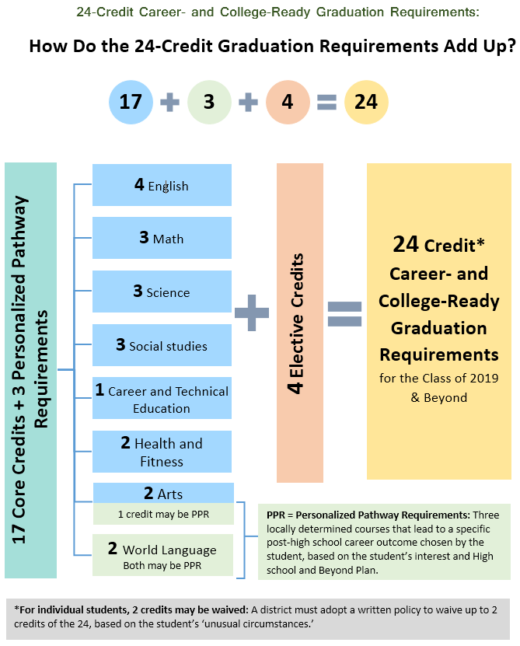

Slide 3
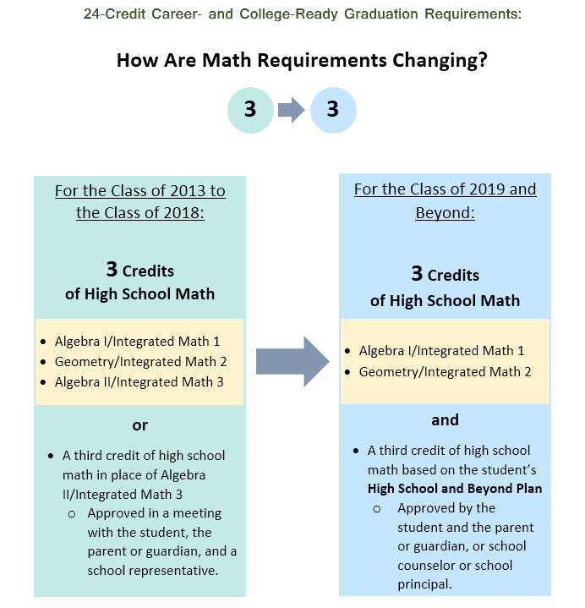

Slide 4
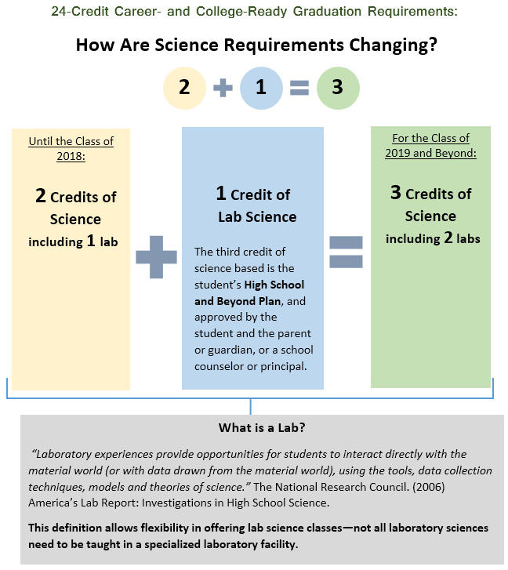

Slide 5
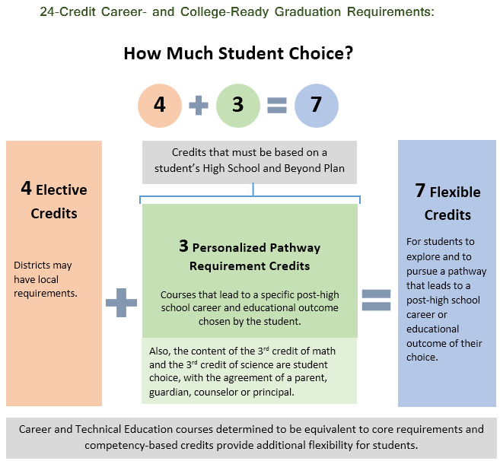

Slide 6
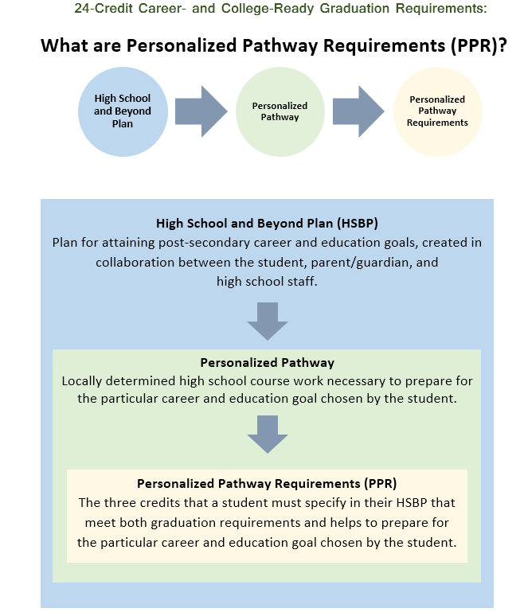

Slide 7
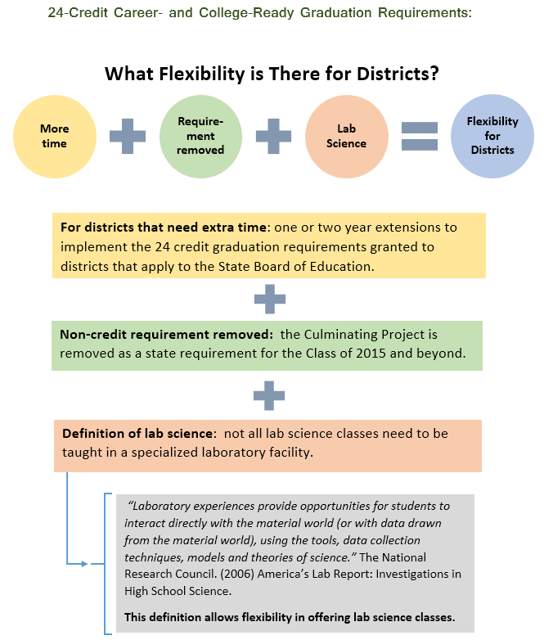

Slide 8
Outreach for Development of Draft Rules
Made initial outreach to education associations, others in March asking input on rules to SB 6552.
Held two meetings with stakeholder groups in April to review rule drafts, solicit comments and suggestions.
Met with Office of the Superintendent of Public Instruction staff:
Directors for Math, Science, and the Arts
Department of Teaching and Learning
Department of Career and Technical Education
Apportionment and Financial Services

