Slide 1
SBAC and High School Graduation Cut Scores
Improving Student Learning at Scale
October 22, 2014

Slide 2
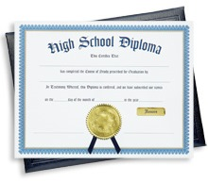
E2SSB 6552
Twenty-four credit requirements
for the Class of 2019
Extra time for districts that need it
Culminating projects eliminated as a state requirement
Flexible hour requirement
About $97 million redirected for:
Guidance counselors
Materials and operating costs
Reduce lab science class size

Slide 3
E2SSB 6552: CTE Course Equivalency
OSPI will develop a selected list of equivalent science and math Career and Technical Education (CTE) courses
Districts must offer at least one CTE math or one CTE science equivalent course
Districts with fewer than 2,000
may seek a waiver

Slide 4
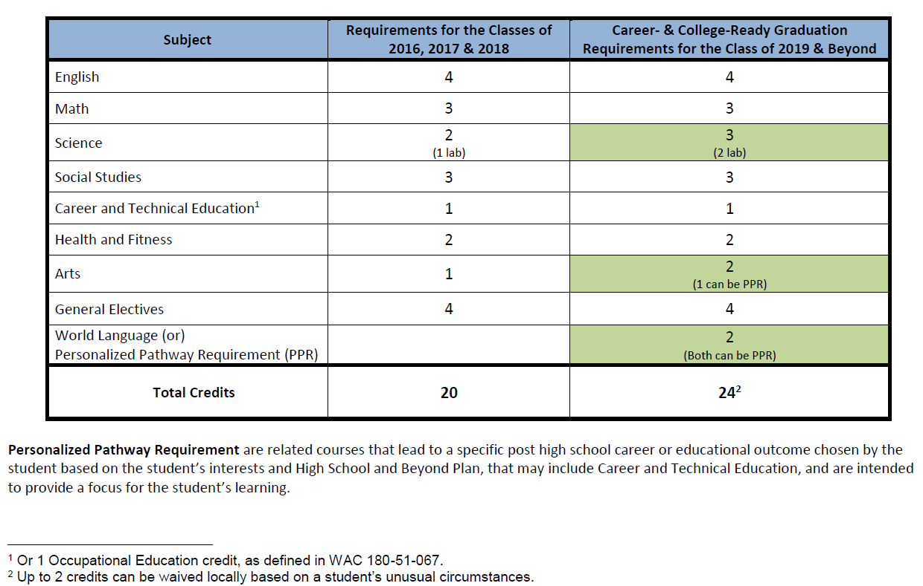
Graduation Course-Taking Requirements

Slide 5
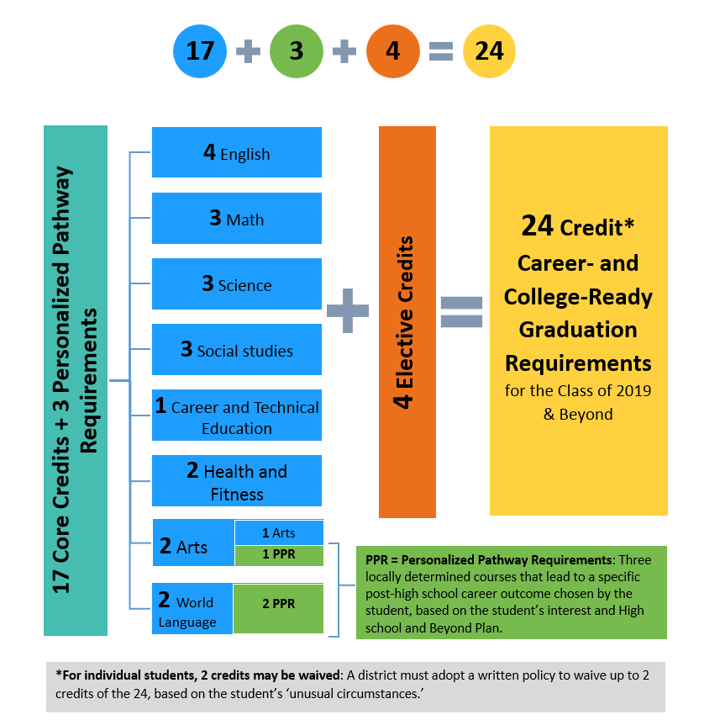
How Do the 24-Credit Graduation Requirements Add Up?

Slide 6
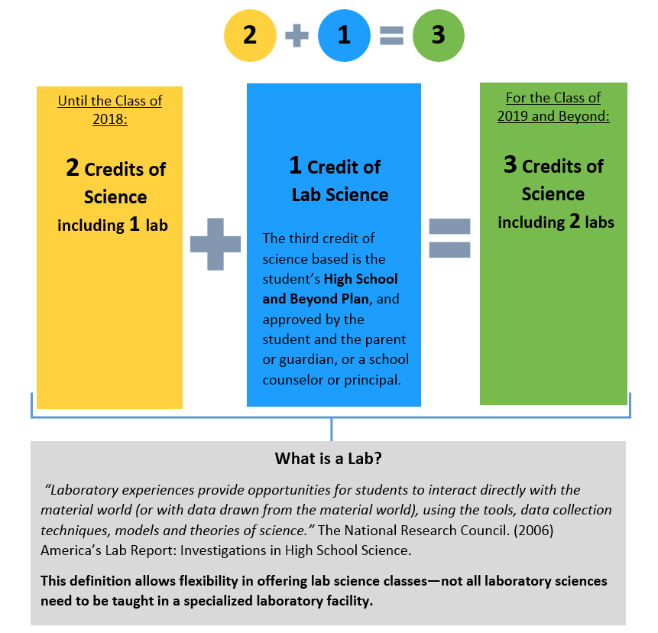
How Are Science Requirements Changing?

Slide 7
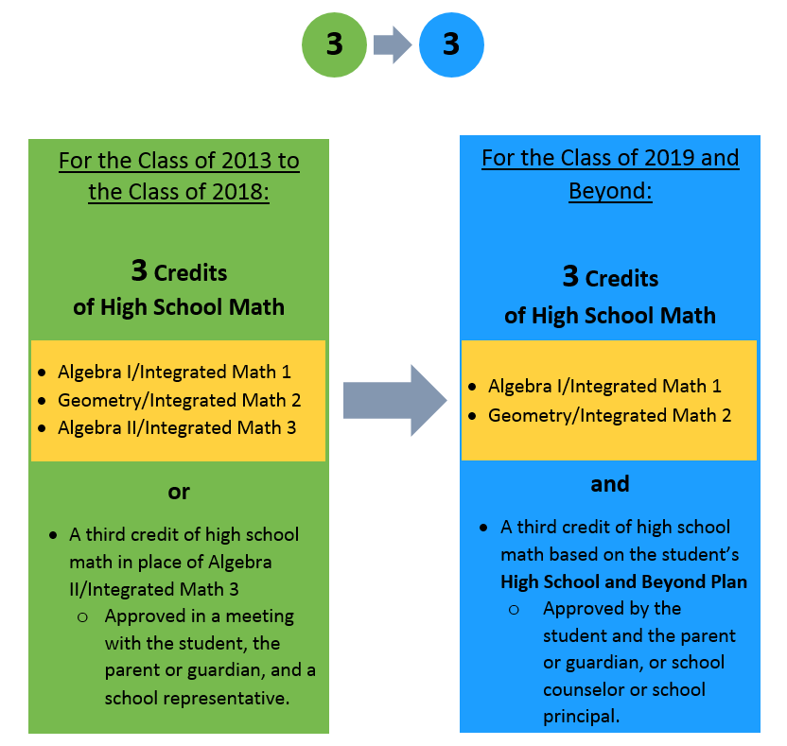
How Are Math Requirements Changing?

Slide 8
Transition to a Career- and College-Ready Assessment System
Up through the Class of 2014
Transition Classes of 2015 to 2018
Additional Options for Math and English Language Arts
Transition of 2019 and Beyond
Reading HSPE and Writing HSPE
Math End of Course
Biology End of Course
Biology End of Course
3 Assessments:
3 Assessments:
Math and English Language Arts SBAC
http://www.k12.wa.us/assessment/StateTesting/default.aspx

Slide 9
Agreement is being developed among 2- and 4-year institutions in Washington to use scores on the SBAC in placement decisions that allow students who achieve at a certain score to by-pass remedial college courses.
http://c2cwa.wordpress.com/about/

Slide 10
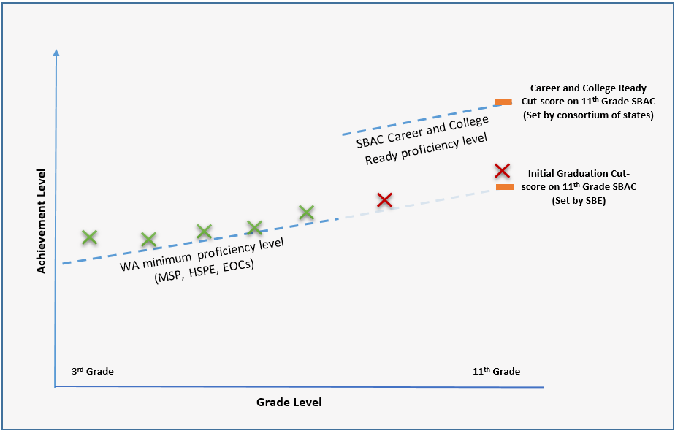
Graduation Cut-score on the 11th Grade SBAC

Slide 11
Resources
Website: www.SBE.wa.gov
Blog: washingtonSBE.wordpress.com
Facebook: www.facebook.com/washingtonSBE
Twitter: www.twitter.com/wa_SBE
Email: sbe@sbe.wa.gov
Phone: 360-725-6025

