Slide 1
24 Credit Graduation Requirement Framework
Ben Rarick,
Executive director

Slide 2
Graduation requirement guiding principles
All students should earn certain foundational high school course credits to meet the intent of Basic Education.
In the 21st century, all students need Science, Technology, Engineering and Math (STEM) skills; 3 credits of math and 3 credits of science are foundational courses credits.
High school electives are important, allowing choice in course-taking, providing the opportunity to explore a range of fields of knowledge, and allowing the opportunity to pursue certain postsecondary pathways.
Every student should have a High School and Beyond Plan by 9th grade or earlier, upon which all course-taking decisions will be based.
All students should be preparing for their life after high school; each student’s High School and Beyond Plan should identify a postsecondary pathway.

Slide 3
Postsecondary Pathways
Post-secondary pathways are locally determined, but should include, at least, the opportunity to:
Attend a skills center or pursue a Career and Technical Education program of study
Pursue a certificate or degree in a professional/technical program
Pursue a 4-year degree via a college, university, or college transfer program

Slide 4
Stakeholder Input
Stakeholder Input | Options
24-credit framework crowds out electives. | Show general electives as unchanged.
CTE pathways need to be incorporated. | Create “personalized pathway requirements.” Change “occupational education” credit to “Career and Technical Education.”
Make sure students have enough free electives to pursue courses at a skills center. | 4 electives + 3 personalized pathway requirements creates a combined 7 available credits.
Embrace a broader definition of college to include postsecondary education and training. | Use “pathways to postsecondary” as branding term for requirements.
The third credit of science and math make it harder for students to attend skills centers. | Develop state models of math and science course equivalencies. Students should get credit for the math and science they take at skills centers.

Slide 5
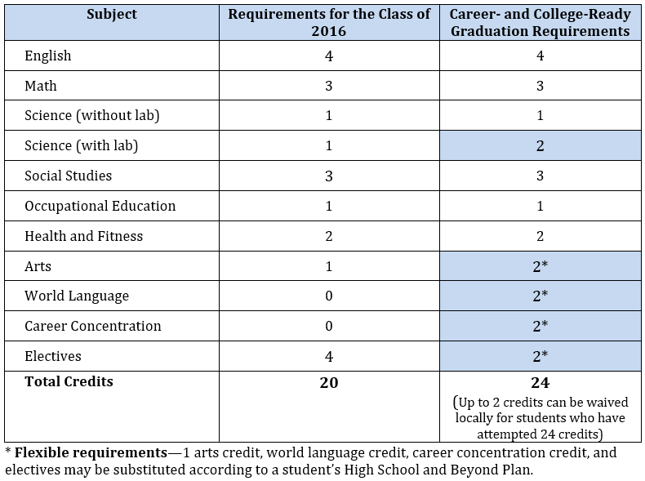
Previously Proposed Requirements

Slide 6
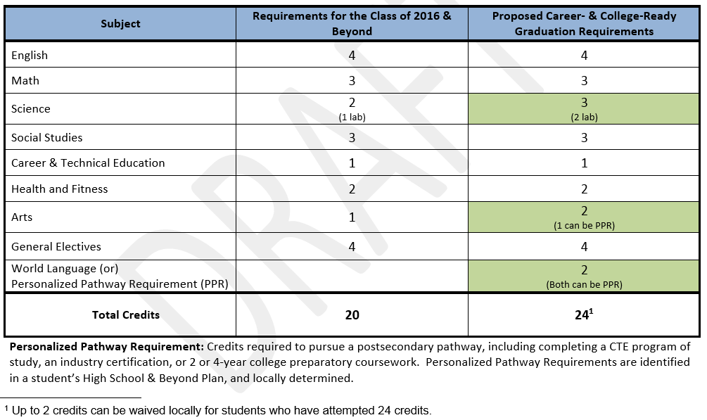
Currently Proposed Requirements

Slide 7
Resources
Website: www.SBE.wa.gov
Blog: washingtonSBE.wordpress.com
Facebook: www.facebook.com/washingtonSBE
Twitter: www.twitter.com/wa_SBE
Email: sbe@sbe.wa.gov
Phone: 360-725-6025

