Slide 1
ESSA Accountability Systems Workgroup / Technical Advisory Committee Update
State board of education
Special meeting - JUNE 20, 2017

Slide 2
Topics for today
School Quality or Student Success measures
Comprehensive Support: Identifying the lowest-performing 5 percent
Targeted Support: Consistently underperforming subgroups
Integrating the English Learner Measure
Extended graduation rates (5, 6, 7 year graduation rates)
Long-Term Goals

Slide 3
Accountability
Accountability
Recap
Academic Indicators
School Quality or Student Success
Proficiency
Growth
English Learner Progress
Elementary
Chronic Absenteeism
Middle School
Proficiency
Growth
English Learner Progress
Chronic Absenteeism
Chronic Absenteeism
High School
Proficiency
Graduation Rate
English Learner Progress
9th Graders on Track
Advanced Course-Taking (dual credit)

Slide 4
The Legislation Charge “Fair, Consistent and Transparent”
Unified system of support for challenged schools that:
Aligns with basic education,
Increases the level of support based upon the magnitude of need, and
Uses data for decisions.
RCW 28A.657.110
Notes:
A multiple measures approach: using multiple outcomes and indicators
Tools for continuous school improvement: use data to self-assess progress
Identifying and closing gaps
Acknowledging progress: identification of schools with exemplary performance

Slide 5
School Quality or Student Success Measures - Process
Analysis of Indicator Definitions: The TAC evaluated each indicator definition against five criteria using school-level data files and displays to inform the analysis.
1) Differentiation – Does the indicator meaningfully differentiate school performance?
2) Inclusion – Does the indicator meaningfully include historically underserved populations?
3) Data quality – Is the indicator reliable, comparable, and statewide?
4) Transparency – Is the Indicator easy for all stakeholders to understand and translate?
5) Objectivity – Is the Indicator objective?
The TAC analyzed multiple measurement options for each indicator against these questions to inform the final indicator recommendations.
Notes:
A multiple measures approach: using multiple outcomes and indicators
Tools for continuous school improvement: use data to self-assess progress
Identifying and closing gaps
Acknowledging progress: identification of schools with exemplary performance

Slide 6
Comprehensive Support Framework

Slide 7
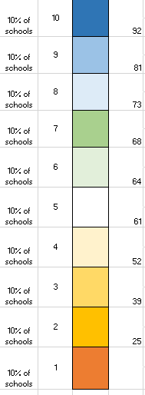
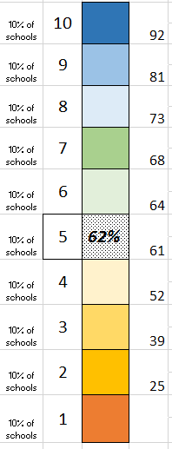
School performance by measure
1-10 scale, such that ~10% of schools in each– an even spread of schools from 1-10
Cut points (thresholds) will be frozen for at least several years
School’s performance on a measure translates to a box (decile)
School can see how to move up, for each measure, over time

Slide 8
Multiple Measures Framework
This view allows schools to see measures where they face most challenges.

Slide 9
Multiple Measures –separated by content area
This view allows schools to see measures where they face most challenges.

Slide 10
Combined Multiple Measures & Lowest performing 5%
Combine Weighted to Priority
Set a threshold of Combined Multiple Measures to include the lowest performing 5%; these would the Comprehensive Support Schools.
The same threshold would be used for subgroup identification for Targeted Support
ID’ed for Comprehensive Support

Slide 11
Use Comprehensive Threshold to Identify Subgroups for Targeted Support
Combined Multiple Measure
Threshold For Comp Support
Identified for Targeted Support

Slide 12
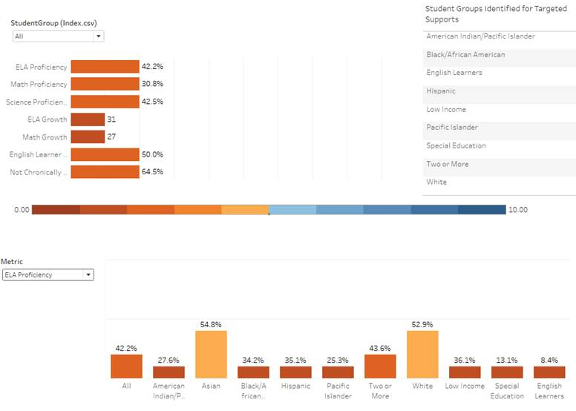
Multiple Measures – Dashboard Mockup

Slide 13
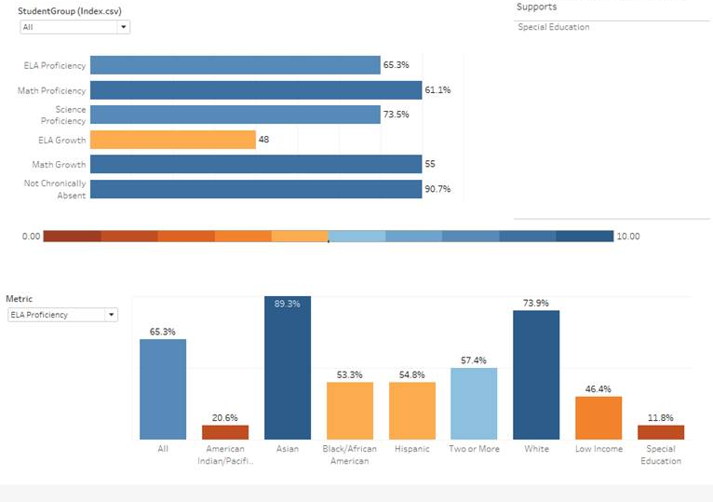
Multiple Measures – Dashboard Mockup

Slide 14
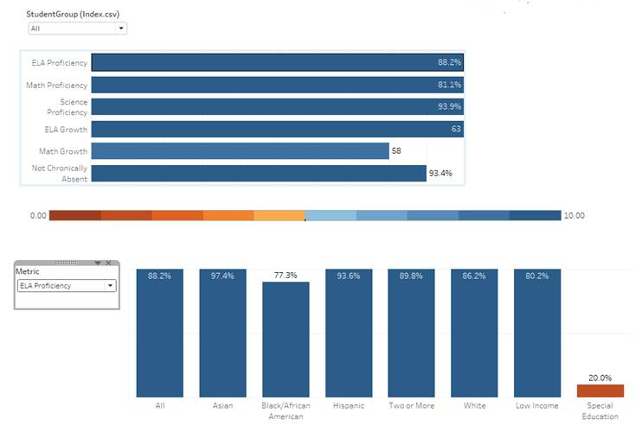
Multiple Measures – Dashboard Mockup

Slide 15
Extended Graduation Rate
ASW Recommended to Include 5, 6, and 7 year grad rates

Slide 16
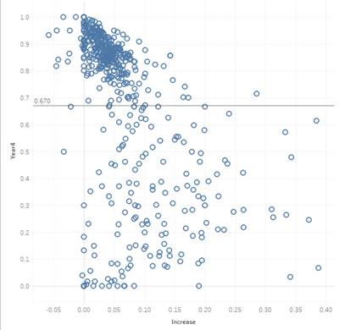
Class of 2015: 4-year rate and increase from 4- to 5- year graduation rate
Class of 2015: 4-year rate and increase from 4- to 5- year graduation rate
Schools that start with lower 4-year rates see much larger increases from 4 to 5 year

Slide 17
Extended Grad Rate Options – Score Boost based on Increase from 4-year Rate
4 Year
Grad Rate
5 Year
Grad Rate
6 Year
Grad Rate
7 Year
Grad Rate
5
50%
55%
65%
70%
3
Base score would be based on the 4-Year Grad Rate.
Look at percentages of students who are graduating in extended timeframe (5th, 6th, or 7th year). Schools that are graduating the most students (high end of the distribution) would be awarded 1 or 2 points, to be added to base score.
3/10/2016

Slide 18
English Learner Proficiency Progress Measure

Slide 19
English Learner Progress Measure - Considerations
EL Progress is included in comprehensive support framework (along with proficiency, growth, grad, and SQSS)
Consideration: Use the EL indicator as a stand alone measure to identify low-performing schools for targeted support. This would be a separate category of targeted support, in addition to consistently underperforming subgroups (in combined multiple measures).

Slide 20
Multiple Measures – Include in Comp Calc

Slide 21
Multiple Measures – ID Bottom 5% for Targeted
Identified for Targeted Support

Slide 22
English Learner Progress Measure - Considerations
Consideration: Proportionally adjust the weights of ELA Proficiency and English Learner progress based on EL population size.
For schools with larger EL populations – more weight would be given to English Learner progress.

Slide 23
Option #2: Proportionally adjust ELA Proficiency and ELP Progress based on population size
Option #2: Proportionally adjust ELA Proficiency and ELP Progress based on population size
23

