Slide 1
SBE Update to the
ESD 113 Superintendents
Regional Meeting
Ben Rarick, Executive Director
May 28, 2014

Slide 2
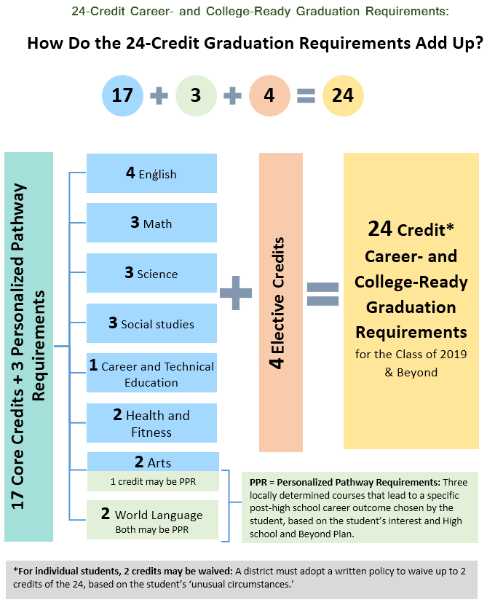

Slide 3
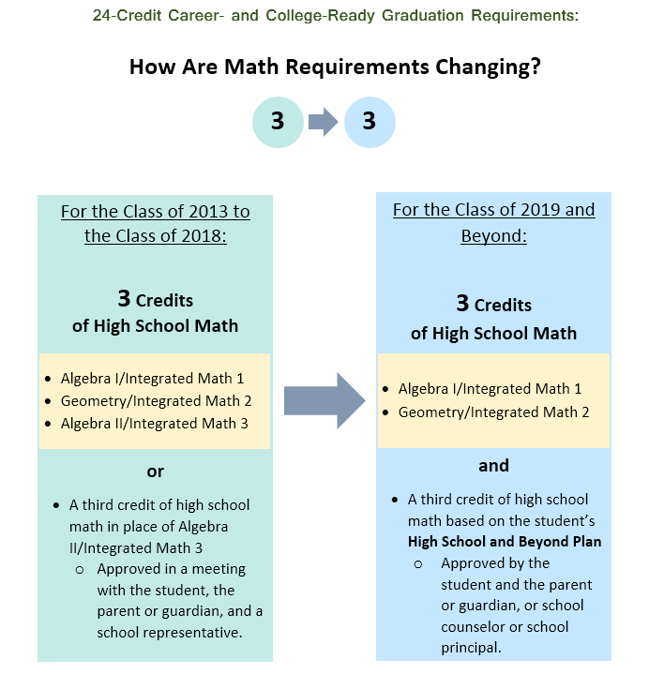

Slide 4
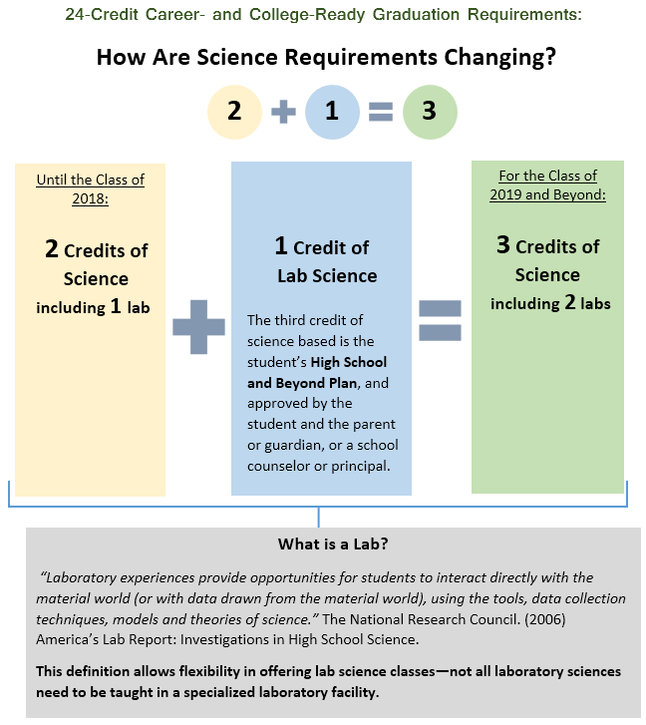

Slide 5
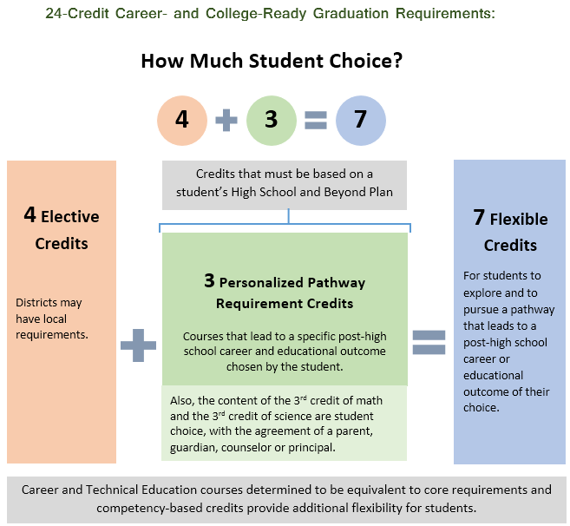

Slide 6
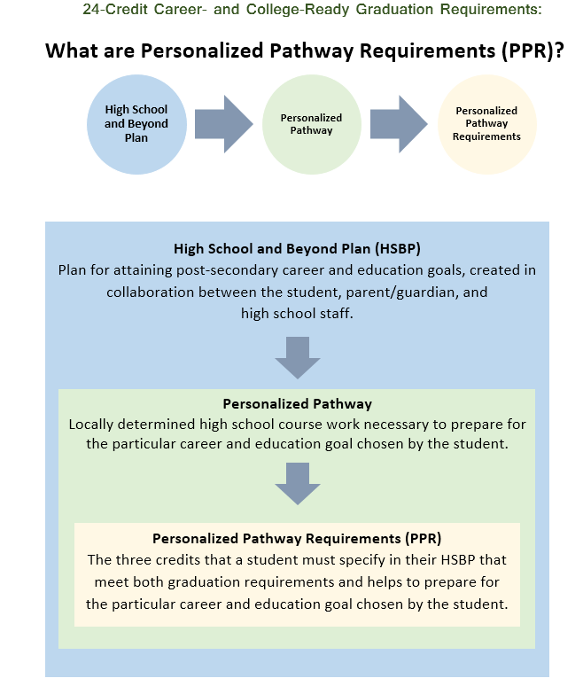

Slide 7
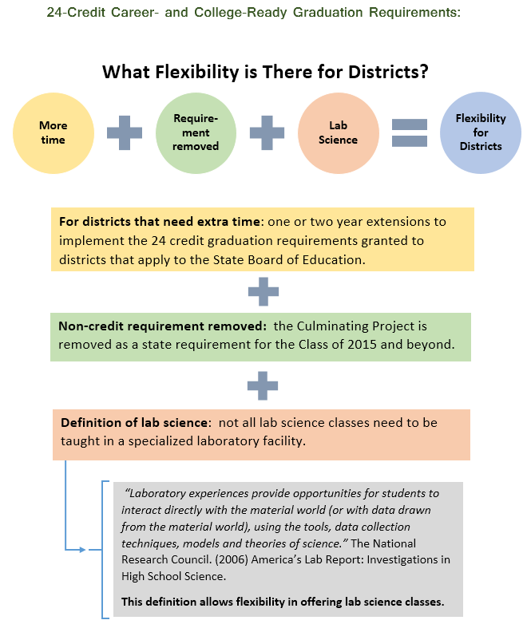

Slide 8
Outreach for Development of Draft Rules
Made initial outreach to education associations, others in March asking input on rules to SB 6552.
Held two meetings with stakeholder groups in April to review rule drafts, solicit comments and suggestions.
Met with Office of the Superintendent of Public Instruction staff:
  Directors for Math, Science, and the Arts
  Department of Teaching and Learning
  Department of Career and Technical Education
  Apportionment and Financial Services

Slide 9
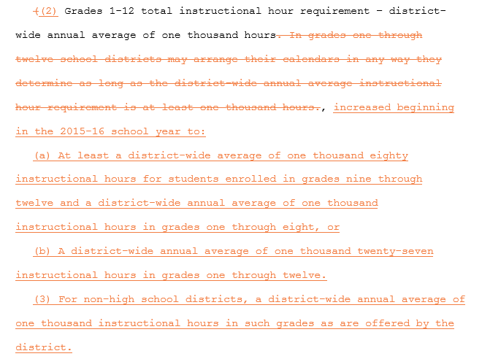
Proposed Draft Rules on Instructional Hour Requirement
Amending WAC 180-16-200:

Slide 10
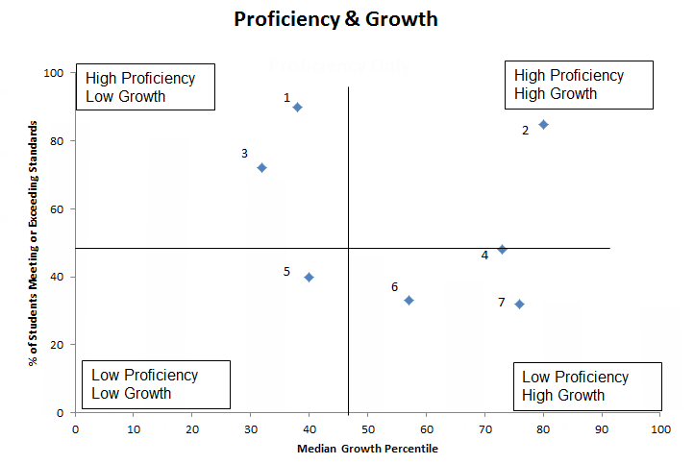
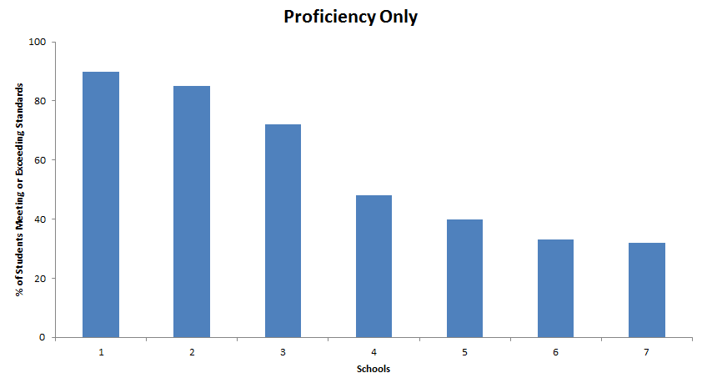
Proficiency + Growth = Better Evaluation

Slide 11
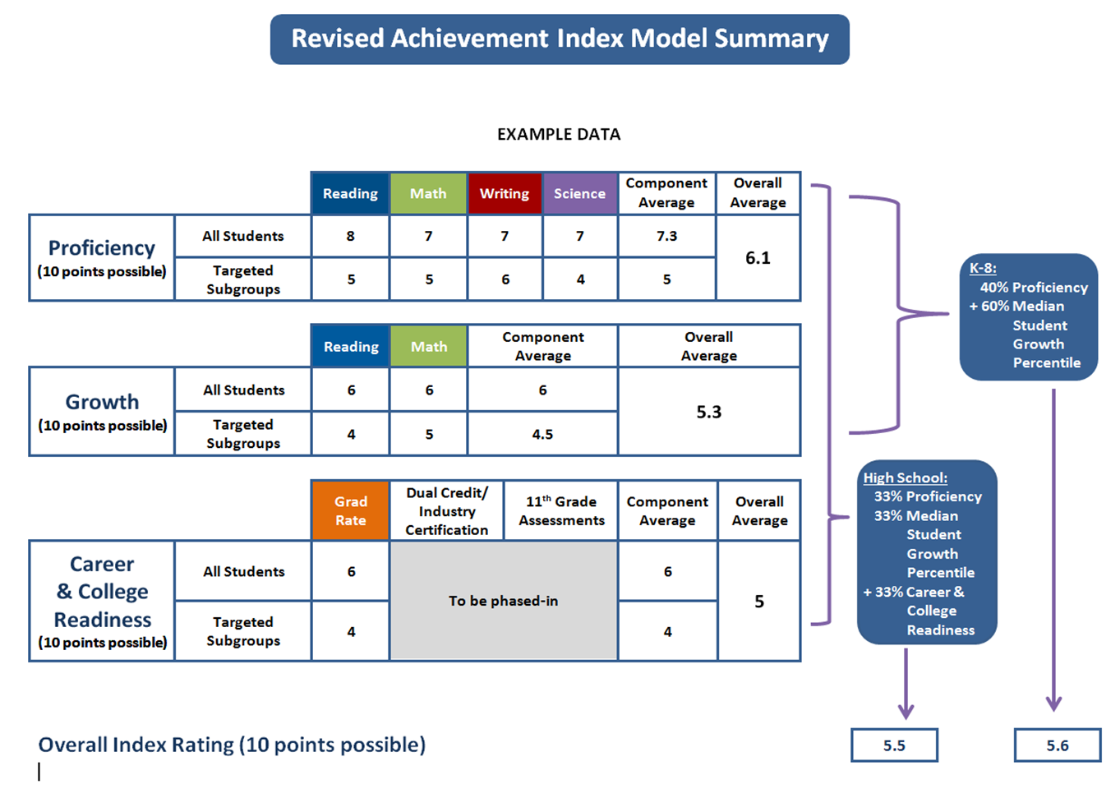

Slide 12
Achievement Award-Winning Schools in ESD 113
Beacon Avenue Elementary
Black Lake Elementary
Boston Harbor Elementary
Capital High School
Cosmopolis Elementary
Edison Elementary
Fort Stevens Elementary
George Washington Bush Middle School
Hoquiam High School
Jefferson Lincoln Elementary
Jefferson Middle School
Lacey Elementary
Leland P Brown Elementary
Morton Elementary
North River School
North Thurston High School
Ocosta Junior Senior High
Onalaska High School
Pacific Beach Elementary
Pleasant Glade Elementary
Simpson Avenue Elementary
South Bend High School
Southside Elementary
Stevens Elementary
Timberline High School
Toledo High School
Tumwater Middle School
Winlock Middle School
Winlock Senior High School
Yelm High School

Slide 13
Highest Growth Schools in ESD 113
District | School | % FRL | 3-Year Average MGP
 |  |  | Reading | Math | Reading and Math
Tumwater SD | Black Lake ES | 31.16 | 74.7 | 65.0 | 69.8
Tumwater SD | East Olympia ES | 31.88 | 65.8 | 70.2 | 68.0
Olympia SD | Jefferson MS | 42.43 | 69.5 | 66.2 | 67.8
Toledo SD | Toledo HS | 45.67 | 55.3 | 70.3 | 62.8
North Beach SD | Pacific Beach ES | 77.78 | 50.8 | 74.3 | 62.6
South Bend SD | South Bend Comp. HS | 57.35 | 52.5 | 70.8 | 61.7
Olympia SD | Boston Harbor ES | 17.22 | 60.3 | 63.0 | 61.7
Tumwater SD | Michael T Simmons ES | 37.76 | 64.5 | 54.3 | 59.4

Slide 14
Priority School Identification
Other Low
5 schools in the bottom 5 percent in reading or math for 3 years.
Continuing Priority – 25 schools currently implementing Priority Turnaround models.
Achievement Index – 18 schools with the lowest Composite (3-Year) Index rating.
Graduation Floor – 11 schools with a 3-Year average graduation rate < 60 percent.
Proficiency Floor – 61 schools with a 3-Year average reading and math proficiency rate < 40 percent.
Cont. Priority
Index
Low Grad
Low Proficiency

Slide 15
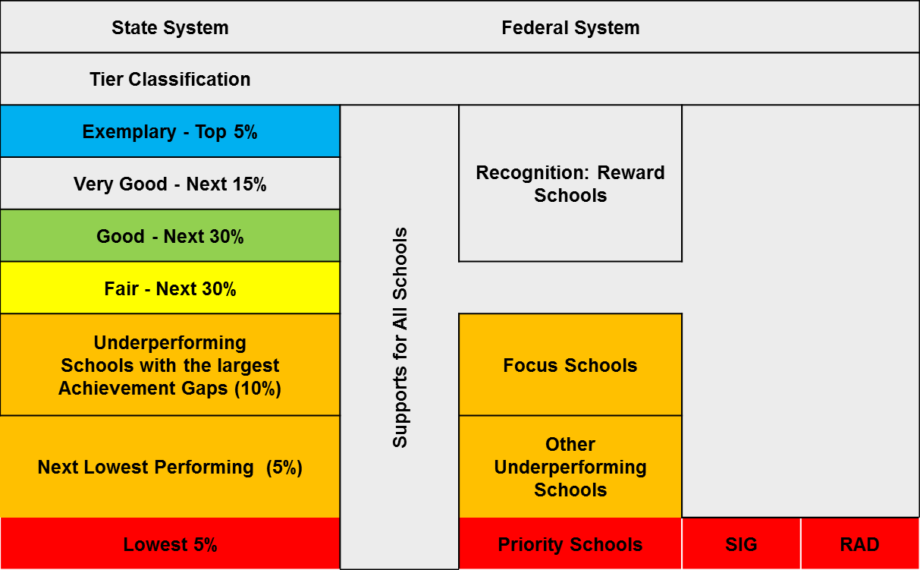
Differentiated Supports and Recognition

Slide 16
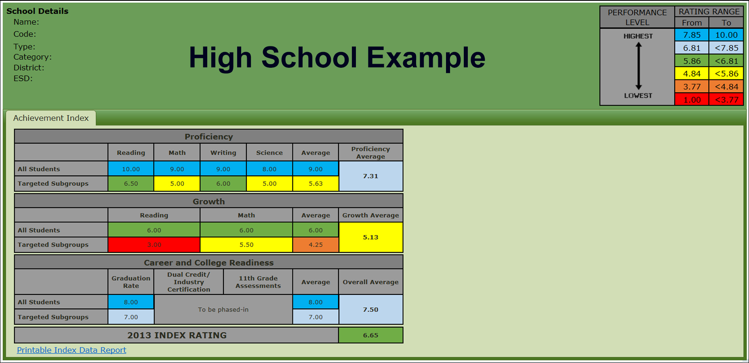
Display of Index Information

