Slide 1
24 Credit Requirements & Challenges, 1000/1080 Instructional Hours
Ben Rarick,
Executive Director
March 14, 2014

Slide 2
Graduation Requirement Guiding Principles
All students should earn certain foundational high school course credits to meet the intent of Basic Education.
In the 21st century, all students need Science, Technology, Engineering and Math (STEM) skills; 3 credits of math and 3 credits of science are foundational course credits.
High school electives are important, allowing choice in course-taking, providing the opportunity to explore a range of fields of knowledge, and allowing the opportunity to pursue certain postsecondary pathways.
Every student should have a High School and Beyond Plan by 9th grade or earlier, upon which all course-taking decisions will be based.
All students should be preparing for their life after high school; each student’s High School and Beyond Plan should identify a postsecondary pathway.

Slide 3
Background
November 2010
SBE adopts a 24-Credit Framework
Changes with no cost implemented
4 credits English and 3 credits Social Studies for Class of 2016
January 2014
SBE adopts a revised 24-Credit Framework for Class of 2019
2013 Legislature
Funding to support opportunity to earn 24 credits
Implementation pending Legislative approval
Implementation pending Legislative approval and funding

Slide 4
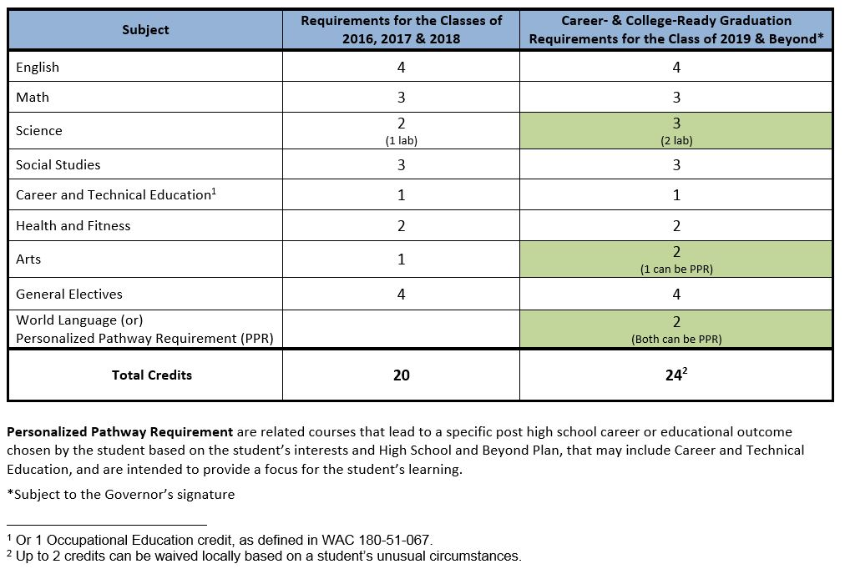
Graduation Requirements

Slide 5
HIGHLIGHTS ENGROSSED SECOND SUBSTITUTE SENATE BILL 6552 (as passed Legislature – pending Governor’s signature)
More Flexible Instructional Hour Requirements
1000 hours in grades 1-8 & 1080 hours in grades 9-12, “all of which may be calculated… using a district-wide annual average… over grades one through twelve.” (read: average of 1027 hours)
$97 million provided for instructional hours increase last year is “redirected” to guidance counselors, supplies, class size.
SBE to implement 24 career and college-ready framework for the Class of 2019.
Individual school districts shall receive 1 or 2-year implementation extensions by filing with the state board of education.
The culminating project is eliminated as a high school graduation requirement.
The third credit of math and science are student choice, based on HSBP, with the approval of a counselor, principal, parent, or guardian.
SBE must allow districts to waive 2 credits for a student, on a case-by-case basis, based on “unusual circumstances.”
Districts must adopt local policies to administer this waiver, and WSSDA is to develop a model policy and make available for districts.
Districts must offer at least one CTE math and at least one CTE science equivalency course. Districts with fewer than 2000 kids can seek a waiver. OSPI, w/ SBE, to develop more standardized approach to CTE equivalency in math & science.
A new task force is created on success of students with special needs. Headed up by Office of Education Ombuds. SBE is a member of this task force.
*This is an initial interpretation. Rules will ultimately implement these provisions and districts should not use this presentation in place of rule language.

Slide 6
Postsecondary Pathways
Postsecondary pathways are locally determined, but should include, at least, the opportunity to:
Attend a skills center or pursue a Career and Technical Education program of study
Pursue a certificate or degree in a professional/technical program
Pursue a 4-year degree via a college, university, or college transfer program

Slide 7
Stakeholder Input
Stakeholder Input | Options
24-credit framework crowds out electives. | Show general electives as unchanged.
CTE pathways need to be incorporated. | Create “personalized pathway requirements.” Change “occupational education” credit to “Career and Technical Education.”
Make sure students have enough free electives to pursue courses at a skills center. | 4 electives + 3 personalized pathway requirements creates a combined 7 available credits.
Embrace a broader definition of college to include postsecondary education and training. | Use “pathways to postsecondary” as branding term for requirements.
The third credit of science and math make it harder for students to attend skills centers. | Develop state models of math and science course equivalencies. Students should get credit for the math and science they take at skills centers.

Slide 8
Frequently Asked Questions
What about Lab Science Facilities?
The National Research Council defines laboratory experiences as “opportunities for students to interact directly with the material world (or with data drawn from the material world), using the tools, data collection techniques, models and theories of science.” This definition allows many laboratory experiences that do not require specialized laboratory facilities.
What about struggling students?
The SBE graduation requirement resolution allows for 2 credits to be locally waived for students who attempt 24 credits.
What about CTE pathways?
SBE supports increasing opportunities for students to earn math and science equivalency credit in CTE programs. Equivalency in other subject areas may also allow greater flexibility in students’ schedules, for example ‘The Big History’ class taught for both a third credit of science and a social studies credit.

Slide 9
Frequently Asked Questions
What about Special Needs students?
Under existing law, students with IEPs may have accommodation, including exemption from graduation credit requirements, if their individual limitations directly impede their progress toward graduation (WAC 180-51-115).
Are more credits linked to a more meaningful diploma?
Most entering college students need to take pre-college level classes; better preparation addresses the gap between high school graduation and college-readiness.
70% of voters think schools should expect more of students in STEM subjects, and 92% thought students with a better foundation in STEM subjects will have more opportunities (WA STEM survey, 2012).
33 other states require 3 or more credits of science to graduate.
SBE believes in districts’ ability to deliver quality in all the courses they offer; 109 districts already require 24 or more credits to graduate; 51 require 3 or more credits of science.

Slide 10
Frequently Asked Questions
What about student guidance?
The Legislature has recognized the need for increased guidance and support with increased graduation requirements
Both chambers included increased allocations for counselors in their budgets
Counselors play a critical rule in helping students create meaningful High School and Beyond Plans
SBE is exploring available tools and best practices in Washington and other states for supporting rigorous High School and Beyond Plans that incorporate students’ personalized pathways

Slide 11
1,080 Hour Requirement
Completed FAQ guidance for field.
Most concerns are about:
Funding considerations
Lack of clarity in link between additional hours and a larger policy objective
The professional development needs of districts vis a vis late starts/early releases
Our view was that FAQ guidance was more appropriate vehicle than rule-writing, since law had not changed on definition of hours

Slide 12
Change in instructional hour requirements for 2014-15
The basic education requirements for minimum instructional hours in grades 1-12 are revised as follows (unless changed by the Legislature):
Through 2012-13 “BEFORE” | District-wide annual average 1,000 hours in grades 1-12
Beginning 2014-15 “AFTER” | 1,000 hours in each of grades 1-6 1,080 hours in each of grades 7-12

Slide 13
Instructional hours – what counts?
RCW 28A.150.205
“Instructional hours” means those hours students are provided the opportunity to engage in educational activity planned by and under the direction of school district staff, as directed by the administration and board of directors of the district, inclusive of intermissions for class changes, recess, and teacher/parent-guardian conferences that are planned and scheduled by the district for the purpose of discussing students' educational needs or progress, and exclusive of time actually spent for meals.
[1992 c 141 § 502.]
Shorthand interpretation: Start from when the first class begins, end when the last class is dismissed, and subtract out lunch.
Notes:
The following are questions and concerns from districts:
Can we count zero period?
Can we take short lunches?
What about before and after school programs we offer to all students – do they count?
Can we average the instructional hours within a grade across schools?
How are we going to provide professional development on Common Core? We can’t schedule PLC “late starts” or “early releases” anymore and still get to 1080 hrs.
Collective bargaining issues need to be resolved soon.
How does this effect our existing 180-day waivers?

Slide 14
5-Day Exemption for Seniors
Five-day statutory exemption for senior commencement activities is difficult to implement when instructional hour requirements are applied by grade.
May be unintended consequence; Legislative fix may be warranted.

Slide 15
Questions?

Slide 16
Resources
Website: www.SBE.wa.gov
Blog: washingtonSBE.wordpress.com
Facebook: www.facebook.com/washingtonSBE
Twitter: www.twitter.com/wa_SBE
Email: sbe@sbe.wa.gov
Phone: 360-725-6025

