Slide 1
Development of a Revised Accountability Framework

Slide 2
Topics for Discussion
Revising the Achievement Index
Implementing Charter Schools Law

Slide 3
Why Revise the Achievement Index?
ESEA Waiver opens the door . . .

Slide 4
Index Principles

Slide 5
Revised Index Scoring
Moving from a seven-point scale to a 10-point scale
Lens on achievement gap -- moves from low-income vs. non low-income to incorporation of individual federal subgroups.
Targeted Subgroups (e.g. Opportunity Gap) – half of overall Index score, and included in every performance indicator
Typical federal accountability business rules will apply:
Non-continuously enrolled students not included in school Index rating
Multiple years of data used
Participation rates of 95%

Slide 6
What is Changing?
Revised Index:
Removes peers, improvement indicators
Adds SGP growth in reading and math for grades 4-8 and high school
Will disaggregate by every federal subgroup
Incorporates “Ever ELL” approach to language learners.
In future years, adds dual credit/industry certification rates for high schools

Slide 7
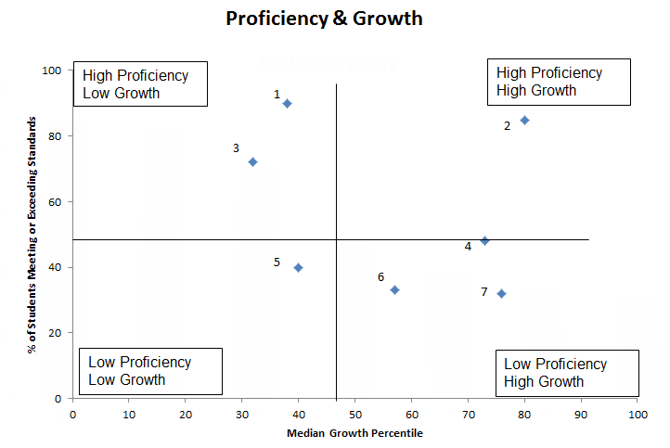
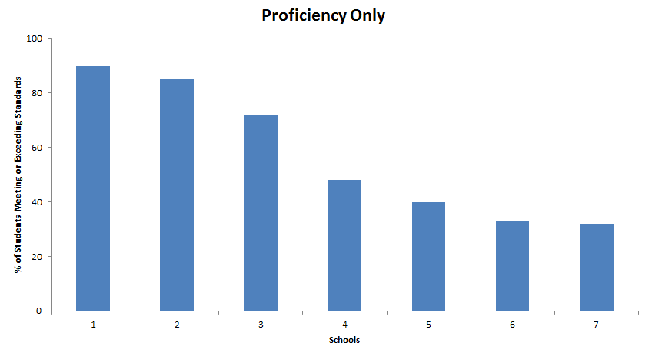
Proficiency + Growth = Better Evaluation

Slide 8
Current Index

Slide 9
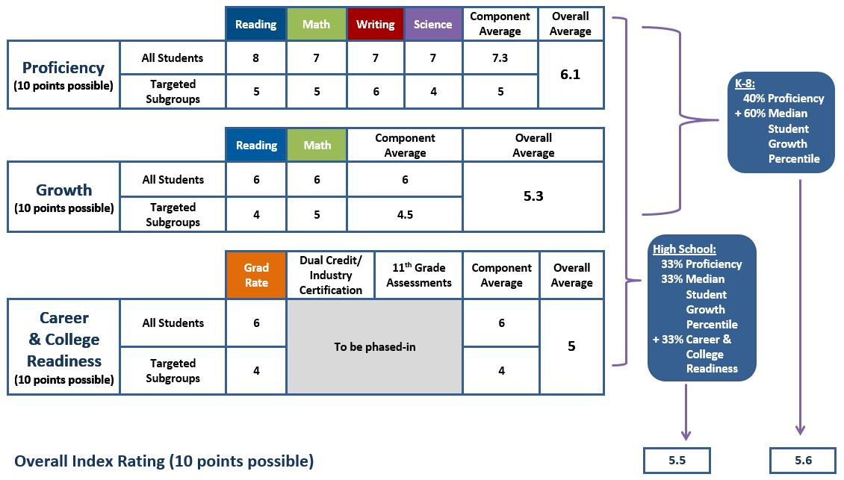
Revised Index

Slide 10
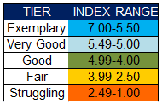
Tier Labels
Current Labels
Revised Labels
Intent is to establish initial distribution, then develop objective cut scores as we transition to Common Core. Ultimate goal: many more schools strive for and gravitate to ‘good’ ‘very good’ and ‘exemplary’ tiers.

Slide 11
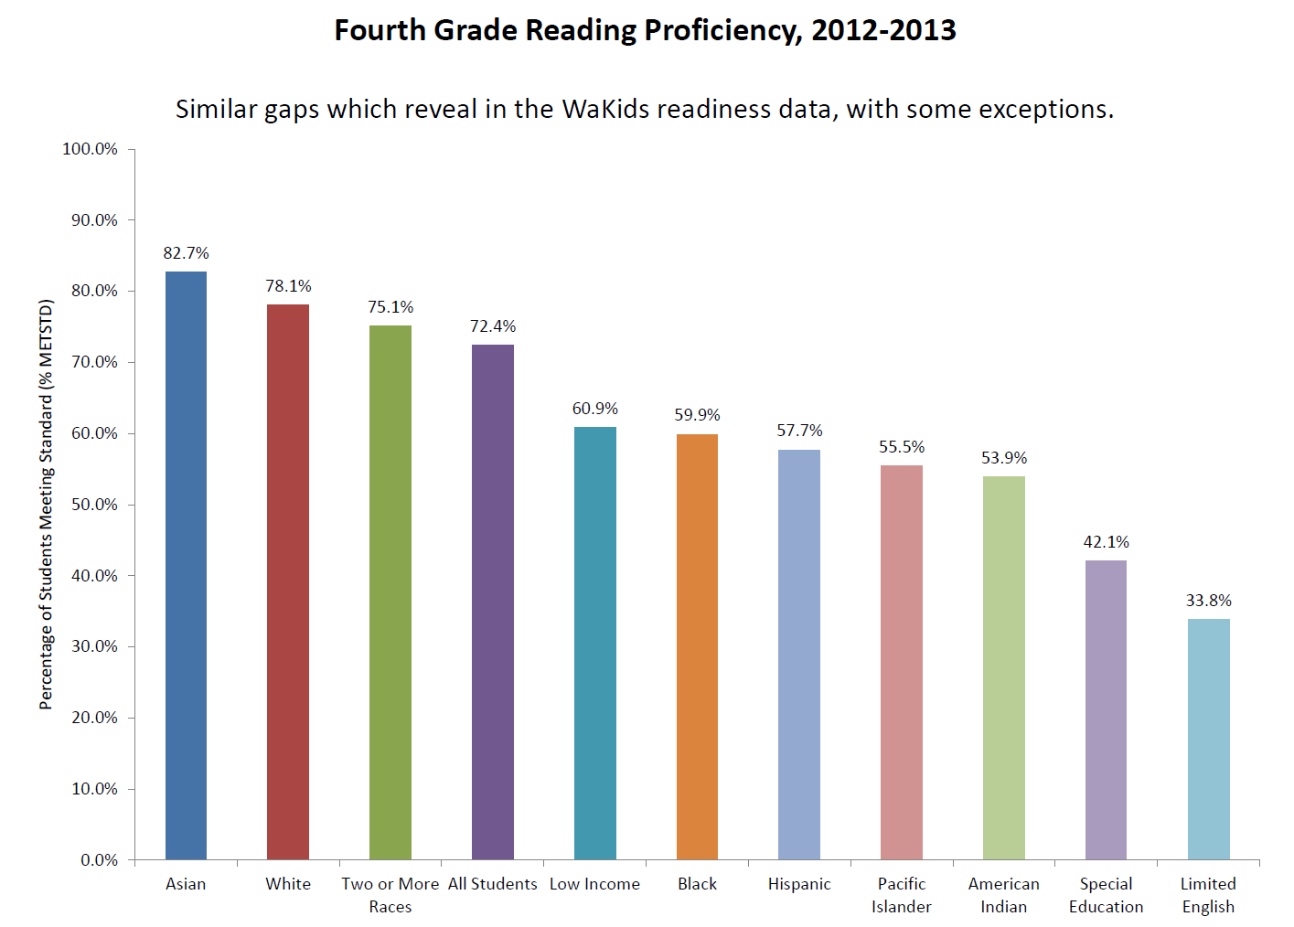
Growth vs. Proficiency Two different points of view

Slide 12
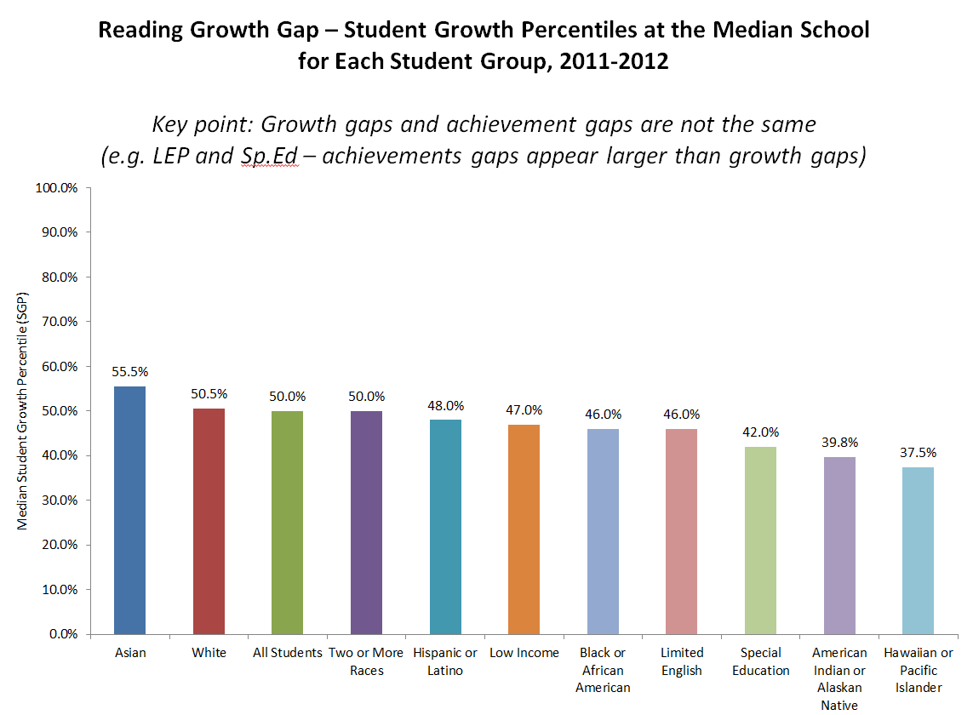
Growth vs. Proficiency Two different points of view

Slide 13
Impacts of Index Revisions
A Fairer way of evaluating what schools do.
Most schools have little control over which kids show up at their door, but they do have some control over how much academic growth those students experience once they are in school. Growth is what schools do!
The Index itself is less important than how its used -- how does it trigger resources and assistance for those schools that need it?
Senate Bill 5329 – More $ for assistance, stronger OSPI role.
SBE OPPOSES A – F grading proposals.

Slide 14
Ever ELL
SBE decided to replace the ‘ELL’ subgroup with an ‘Ever ELL’ subgroup in the revised Achievement Index submitted to the U.S. Dept. of Education.
The ‘ELL’ subgroup consists ONLY of students currently in TBIPs.
An ‘Ever ELL’ subgroup would consist of current AND former ELL students.
The goal: recognize that language learners have needs after exit, and incorporate long-term approach to ELL evaluation
“Just as many ELLs achieve success, they leave the category”

Slide 15
Next steps
SBE adopts ‘accountability framework’ in rule, and works with OSPI to establish business rules on Priority, and Focus schools designations.
Negotiations with US Dept of Education continue.
Data vetting process with districts.
Development of online tools and training opportunities.

Slide 16
Resources
Website: www.SBE.wa.gov
Blog: washingtonSBE.wordpress.com
Facebook: www.facebook.com/washingtonSBE
Twitter: www.twitter.com/wa_SBE
Email: sbe@sbe.wa.gov
Call: 360-725-6025

