Slide 1
AWSP Board Meeting SBE Liaison Report
Ben Rarick,
Executive Director
September 25, 2014

Slide 2
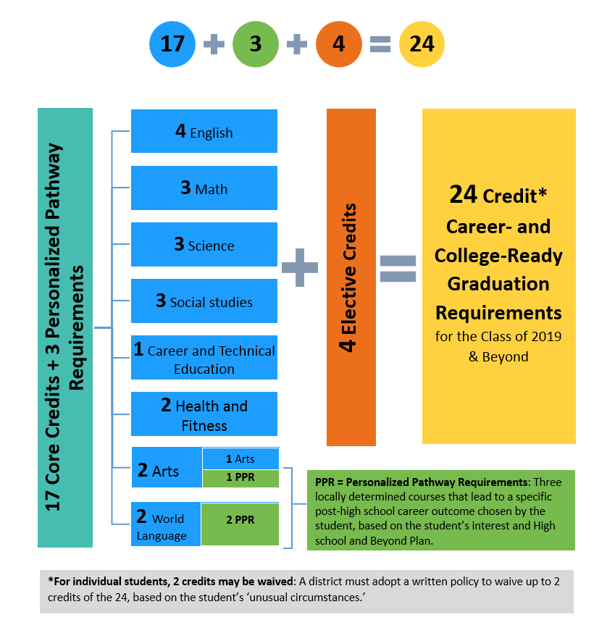
How Do the 24-Credit Graduation Requirements Add Up?

Slide 3
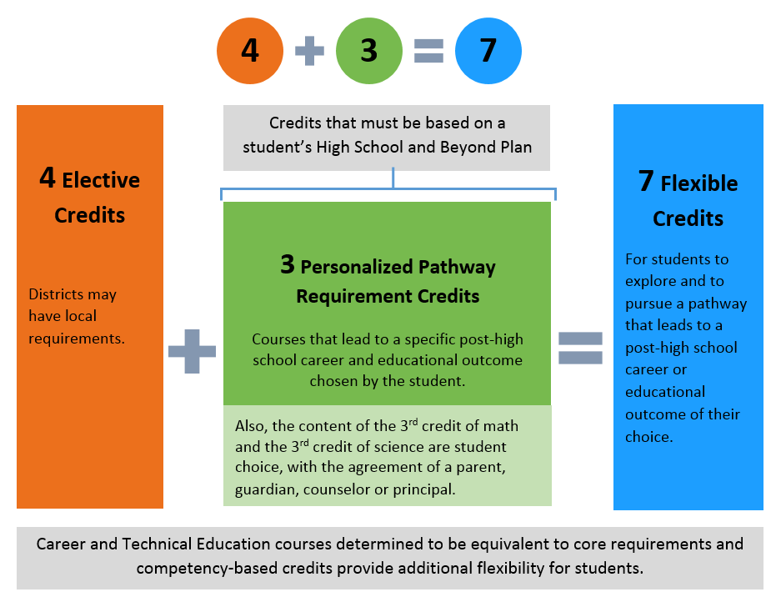
How Much Student Choice?

Slide 4
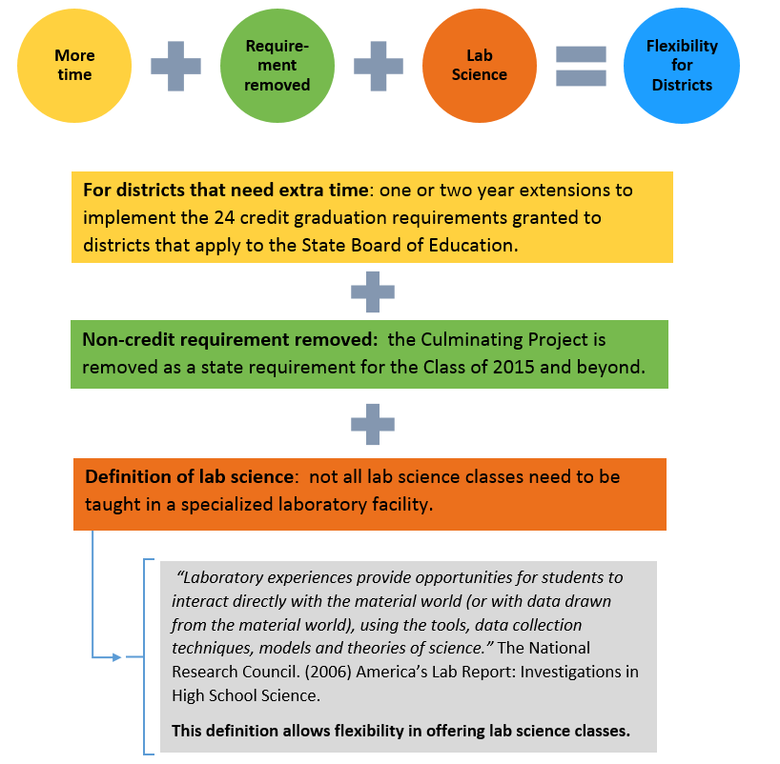
What Flexibility is There for Districts?

Slide 5
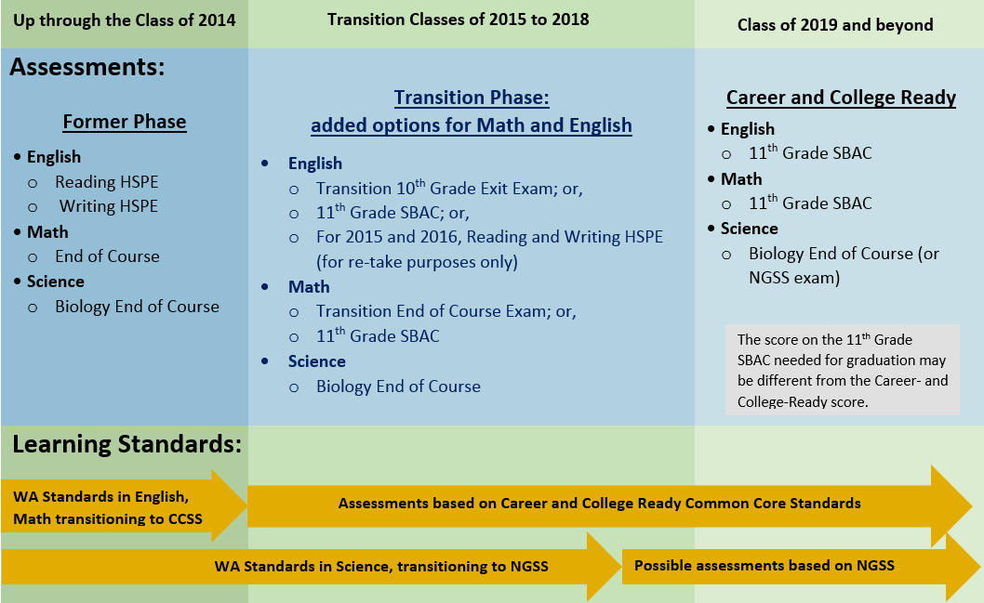
Transition to a Career- and College-Ready Assessment System

Slide 6
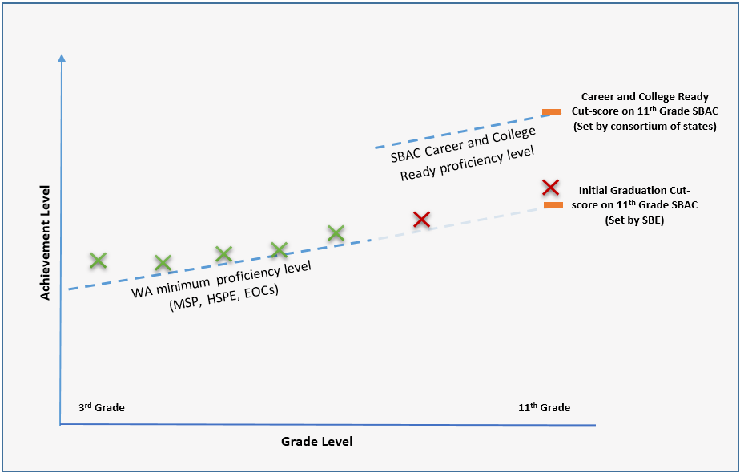
Graduation Cut-score on the 11th Grade SBAC

Slide 7
The High School and Beyond Plan
Will guide students’ personalized pathway and third credit of math and science choices
SBE working with partners to ensure students have access to high-quality, meaningful HSBP

Slide 8
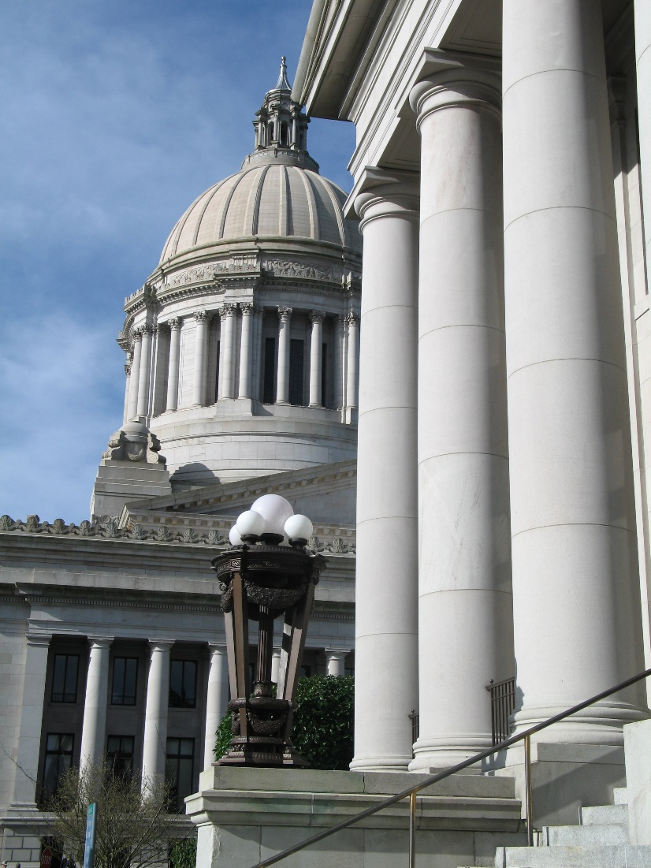
McCleary School Funding Resolution
On September 10, 2014, the Board, in view of its statutory responsibility to provide strategic oversight of the public education system, voted to adopt a resolution suggesting six guiding principles to the Legislature in the performance of its duties to ensure that ample provision is made for all students, in a general and uniform system of public schools.

Slide 9
Six Guiding Principles
Any consideration of delaying the timeline for compliance with McCleary orders should be weighed against the consequences those delays will have on entering cohorts of kindergarten students and their opportunity to ultimately realize the goals of the program of basic education.
The Board affirms that there can be no credible plan to make ample provision for public schools that does not include new revenue to the state budget.
Proposals to increase funding for public schools by decreasing funding in other state programs should be viewed not merely through the lens of Court compliance, but also in view of the ultimate impact on students and their families. Scaling back social service programs, or early and higher education programs, may help narrowly satisfy Court compliance requirements but may also compromise progress towards the goals of the program of basic education.
A comprehensive school funding solution should include a substantial increase in the state funding share accompanied by some additional clarity on the intended limits of local levy authority or spending. However, proposals that seek to merely exchange taxing authority between the state and local governments in a revenue neutral way, such that overall funding to public schools remains roughly constant while only the source of revenues changes, are highly unlikely to materially improve outcomes for students and families. What is needed is not different dollars; what is needed is more dollars.
The Board further affirms that a comprehensive statewide accountability program continues to be an essential element to any significant McCleary investment in public schools. In addition to school-level accountability, such a system should include explicit goals for student outcomes at a system-wide level, as well as self-imposed, reciprocal elements of accountability for the Legislature in the event that it cannot fulfill its duties under law, even as schools and students are expected to fulfill theirs.
The Board affirms that Washington’s system of public schools has the potential to be the best in the world, and could serve as a case study of best practice public education for other states and nations. The Board urges the Legislature to embrace this challenge, and to process all school funding decisions with the success of each student in mind.

Slide 10
Resources
Website: www.SBE.wa.gov
Blog: washingtonSBE.wordpress.com
Facebook: www.facebook.com/washingtonSBE
Twitter: www.twitter.com/wa_SBE
Email: sbe@sbe.wa.gov
Phone: 360-725-6025

