Slide 1
House Education Committee:
ESSB 5491 Indicators of Educational Health
Ben Rarick, State Board of Education, Executive Director

Slide 2
Systems Perspective on Educational Health
Attainment is the ultimate objective of the educational system
  All students should be planning for education or training beyond high school
Closing the large and persistent opportunity gap is a requirement to reach this objective
Integration and alignment across agencies is an enabling strategy to monitor system health
Notes:
Somebody should ask how the “Opportunity Gap” is being defined for purposes here.
The 5491 post-high school indicators as originally specified measured “engagement” rather than “attainment”

Slide 3
Guiding Principles
Meet the requirements of ESSB 5491
Build on the learning and conversations underway across agencies
  The goal is not always obvious
  Improvement takes time & resources
  System alignment is a key goal
  Deliver the best we can today and plan for a better future
Notes:
The impact of additional resources today may not be realized for years down the road – takes time.

Slide 4
Stakeholder Input on ESSB 5491
Partner agencies, Achievement and Accountability Workgroup, and district and ESD leadership
Key stakeholder input
  Need a phased approach to account for changes in assessments
  Raise the prominence of English language acquisition
  Increased rigor: Writing & Science are missing
  Align and leverage district and school accountability measures
  Align with recent research on systemic measures of leading indicators toward postsecondary attainment

Slide 7
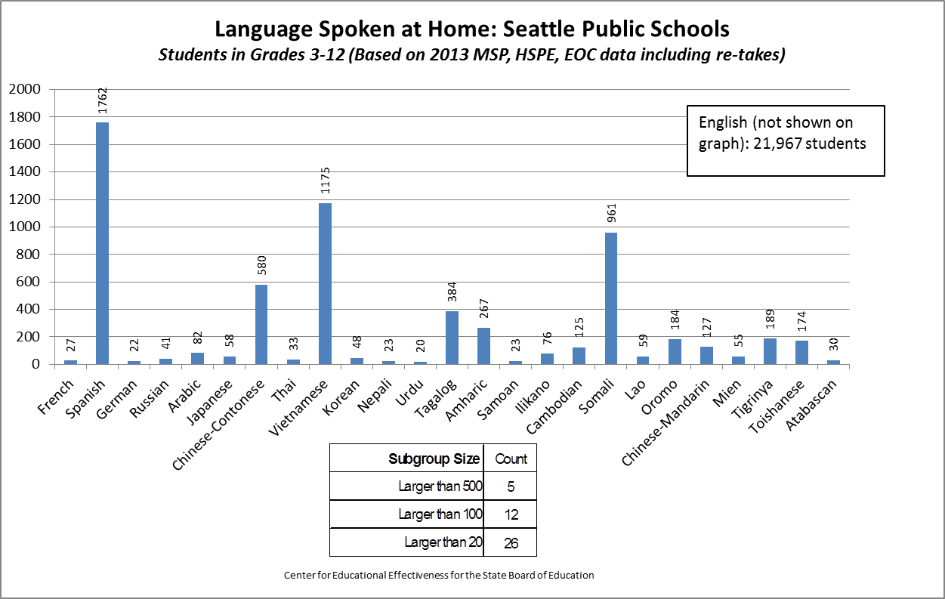
Goals Need to be Sensitive to Diversity of Student Needs
Notes:
CEDARS collects information on home languages and race/ethnicity meaning that disaggregation beyond the ESEA subgroups is possible. However, the value added from deeper drill down has yet to be determined.

Slide 8
Specific Indicators in ESSB 5491
(Current Law)
The following statewide indicators of educational system health are established:
  The percentage of students demonstrating the characteristics of entering kindergartners in all six areas identified by the Washington kindergarten inventory of developing skills administered in accordance with RCW 28A.655.080;
  The percentage of students meeting the standard on the fourth grade statewide reading assessment administered in accordance with RCW 28A.655.070;
  The percentage of students meeting the standard on the eighth grade statewide mathematics assessment administered in accordance with RCW 28A.655.070;
  The four-year cohort high school graduation rate;
  The percentage of high school graduates who during the second quarter after graduation are either enrolled in postsecondary education or training or are employed, and the percentage during the fourth quarter after graduation who are either enrolled in postsecondary education or training or are employed; and
  The percentage of students enrolled in precollege or remedial courses in college.

Slide 9
The Gap Starts Early

Slide 10
Bridge the Gap Between High School and Postsecondary
Notes:
Is this true? Has the remediation rate remained essentially unchanged for the five previous years?

Slide 11
December 2013 Initial Report
Details for each of the ESSB 5491-specified indicators
  status of each data element
  goals for each indicator
Focus is on refinement for the future based on the conversations occurring across agencies
  additional and different indicators
  necessity for resetting goals (CCSS and SBAC)
  SBAC field test flexibility
Notes:
Someone might ask, “why do new baselines and goals need to be set?”
Someone might ask, “how will the SBAC field test impact current measures?”

Slide 12
Recommended Revisions
Key Indicator: Postsecondary Attainment
  The percentage of high school graduates attaining certificates, credentials (AA/BA), and completing qualified apprenticeships by age 26
  The percentage of high school graduates who during the second quarter after graduation are either enrolled in postsecondary education or training or are employed, and the percentage during the fourth quarter after graduation who are either enrolled in postsecondary education or training or are employed
Notes:
Revisions are shown in bold font.

Slide 13
Recommended Revisions
Quality of Secondary Diploma
  The percentage of high school graduates enrolled in precollege or remedial courses in public postsecondary educational institutions (within 4 years of high school graduation)
  The percentage of students meeting standard on the 11th grade SBAC College and Career Readiness Assessment
  The percentage of students who have reached English language proficiency on the state language proficiency assessment in grades K-11

Slide 14
Recommended Revisions
Extended 5-Year Graduation Rate
The percent of students graduating using the 5-year (extended) graduation rate data
Supporting indicator (per ESSB 5491): 4-year cohort graduation rate

Slide 15
Recommended Revisions
8th Grade Readiness for High School
Reading, Math, and Science: The percent of students meeting standard on 8th grade state assessments
English Language Acquisition: The percentage of students who have reached English language proficiency on the state language proficiency assessment in grades K-8
Growth Gap Indicator: The percentage decrease in student growth percentiles (using Achievement Index Growth measure)

Slide 16
Recommended Revisions
3rd Grade Reading
  The percent of students meeting standard on the third grade Reading (English / Language Arts under the Common Core State Standards) assessment
  The percentage of students who have reached English language proficiency on the state language proficiency assessment in grades K-3

Slide 17
Recommended Revisions
Kindergarten Readiness
  Percent of students demonstrating the characteristics of entering kindergarteners on all six areas of Wa-KIDS
Access to Quality Schools
  The percent of students attending schools at, or above, the “Good” tier of the revised OSPI/State Board of Education Achievement Index

Slide 18
Summary: System Perspective
Attainment is the ultimate objective of the educational system
Closing the large and persistent opportunity gap is a requirement to reach this objective
  Monitoring student growth rates is essential
Integration and alignment across agencies is an enabling strategy to monitor system health

Slide 19
ESSB 5491 Goal Summary: Application of Initial Targets
Indicator | Current State | Comparative across states or Nation? | 2012-2013 results | Change per year (PPPY=percentage points per year) | Goal- Change Per Year | 2013-’14 Goal | 2020 Endpoint
WA-KIDS: Percent of students who demonstrate the characteristics of entering kindergartners in all 6 domains | 2012. N=20,700 students in 118 schools. Biased toward high- need schools. | No | 37.2% | N/A | +5.2 | 42.4% | 68.6%
4th Grade Reading | Stable with extensive historical data. | No | 72.4% | +0.19 PPPY | +2.3 | 74.3% | 85.8%
8th Grade Math | Stable with extensive historical data. | No | 53.2% | +0.87 PPPY | +3.9 | 58.3% | 77.8%
High School Graduation Rate- 4 Year Cohort | Stable with extensive historical data | Yes | 77.2% | +1.35 PPPY | +1.9 | 79.1% | 88.5%
Percents of graduates enrolled or employed in 2nd and 4th quarter after graduation
Postsecondary Education | All students | Yes | 60% | -0.10 PPPY | +3.3 | 63.3% | 80.0%
Postsecondary Employment | Approx. 50% of graduates w/ SSN | TBD | TBD | TBD | TBD | TBD | TBD
Percentage of students enrolled in precollege or remedial courses
Attending 2-Year | Stable | Yes | 57.0% | -0.20 PPPY | -4.8 | 52.7% | 28.8%
Attending 4-Year | Stable | Yes | 11.0% | -0.20 PPPY | -.96 | 10.5% | 5.8%
Notes:
Goals on this chart are for the “All Students” group.
Somebody should ask whether or not incremental goals were set for subgroup improvement.
How do the subgroup targets compare to the targets shown here?
For the 4th Grade Reading, when 0.19 PPPY is demonstrated, do you believe a 2.3 percent increase per year is both “rigorous and achievable?”

