Slide 1
2017 Legislature and Governor’s Proposed 2017-19 K-12 Budget
Kaaren Heikes, Director of Policy & Partnerships
January 9, 2017 / ESD 113

Slide 2
What has transpired since the Board adopted its 2017 legislative priorities?
Election results were finalized
Legislative chambers have established their organization (leadership and committees)
Governor Inslee has released his proposed K-12 budget for the 2017-19 biennium
The Education Funding Task Force has held several meetings and concluded
Key K-12 stakeholder groups have circulated their 2017 legislative agendas
SBE staff have had many meetings with Legislators, the Governor’s staff, and key stakeholders to collaborate, stay informed, and move your legislative priorities forward
The Washington 2017 Legislature has convened, committees have met, etc.

Slide 3
Legislative Election Results
House of Representatives
14/98 new members in the House (14% new)
50 Democrats
48 Republicans
Senate
8/49 new members in the Senate (16% new)
25 in Republican Caucus
24 in Democratic Caucus

Slide 4
Legislative Leadership and Key Committees
Leadership, Education and $ Committees
(pp 4-6 in PDF)
Senate: Page 42 in packet
House: Pages 43-44 in packet
Do you live in any of the legislative districts of legislators in leadership positions or on key committees?
Do you know any of legislators in leadership position or on key committees? Or do you know someone who has relationship/influence with one?

Slide 5
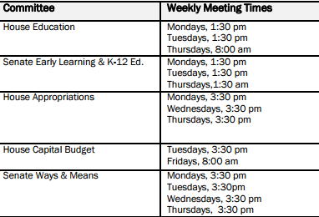
Meeting Schedules of Key Committees

Slide 6
2017 Session Bill Cutoffs
Key dates:
February 17 - Policy Committee Cutoff
February 24 – Fiscal Committee Cutoff
March 8 – House of Origin Cutoff
March 29 – Policy Committee Cutoff (opposite Chamber)
April 4 – Fiscal Committee Cutoff (opposite Chamber)
April 12 – Opposite Chamber Cutoff
2017 Session Cutoff Calendar

Slide 7
Governor’s Proposed K-12 Budget
Each year, by law, the Governor is required to submit budget proposals (Operating Budget, Capital Construction Budget, and Transportation Budget) to the Legislature by December 20th.
Governor Inslee released his proposed 2017-19 biennial budget over the course of a week in mid-December. His K-12 budget debuted first, a $3.85 billion K-12 funding package along with a revenue package to fund it.
The Governor’s K-12 education budget is entitled “Putting Washington’s Students First.”

Slide 8
Governor’s 2017-2019 budget: Fundamental Goals
Fully fund K-12 schools in next biennium
Solve fundamental state budget challenge
Increase school funding in all districts; honor local control and decision making
Launch major overhaul of mental health system
Continue efforts to prevent and reduce homelessness
Continue progress on clean energy, environment
Preserve safety net for vital services
We cannot cut our way to success to meet major challenges
Source: OFM
Notes:
K-12 is top priority in Governor Inslee’s 2017-19 proposed budget.

Slide 9
Putting Washington’s Students First
Three major areas, or “planks:”
Recruit, Retain, and Continuously Train Great Educators ($2.96 billion)
Close the Opportunity Gap ($865.8 million)
Engage Students ($26.1 million)

Slide 10
Summary of Governor’s Proposed K-12 Budget
WA STEM is matching this $10 million

Slide 11
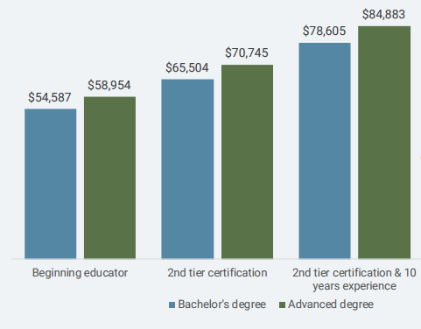
Teacher Compensation Model (Governor)
SALARY ALLOCATION MODEL FOR SCHOOL YEAR 2018-19
Current Beginning Educator Salary is $35,700. Governor proposes increasing it to $44,976 in 2017-18 and $54,587 in 2018-19 (50% increase over the biennium).
Smaller increases for 2nd tier certification and 2nd tier & 10+ years experience.

Slide 12
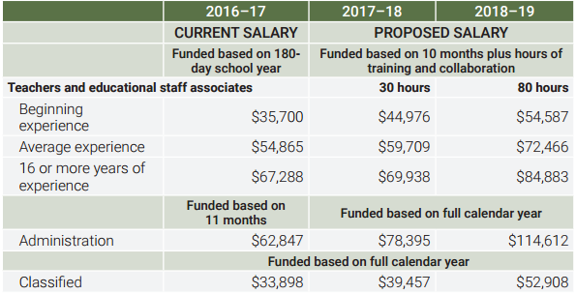
Administrator and Classified Compensation Model (Governor)
↗
↘
Classified staff: 18% increase in 2017-18, 54% increase (from current) in 2018-19
Administrators: 25% increase in 2017-18, 180% increase (from current) in 2018-29

Slide 13
Governor’s Proposed K-12 Budget…
Addresses court order to fully, sustainably fund basic education
$2.7 billion to pay state’s full share of teacher compensation
Includes salary increase for beginning teachers
Every district will receive more money from state
Local school taxes reduced by at least $250 million per year
No increase in state property tax
Alleviates decades-long funding disparities among districts
Budget includes another $1 billion to:
Continue shrinking early elementary class sizes
Boost teacher mentoring and other proven strategies
Address opportunity gaps
Source: OFM

Slide 15
What about local levies?
Governor’s budget proposes maintaining current law for CY 2018:
Local levy authority is set to decrease from 28% to 24%;
LEA (Local Effort Assistance) is 12%
Grandfathered levy rates would remain in place
“Ghost money” in the levy base is eliminated

Slide 16
Governor’s budget proposal for CY (levies)
Levy authority drops down to 15%; lower percentage, but the base on which that percentage is calculated is much, much higher.
Some districts will see a rollback of levy authority; all districts experience a net gain in resources from the combination of new state dollars and levy authority.
119 SDs will see a local property tax decrease (75% of households and businesses), $250m state-wide tax decrease.
50% match for LEA (Local Effort Assistance), no grandfathering, no ghost money (because base has ample funding).
2019 plan is intended to make levy cliff discussion moot (per OFM staff)

Slide 17
Additional Education Investments
Pre- and Post- K-12…
$42m builds on recent historic investments in early childhood education:
Funds 2,700 more ECEAP slots
Increases ECEAP rates by more than 6%
Higher education costs remain significant burden for middle-class students and families. The governor’s budget:
Freezes tuition for next two years, offsets costs to colleges and universities
Includes $146 million for financial aid to 14,000 more students
Source: OFM
Notes:
Pre-K investments align with SBE’s recommendations to increase access to high-quality early learning…

Slide 18
Revenue side of the equation
Governor Inslee’s proposed budget also includes a revenue enhancement proposal that would increase revenues by:
Increasing the B&O rate on services (from 1.5% to 2.5%) and extending B&O tax to all services.
Implementing a new Carbon Tax
Implementing a new Capital Gains Tax
Numerous other smaller taxes, including:
Applying sales tax to vehicle trade-ins valued over $10,000
Applying real estate excise tax to certain foreclosure sales
Repealing sales tax exemption on bottled water
Most of these proposed tax changes have been proposed – in similar or different form – through legislation or initiative over the past four years.

Slide 19
Education Funding Task Force
Charge: develop recommendations about how to accomplish the remaining steps of fully funding basic education, including educator compensation and revenue sources
Met regularly for seven months
Extensive data collection, analysis, and review
Final meetings January 4th and 9th
Democratic Caucus Proposal
$7.3 billion over next four years
9 recommendations

Slide 20
Education Funding Task Force
Republican Caucus Proposal
11 Guiding Principles
Of note:
Collective Bargaining Reform
Clarifying Basic Education vs Enrichment
Statewide Health Benefits System for Educators
Funding K-12 first

Slide 21
Education Funding Task Force
No recommendations adopted (all motions failed along party lines)
Caucus recommendations likely indicative of proposals and points of tension during session

Slide 22
How can SBE Members participate?
SBE 2017 Legislative Session Protocol
Staff will check daily bill introductions
Bills that are relevant to the Board’s work will be circulated for staff comment and entered into a Bill Tracking Matrix (example below)
Bills will be assigned a status of Priority or Monitoring*
Bills will be categorized by area of SBE Work or Legislative Priority
Staff will recommend a preliminary position based on alignment with the Board legislative priorities, which will be discussed by the Executive Committee
The Bill Tracking Matrix will be discussed at Executive Committee meetings, and updated accordingly.
Staff will send the Bill Tracking Matrix to the entire Board once a week, typically on Friday, or as needed; staff will begin including a Bill Status document, as well, once relevant (i.e., after the first policy cut-off in mid-February)
Other updates on staff and Board testimony and other topics as needed will be sent out on Friday with the Bill Tracking Matrix.

Slide 23
How can SBE Members participate?
Advocacy ideas:
Personal notes to your Legislators (your residence and place of work)
Letters to your Legislators (your residence and place of work)
One-on-one meetings with Legislators
Advocating in your networking with other stakeholders/influencers

