Slide 1
Update to the Association of Washington School Principals Board Meeting
Ben Rarick, Executive Director
May 1, 2014

Slide 2
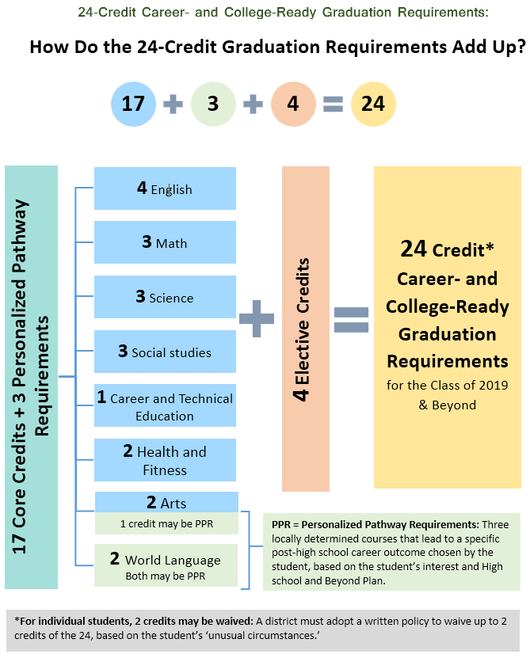

Slide 3
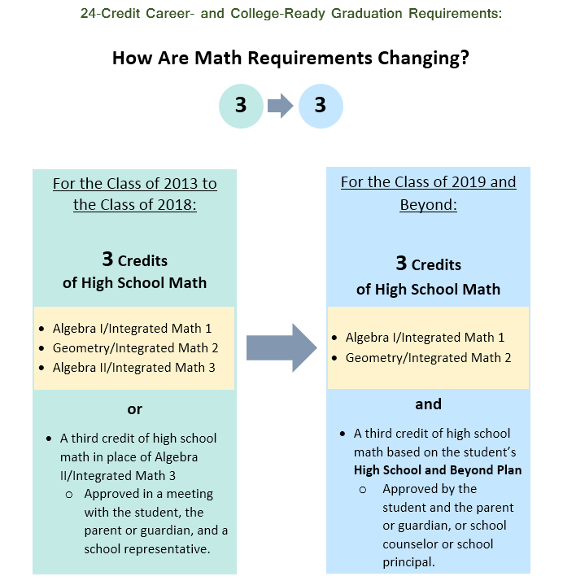

Slide 4
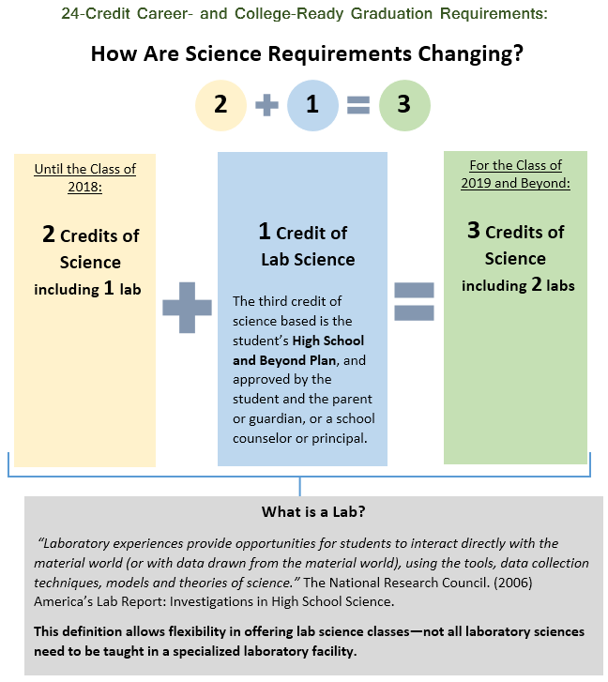

Slide 5
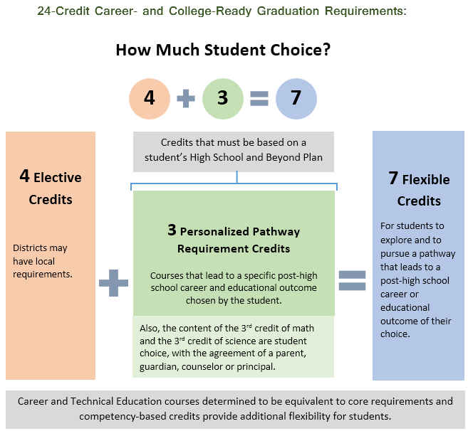

Slide 6
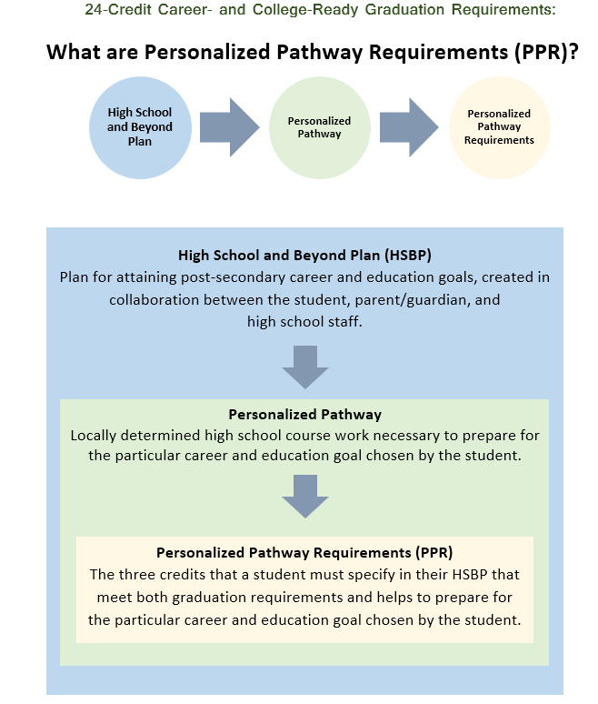

Slide 7
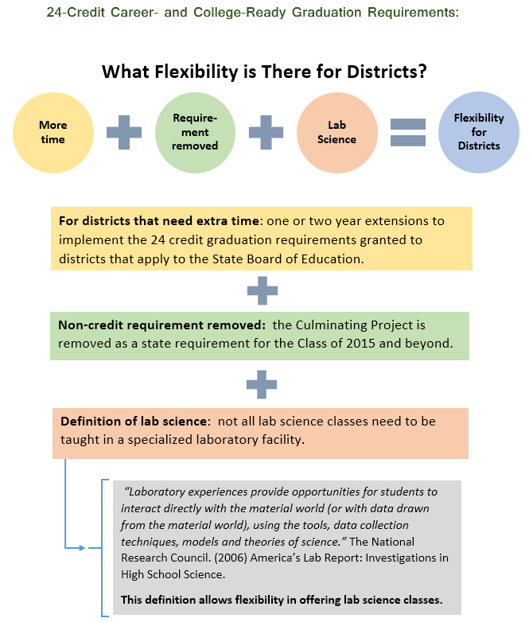

Slide 8
Outreach for Development of Draft Rules
Made initial outreach to education associations, others in March asking input on rules to SB 6552.
Held two meetings with stakeholder groups in April to review rule drafts, solicit comments and suggestions.
Met with Office of the Superintendent of Public Instruction staff:
Directors for Math, Science, and the Arts
Department of Teaching and Learning
Department of Career and Technical Education
Apportionment and Financial Services

Slide 9
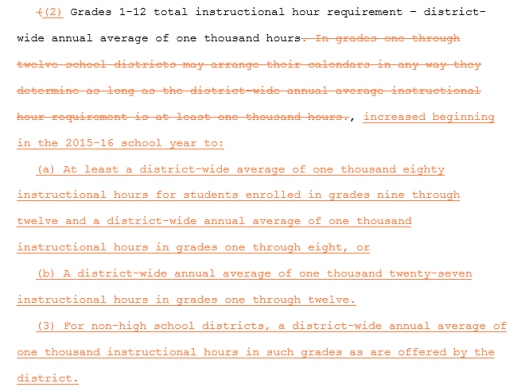
Proposed Draft Rules on Instructional Hour Requirement
Amending WAC 180-16-200:

Slide 10
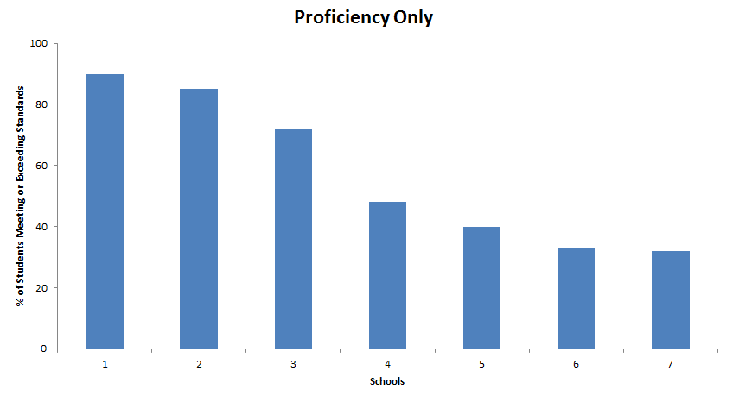
Proficiency + Growth = Better Evaluation

Slide 12
Highest Growth Schools
District | School | % FRL | 3-Year Average MGP
 |  |  | Reading | Math | Reading and Math
SUMNER | Liberty Ridge ES | 58 | 71 | 77 | 74
WEST VLY (YAKIMA) | Wide Hollow ES | 59 | 61 | 87 | 74
SEATTLE PS | Mercer MS | 74 | 68 | 75 | 72
CLOVER PARK | Hudtloff MS | 66 | 68 | 69 | 69
WAITSBURG | Waitsburg HS | 22 | 84 | 56 | 70
RIDGEFIELD | Ridgefield HS | 28 | 61 | 72 | 67

Slide 13
Priority School Identification
Other Low
5 schools in the bottom 5 percent in reading or math for 3 years.
Continuing Priority – 25 schools currently implementing Priority Turnaround models.
Achievement Index – 18 schools with the lowest Composite (3-Year) Index rating.
Graduation Floor – 11 schools with a 3-Year average graduation rate < 60 percent.
Proficiency Floor – 61 schools with a 3-Year average reading and math proficiency rate < 40 percent.
Cont. Priority
Index
Low Grad
Low Proficiency

Slide 14
Differentiated Supports and Recognition

Slide 15
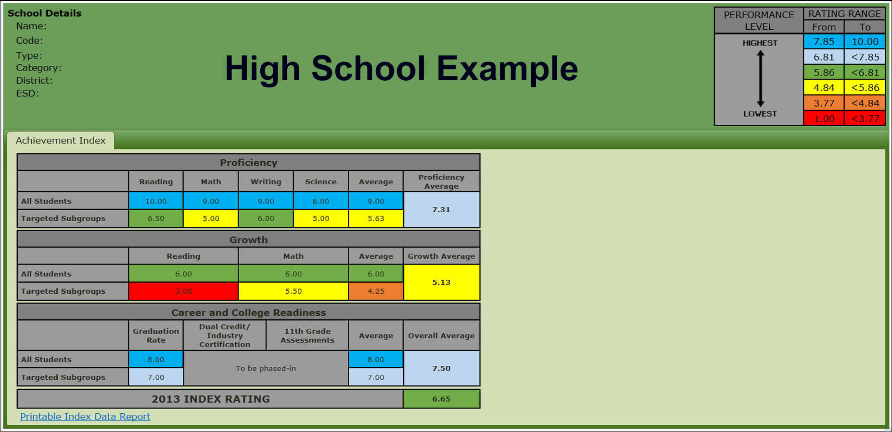
Display of Index Information

