Slide 1
adequate Growth percentiles
in the achievement index
Achievement & Accountability Workgroup Meeting
June 20, 2014
Krissy Johnson, MPA, Data Analyst
Deb Came, PhD, Director of Student Information
Damian Betebenner, PhD, Senior Associate, Center for Assessment

Slide 2
Today’s Topics
Review of Student Growth Percentiles
What is adequate growth?
Catching-Up/Keeping-Up & Moving-Up/Staying-Up
Time horizon of adequate growth targets
Transition to Smarter Balanced
New standards, new destination

Slide 3
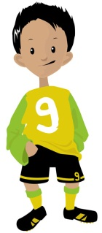
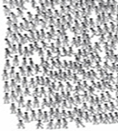
SGP Review: Anthony
454
385
Anthony
SGP: 75
357
352
2011-12
2012-13
Notes:
Anthony and many other students, his academic peers, scored a 357 on their Reading assessment in third grade. The next year, these same students had a wide range of scores. Anthony’s score was 400 and his SGP was 75, which means that he scored better than 75 percent of his academic peers.

Slide 4
4th Grade Score Distribution
75% of students in Anthony’s academic peers scored below him
Basic
Proficient
Below
Basic
Advanced
385
Anthony’s Peer Group
Prior Score ~ 357
Notes:
Or, this may look familiar to you, looking at Anthony’s peer group in comparison to the rest of the state, we can see they’re a lower performing group, however, Anthony is scoring better than 75% of them. Hence, his SGP of 75.

Slide 5
SGP Key Concepts
Academic peers are all students in Washington State in the same grade and assessment subject that scored similarly in previous years.
Students can have high growth if they are score low, and high scoring students can have low growth.
SGP calculations require at least two years of consecutive scores; use as many consecutive scores available, back to 2005-06.
This model only controls for prior score history; no other characteristics, such as income or ethnicity, are considered.
Washington’s state assessments are not vertically scaled. Therefore, we can’t subtract one year’s score from the next.

Slide 6
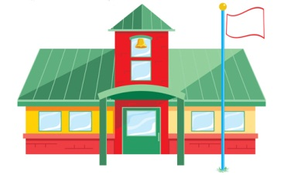
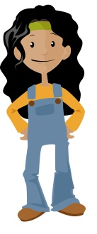
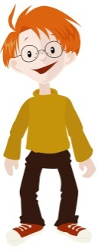
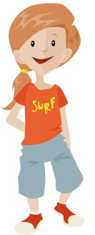
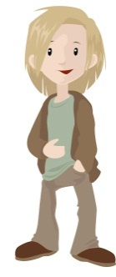
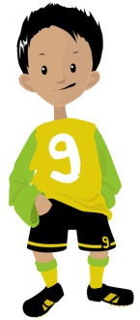
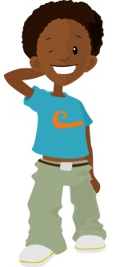
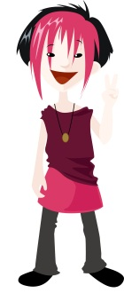
Median Growth Percentiles
71
42
20
52
75
57
27
The Median Growth Percentile of this school is the middle student’s SGP
Notes:
Again, I know we’ve all been over this before, but just to set the stage… We are using median growth percentiles in the index, which are determined by ordering the student growth percentiles from lowest to highest then selecting the middle value. We’ll call this the median growth percentile. We can say, “on average”, these students are growing at the 52nd percentile. Keep in mind that even when students are grouped by targeted subgroup their individual SGP does not change, students are always compared to their academic peers across the state.

Slide 7
Why Growth?
Notes:
Let’s remember why growth has been valued and included in our school accountability efforts. Let’s use a metaphor of a mountain, where all kids need to reach the top, the top being career and college ready. Here we have Greta [CLICK] and Anthony [CLICK]If both kids have five days to climb, Greta, who is closer to reaching the summit, can take care, go slower, and she [CLICK] will reach the top in that time frame, because she has a much shorter distance to climb than Anthony does. Even if Anthony climbs at a faster rate than Greta, and makes more progress in those 5 days, he may not reach the summit at all. So, the current index values the efforts of Anthony’s school for helping him to travel at a faster rate, no matter where he begins on the mountain.

Slide 8
Adequate Growth Percentiles
3rd Grade
Year 1
Year 2
Year 3
Year 4
AGP = 43
L3: Proficient
SGP = 56
AGP = 82
SGP = 75
Notes:
The Index currently includes both the status measure of percent at or above proficient and it uses SGPs, a normative growth measure, which compares students to their peers absent of any relationship to standard. In addition to the normative measure, the Washington Growth Model includes a growth-to-standard measure, called adequate growth. The concept of “adequate growth” establishes if a student is on track to meet proficiency over a multi-year timeline.
Both Anthony and Greta have a [CLICK] proficiency goal of Level 3: Proficient. In this case, the target year is four years [4 CLICKS] from 3rd grade [CLICK]. Anthony’s growth target or [CLICK] adequate growth percentile is 82. This growth target percentile can be viewed as an indicator of how difficult reaching proficiency is likely to be. Anthony’s percentile of 82, means that fewer than two-thirds of the students with Anthony’s score history have reached standard by grade 7. Therefore, we can evaluate his SGP, [CLICK] his observed growth, by comparing it to the estimated growth required to reach proficiency. His SGP is 75, so, in this case, he’s not meeting that target or not making adequate growth.
Greta has an adequate growth target of 43, her SGP last year was 56, so she is exceeding her target, and we can say she is making adequate growth.
Both the adequate growth percentile and a student’s SGP are calculated in Year 1 or this case in 4th grade, looking back one year.

Slide 9
Catch-Up/Keep-Up Categories
Category | Achievement Level in Previous Year | Proficiency Goal
Catching Up | L1 or L2: Below Basic or Basic | L3: Proficient
Keeping Up | L3 or L4: Proficient or Advanced | L3: Proficient
Moving Up | L3: Proficient | L4: Advanced
Staying Up | L4: Advanced | L4: Advanced
Notes:
There are a couple of categories we can use to describe if a student is on track to reaching their proficiency goal.
For students that score at level 1 and level 2, those that are not yet Proficient in the prior year – they would be in the first category: if their SGP exceeds their Adequate target, they are considered Catching Up
For students that are already at or above proficiency in the prior year (scoring the Level 3 or 4 ranges), if their SGP exceeds their adequate growth target, they are considered to be Keeping Up. All students with an SGP, receive an SGP target that represents the difficulty of reaching or staying proficient. This is Catching-Up/Keeping-Up.
[CLICK]
For the latter group of students, we also calculate what it would take to get them to Advanced (Moving-Up) or to remain at Level 4 (Staying-Up) if they are already there, this the MoveUpStayUp adequate target or adequate growth percentile. For students that are proficient, we can compare their SGP to their MoveUpStayUp target and if it is greater, we could say they are on track to reach Advanced. And for Advanced students, if their MoveUpStayUp target is greater than their SGP then we could say they are on track to remain Advanced.
No High School Targets
Targets are not calculated for math end of course assessments or HSPE Reading, because they are terminal

Slide 10
School-Level Measures
Median Adequate Growth Percentile
% Catching-Up/Keeping-Up and/or % Moving-Up/Staying-Up
Consider what the appropriate target should be for higher achieving students
Notes:
Adequate Growth Percentiles can be summarized in a few different ways to create school-level measures.
Could include only adequate targets that will get students to proficient, for all students – or all students’ catch-up/keep-up status. Or could require different targets for students that are already proficient or advanced.

Slide 11
Timeline Changes the Trajectory
3rd Grade
4th Grade
5th Grade
6th Grade
7th Grade
AGP = 45
AGP = 56
AGP = 90
AGP = 82
Notes:
A key question to be considered is the timeline within which students are expected to reach their proficiency goals.
In our first example, we looked at a four year timeline. The board can also consider, a three year timeline. we can see this changes the slope of the line, shortening the time horizon creates a greater challenge for students. For Accountability purposes, many states use a four year timeline.
This concept also applies to higher grades, where the target represents 3 years or 8th grade, whichever is nearer.
Districts received this adequate data in 2012-13. There were no policy decisions as of yet about what constitutes “adequate” growth, we referred to these percentiles as “targets” in the data files and these targets represented a three year timeline.

Slide 12
Transition to Smarter Balanced
Notes:
We also face some unknowns, with the transition to smarter balanced. The adequate growth percentiles are based on the calculations we derive from current performance on state assessments based on current standards. We anticipate with the implementation of Common Core Standards, that will be measured by the Smarter Balanced assessments, that the mountain top will be higher. This will change the trajectory students will need to reach career and college ready, we anticipate that the slope of the line will be steeper in the future.

Slide 13
Availability of Data
Adequate growth targets may not be available until 2015-16 or 2016-17
Smarter Balanced Field Testing affects the availability of SGPs
Notes:
Due to this shift in standards, OSPI is considering not providing adequate growth targets to districts this year – because the targets based on our current assessments may not reflect the actual challenge.

Slide 14
Student Growth Percentile (SGP) Transition to Smarter Balanced
2012-13
Entire state: MSP/HSPE/EOC
2013-14
2/3 of state: MSP/HSPE/EOC
1/3 of state: SBAC Field Test
2014-15
Entire state: SBAC fully operational
Entire state: MSP/HSPE/EOC
2011-12
SGP
SGP
SGP
SGP

Slide 15
Possible Availability of Adequate Growth Percentiles
2013-14
2014-15
2015-16
2016-17
2/3 of state: MSP/HSPE/EOC
1/3 of state: SBAC Field Test (no growth)
Entire state: SBAC fully operational
1st Year of SBAC SGPs
2nd Year of SBAC SGPs
1st Year of SBAC Adequate Growth Targets
3rd Year of SBAC SGPs
2nd Year of Adequate Growth Targets
Notes:
2015 – 16, we will have for the first time two years of data from the Smarter Balanced, and that is the first time we could calculate adequate growth targets relying solely on SBAC and the new standards.

Slide 16
the transition to smarter balanced
How are other state’s handling the growth?
A discussion with Damian

Slide 17
Thank You
Krissy Johnson, krissy.johnson@k12.wa.us
Deb Came, deb.came@k12.wa.us

Slide 18
Extra Slides

Slide 19
Why Growth?

Slide 20
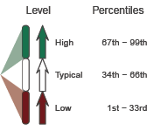
Adequate Growth Percentiles
1 Year of Growth
SGP = 75
3 Years of Growth
AGP = 82
Reading
L4: Advanced
L3: Proficient
L2: Basic
L1: Below Basic
Grade 3
2011-12
Grade 4
2012-13
Grade 5
2012-13
Grade 6
2013-14
Scale Score
Achievement Level
357
L1: Below Basic
385
L2: Basic
Achievement
Growth Percentile
Growth Level
75
High
Growth
Notes:
You may be familiar with this student growth report, where we see in this case Anthony’s 3rd and 4th grade scores, as well as his SGP which was 75. We know in order to calculate growth we need at least two years of scores, so the growth score is calculated here, in 2013, looking back at their 2012 score. We also, at this time can establish the adequate growth percentile, essentially a growth target that will tell us if the student is on track to meet their proficiency goal. In Anthony’s case, his proficiency goal is Level 3: Proficient. (show blue arrow) and the target year is three years from 3rd grade, or two years out from the year his SGP and target SGP are calculated. Anthony’s growth target or adequate growth percentile is 82. Therefore, we can evaluate his SGP, his observed growth, by comparing it to the estimated required growth to reach proficiency (his adequate growth percentile or AGP).
To determine this percentile, we use the achievement and growth data we have about current students. So, this growth target percentile should be viewed as an indicator of how difficult reaching proficiency is likely to be. Anthony’s percentile of 82, means that fewer than two-thirds of the students with Anthony’s test history have reached standard by grade 6.
Districts received this adequate data in 2012-13, as there were no policy decisions about what constitutes adequate growth, we referred to these percentiles as “targets” in the data files.

Slide 21
Adequate Growth Percentiles
1 Year of Growth
SGP = 75
3 Years of Growth
AGP = 82
Reading
L4: Advanced
L3: Proficient
L2: Basic
L1: Below Basic
Grade 3
2011-12
Grade 4
2012-13
Grade 5
2012-13
Grade 6
2013-14
Scale Score
Achievement Level
357
L1: Below Basic
385
L2: Basic
Achievement
Growth Percentile
Growth Level
75
High
Growth
Notes:
This is another student (not Greta) who is already proficient – her proficiency goal could be reaching advanced – set the stage for Move Up Stay Up – perhaps introduce this later or simply in passing without a slide -

